Slide 1

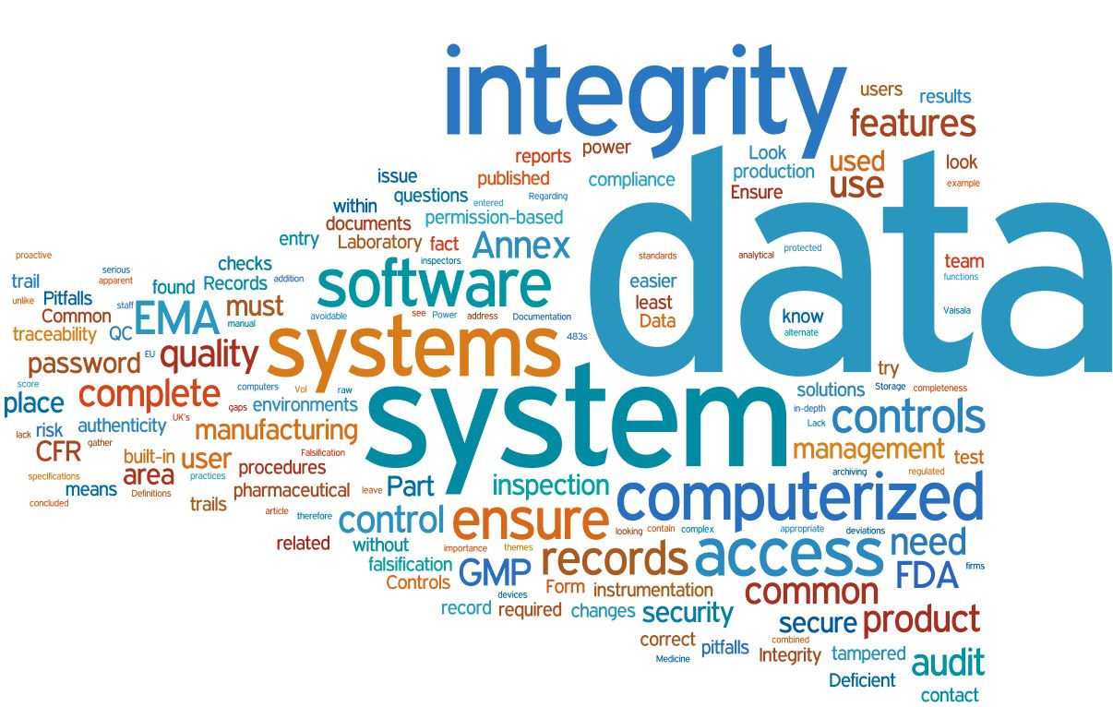
Data Integrity
Summary of Dillman/Bryn Lectures

Slide 2
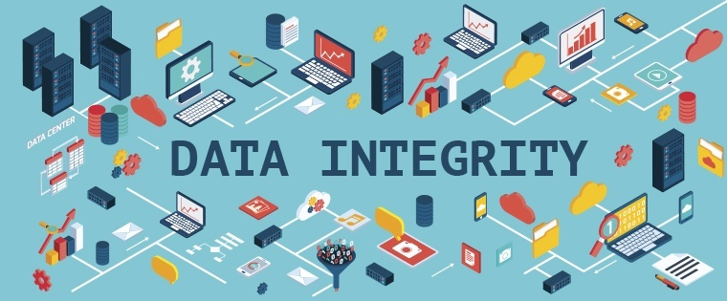
Objectives
Describe Global perspective of Data Integrity
Review Data Integrity and Computer System Validation
Review Data Integrity Auditing

Slide 3
Data Integrity and GXP
Goal of GXPs – to ensure safety, efficacy and quality of medical products throughout product lifecycle
Global challenges have led to increased harmonization of GXPs and related guidance/ guidelines
Confirmation of GXP compliance relies on Data Integrity
Francesco Amorosi, PhD, Oct 2017

Slide 4
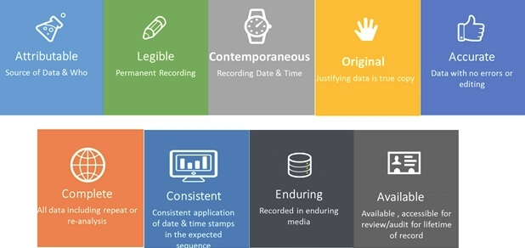
Data Integrity
All data generated and maintained with integrity
Ensure accuracy
Ensure reliability
Ensure authenticity
Ensure data is complete,
consistent, accurate
Data used to make critical decisions
  certain raw data
  summaries
  electronic or paper
ALCOA +

Slide 5
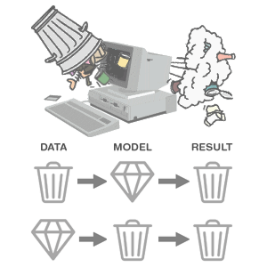
Poor Data Integrity?
Can undermine quality, safety and efficacy
Can lead to harm or death
Means data is unreliable
Objective evidence suggests data is incorrect
Infers raw data problem
Summaries wrong
Systems that produced the data not validated

Slide 6

Global Regulatory Response to Lack of Data Integrity

Slide 7
21 CFR Part 11
Enacted in 1997
Covers electronic signature, electronic records
Emphasizes risk based approach
Validation required only if the data is critical
See FDA guidance on Software Validation
Careful of changes and change control issues

Slide 8
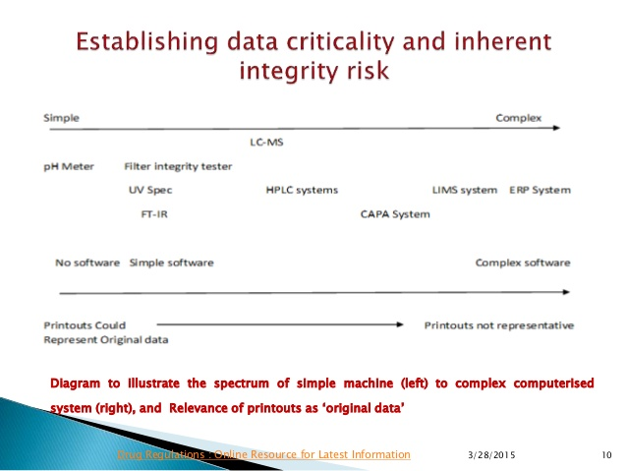
Analytical Instruments
Software for
control
Data acquisition
Data processing
Change control

Slide 9
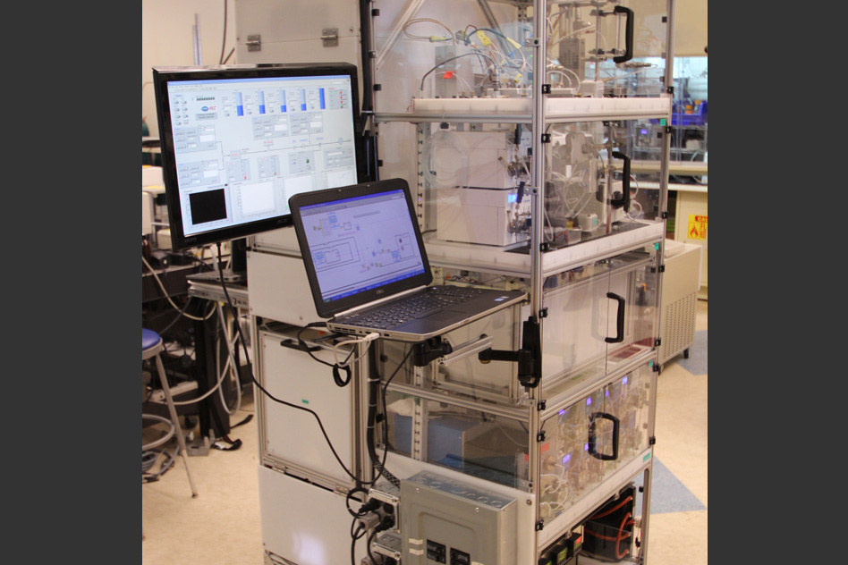

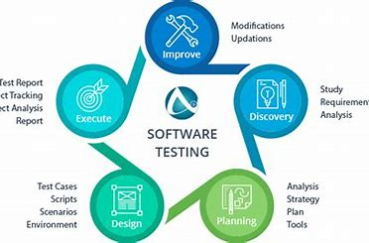
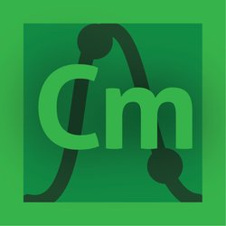

Who Does Computer System Validation?
OpenLab CDS
Software Firm
Manufacturer
Provider/Vendor
CSV is the responsibility of the manufacturer
of the medical product!

Slide 10
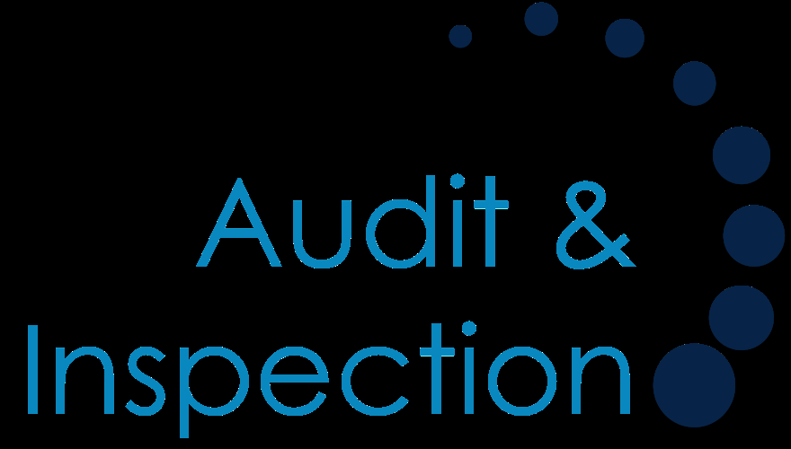
Focus of Audits
Highest Risk Systems
How raw data is defined
How does data flow
Is there a data audit trail
SOPs that cover the data handling
Data governance

Slide 11
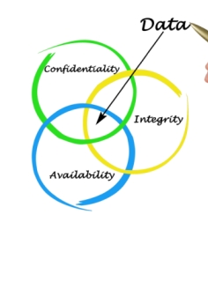
Advantages of Data Integrity
Increases reliability
Increases chances of success
Can reduce long term costs by avoiding recalls, etc.
Required for drug approvals
Increases public health and safety

Slide 12

Recap/Review
Global perspective of Data Integrity
Data Integrity and Computer System Validation
Data Integrity Auditing

Slide 13

Contact Information
Monica Koenig Caphart
monicaekc@gmail.com

