Slide 1
Using R to Create Interactive Data Maps
Ann Bessenbacher
Evaluation and Learning Research Center
Purdue University

Slide 2
Overview
What are you going to get out of this?
Introduction to , yes it’s more than a letter in the alphabet.
Description of data for examples
Merging of R and data to create Interactive Maps

Slide 3
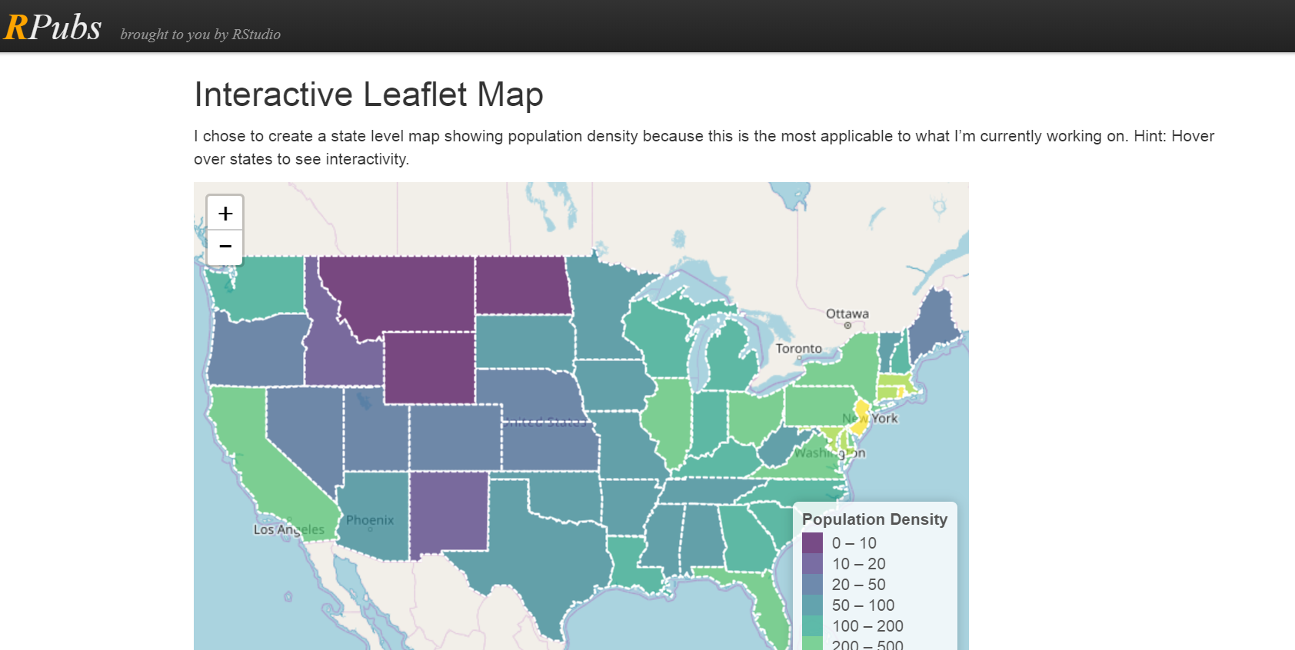
What are you going to get out of this?
http://rpubs.com/abessenbacher/leaflet

Slide 4
Introduction to
R is a programming language used for statistical analysis, data mining and much more.
It’s free!!!
Has a graphical user interface
A large user base developing new packages for all to use

Slide 5
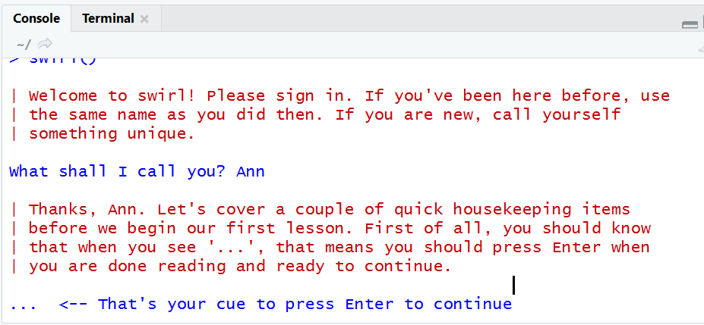
Installing and Using R
Need to install both R and R studio.
Download from ‘https://www.r-project.org/’
R comes with basic packages preinstalled. If new to R, be sure to download swirl package. It walks you step-by-step through using R.
https://swirlstats.com/

Slide 6
Data for Examples Today
Evaluation and Learning Research Center was contracted by the USDA to complete a program evaluation for the USDA 2013 Specialty Crop Block Grant Program (SCBGP).
The Farm Bill defines specialty crops as “fruits and vegetables, tree nuts, dried fruits, horticulture, and nursery crops (including floriculture).”
The data used in these examples is readily available online here: https://www.ams.usda.gov/services/grants/scbgp/final-reports/2013

Slide 7
Data for Examples Today
SCBGP reports were collected from all 50 US States, the District of Columbia and 3 US territories.
Total of 664 projects in 6 different project types including: Marketing & Promotion, Education, Plant & Pest Health, Research, Food Safety, and Production.
More than $51.5 million were awarded to fund the 664 project.
Project Type | # Projects | 2013 Funding | % Total Funding
Marketing & Promotion | 188 | 13.9 | 29
Education | 162 | 8.8 | 19
Plant & Pest Health | 112 | 9.2 | 20
Research | 105 | 7.6 | 16
Food Safety | 55 | 4.7 | 10
Production | 42 | 3.0 | 6

Slide 8
Why would we do this?

Slide 9
Step 1: R Packages Needed for Map Creation
Use R markdown and Leaflet package to create interactive maps.
Rmarkdown should come preloaded with R Studio IDE, but it can be downloaded separately (Tools -> Install Packages -> rmarkdown)
More details available through the online Leaflet tutorial at: https://rstudio.github.io/leaflet/
To download the Leaflet package (Tools -> Install Packages -> leaflet)
You will also need the xlsx package because the data used in the map will be created in Microsoft Excel. (Tools -> Install Packages -> xlsx)

Slide 10
Step 1: R Packages Needed for Map Creation
When you install packages, dependent packages are often installed as well.
When you are ready to create you R markdown file to create your map make sure you have the following packages installed: (if you’re missing one, install it separately)
leaflet
geojson
geojsonio
sp
xlsx
rmarkdown
knitr

Slide 11
Step 2: Create R Directory for Your Files
In our example the directory is: USDA
In the R markdown file USMapProjects.Rmd you’ll want to make sure the correct directory name is used. If you use a different name then go to line 15 as seen here: setwd("~/R/USDA") and change it to the name you created.
The tempgeo file contains the spatial definitions for the map.

Slide 12
Step 3: Download Files
Go to : https://stemedhub.org/resources/4213/
Download a copy of each of the following and save in the previously created directory:
tempgeo.json
state.xlsx
USMapProjects.rmd

Slide 13
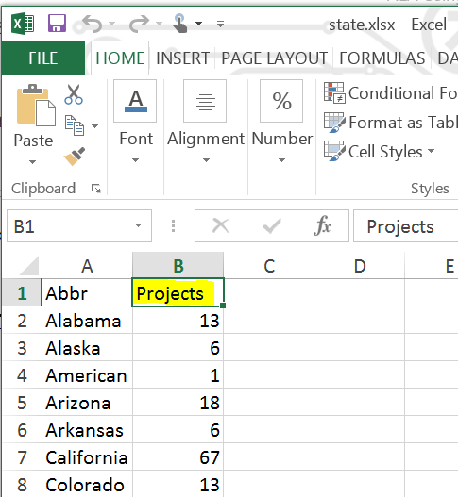
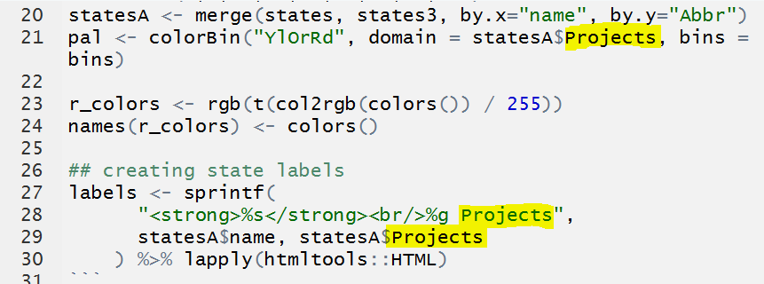
Step 4: Set-up Your Excel File
Modify the second column in the Excel file to contain the data you want to map. It needs to be numerical data. Make sure that the column title matches the value you use in the USMapProjects.rmd file on each of the following lines: 21, 28, 29, 42, 61. Just be sure to change it in each location.

Slide 14
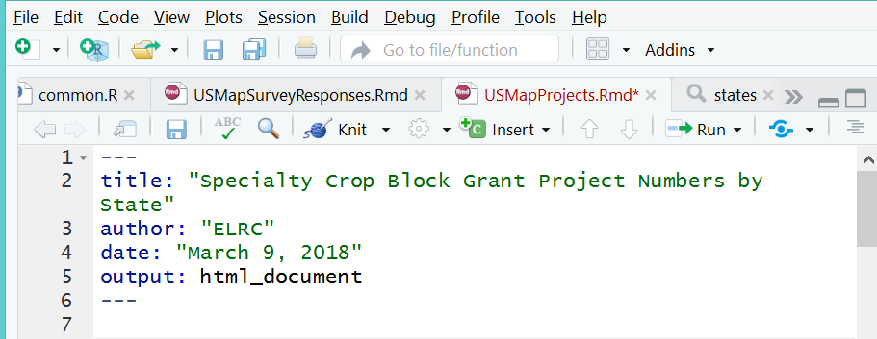
Step 5: Modify Header in UsMapProjects.rmd
Edit the Header: Title, Author and Date as you want them to appear on your finished map.

Slide 15
Step 6: Tweak Map Features
The map colors can be modified on line 21 of the ‘USMapProjects.rmd’ file.
‘YlOrRd’ used in the example stands for yellow, orange, brown. ‘BuGn’ would give you an array of colors from light blue to green and ‘PuRd’ would give you an array of colors from Purple to Red. You can find more color recommendations here: http://colorbrewer2.org

Slide 16
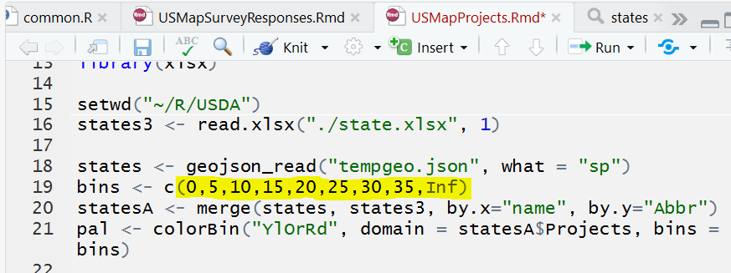
Step 6: Tweak Map Features Continued
Define the number of bins appropriate your data into on line 19

Slide 17
Step 6: Tweak Map Features Continued
Modify the map legend Title so it is appropriate for your data on line 58.
For more customization ideas see the leaflet tutorial: https://rstudio.github.io/leaflet/

Slide 18
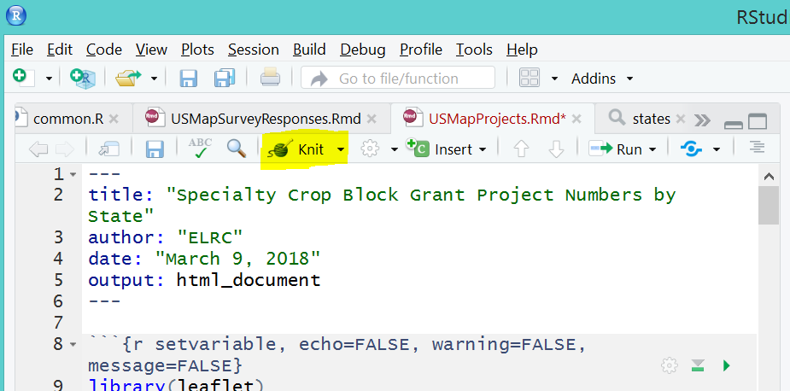
Step 7: Knit Your Map
Once you finish all of your modifications, click on the ‘Knit’ button to create your map. If everything works as expected, the finished html file will be created in the directory you set-up and it should open up as well.

Slide 19
Questions???
Don’t forget to go to: https://stemedhub.org/resources/4213/ to find copies of all of the files and this presentation.
If you have any questions or trouble feel free to email me at: ambessenbacher@purdue.edu
You can also google and R questions you have as many of them have already been answered.

