Slide 1
Exploring packaging design

Slide 2

Examining your collection
Looking at the different shopping bags, consider the following questions:
What makes a shopping bag effective (strong)?
Notes:
What are some features that make a bag strong?
What are some features that make a bag attractive?

Slide 3
Design a Better Candy Bag!
You and your partners are employees of the Sweet-Tooth Candy store. Recently your boss has learned that customers would like to have a candy bag that is more functional than the one they currently use when they shop in the store. Your boss has asked your team to design and build a new and improved candy bag that is sturdy and functional. She is interested in a candy bag that is able to hold maximum weight but she has not specified minimum dimensions or the amount of weight the bag must hold.
The design, construction method, and materials used will determine the strength of a bag. You will want to test the strength of your candy bag and will redesign and retest as needed. Measurements may be taken to determine how to improve the strength of your candy bag and to estimate the weight of the bag will hold.
Source: http://www.tryengineering.org/lessons/candybag.pdf

Slide 4

Problem Scoping
Identifying the problem
What is the problem?
  customers want a candy bag that is more functional than the one they currently use when they shop in the store.
What is the goal?
  design and build a new and improved candy bag that is sturdy, functional, and attractive.
Who is the client?
  Owner of Sweet-Tooth Candy store
Who is the end user?
  Customers buying candy

Slide 5
Problem Scoping
Identifying the problem
What are the design criteria (desired features)?
  Hold maximum weight.
  Attractive
What are the design constraints?
  Materials provided
  Time

Slide 6

Idea Generation
Individual Plan
Do you have enough information?
What questions do you still have?
In your design notebook, label “Individual Design” on one page
Draw a sketch of your design → Include labels, perspective, scale

Slide 7

Idea Generation
Team Design
In your design notebook, label “Team Design” on next page.
Share your plan with members of your design team.
Agree on one design. Draw a sketch of your team design and create a list of materials you will need (and cost).

Slide 8
Materials
Material
Painter’s tarp
Masking Tape

Slide 9
Solution Production and Performance - Construct and Test
You will have 15 minutes to construct
Keep in mind:
  You must follow your team design
  Use only the materials provided
  Note any modifications you wish to make to your design

Slide 10
Solution Production and Performance - Construct and Test
How are we going to test our designs?
Test Conditions
Attach bag to digital scale.
Add 3 lbs of beans to represent candy.
Hold for 30 seconds.
Record results.

Slide 11

Communication
Share Results
What were your results?
  What was the actual weight the bag could hold and the estimated volume of the bag?
Did your team’s design meet the client’s needs?
In what ways did your team use what you know about packaging to inform your design?

Slide 12
Optimization
Improve and Re-design
In what ways could you improve your design?
What is one feature you could re-design?
To what extent could your re-design improve your results?

Slide 13
Data Collection
Team # | Trial 1 (seconds) | Trial 2 (seconds) | Average (seconds) | Average Speed (inches/second)
1
2
3
4
5

Slide 14
Student Work

Slide 15
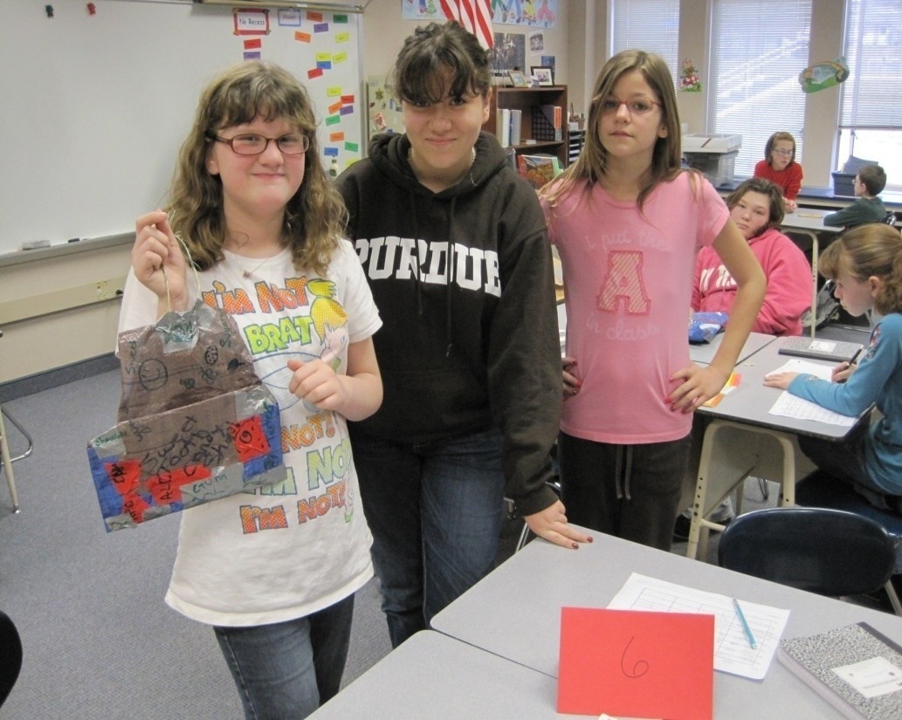
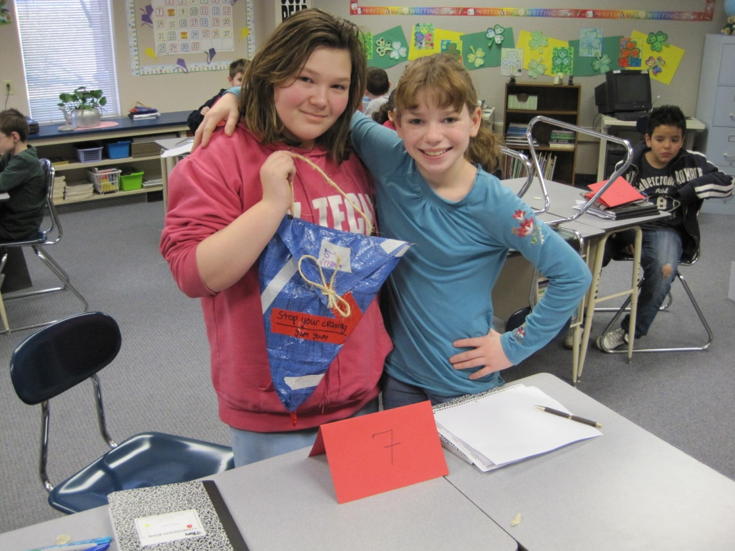
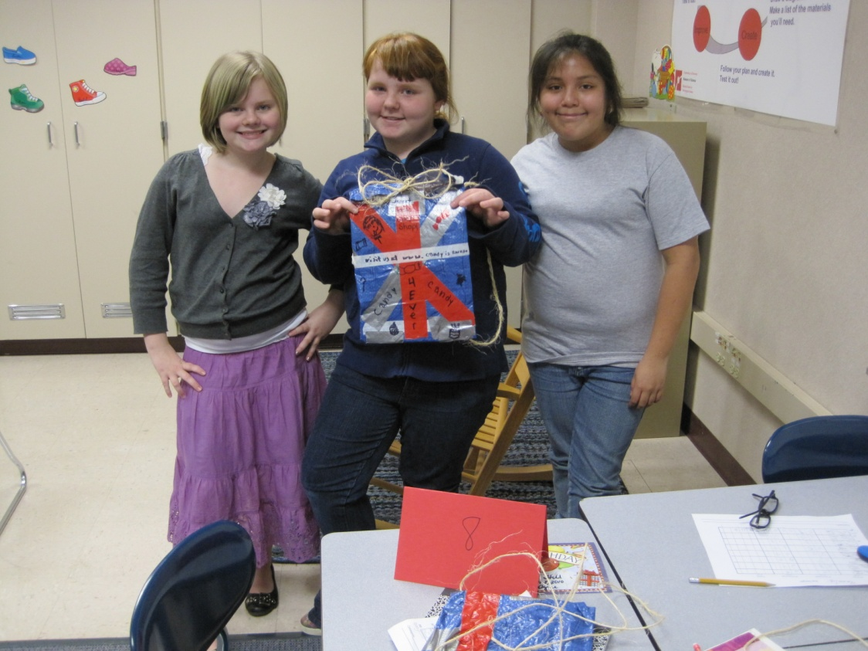
Notes:
Chell

Slide 16
Cross curricular connections
Mathematics
  Estimation
  Computation (use of equations)
  Cost analysis
Literacy – Writing
  Persuasive writing
  Narrative writing
Literacy - Reading

Slide 17
Literacy
Books
  Toy Boat

Slide 18
Assessment

