Slide 1
Simple Machines
Kendra Erk, Ann Kirchmaier, John Lumkes, Jaime Peterson, and Jill Shambach

Slide 2
Introduction to Simple Machines
Slide set

Slide 3
Inquiry Activities
For each class of simple machines, three different activities are proposed in order to allow the students to
become familiar with real-world examples of simple machines,
identify examples of simple machines that are found in nature, and
be able to construct versions of simple machines using common classroom materials.

Slide 4
Simple Machines in Nature
Slide set

Slide 5
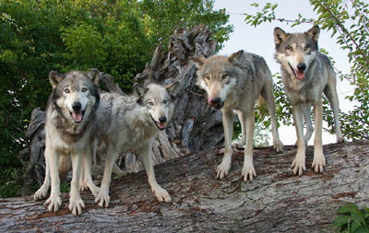
Save the Wolf!
A gray wolf has wandered into an active construction zone on the campus of Purdue University. The construction zone is not a safe place for the wolf. Purdue decides to hire the staff of Wolf Park to safely capture and move the wolf from the construction zone to their park in Battleground, Indiana.
As a staff member of Wolf Park, you and your team must design a compound machine to safely capture the wolf. The machine must be large enough to comfortably contain the wolf and should prevent the wolf from escaping. The machine should be made from at least two classes of simple machines (lever, pulley, wedge, inclined plane, wheel/axel, screw) and should be constructed from the materials provided.
http://wolfpark.org/animals/info/wolves/

Slide 6
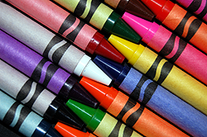
Problem Scoping Identifying the problem
What is the problem?
A wolf has wandered into a construction zone at Purdue University and must be safely trapped and relocated.
What is the goal?
Design and construct a compound machine that can safely trap and contain the wolf.
Who is the client?
Purdue University
Who is the end user?
Staff at Wolf Park

Slide 7
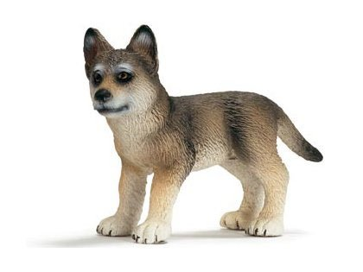
Problem Scoping Identifying the problem
What are the design criteria (desired features)?
Must be large enough to hold the wolf
Should prevent the wolf from escaping
What are the design constraints?
Compound machine must be composed of at least two classes of simple machines
Materials provided
Size of the wolf

Slide 8
Materials
Material | Material
Construction paper | Brads
Paper/Styrofoam plates | Index cards
Styrofoam cups | Paper-towel rolls
String | Straws
Wooden spools | Paperclips
Push-pins | Binder clips
Cardboard

Slide 9
Idea Generation Individual Plan
Do you have enough information?
What questions do you still have?
In your design notebook, label “Individual Design” on one page
Draw a sketch of your design → Include labels, perspective, scale

Slide 10
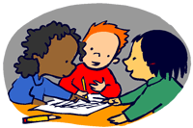
Idea Generation Team Design
In your design notebook, label “Team Design” on next page.
Share your plan with members of your design team.
Agree on one design. Draw a sketch of your team design and create a list of materials you will need (and cost).

Slide 11
Solution Production and Performance - Construct and Test
You will have 15 minutes to construct
Keep in mind:
You must follow your team design
Use only the materials provided
Note any modifications you wish to make to your design

Slide 12
Solution Production and Performance - Construct and Test
How are we going to test our designs?
Test Conditions
Place wolf next to device.
Demonstrate compound machine can capture the wolf.

Slide 13
Data Collection
Team # | Did it have at least two classes of simple machines? | Did it have a compound machine? | Did it capture the wolf?
1
2
3
4
5

Slide 14
Communication Share Results
What were your results?
Did your team’s design meet the client’s needs?
In what ways did your team use what you know about simple machines to inform your design?

Slide 15
Optimization Improve and Re-design
In what ways could you improve your design?
What is one feature you could re-design?
To what extent could your re-design improve your results?

Slide 16
Student Work

Slide 17
Literacy
Books
Toy Boat

Slide 18
Assessment

