Slide 1



Science Learning through
Engineering Design (SLED)
Summer Institute Welcome
Monday, June 8, 2015
Hall for Discovery and Learning Research
Purdue University
This project is supported by the
National Science Foundation, Grant #0962840

Slide 2

Welcome and Introductions

Slide 3

Purdue SLED Team
(left to right)
Alyssa Panitch, Engineering
Brenda Capobianco, Education
Todd Kelley, Technology
Jim Lehman, Education
Chell Nyquist, Engineering (project manager)
Graduate students (not pictured)

Slide 4

Teacher Participants
Let’s go around the room and have everyone introduce themselves.
Notes:
Welcome back to those who participated last year, and welcome to all the new participants.

Slide 5

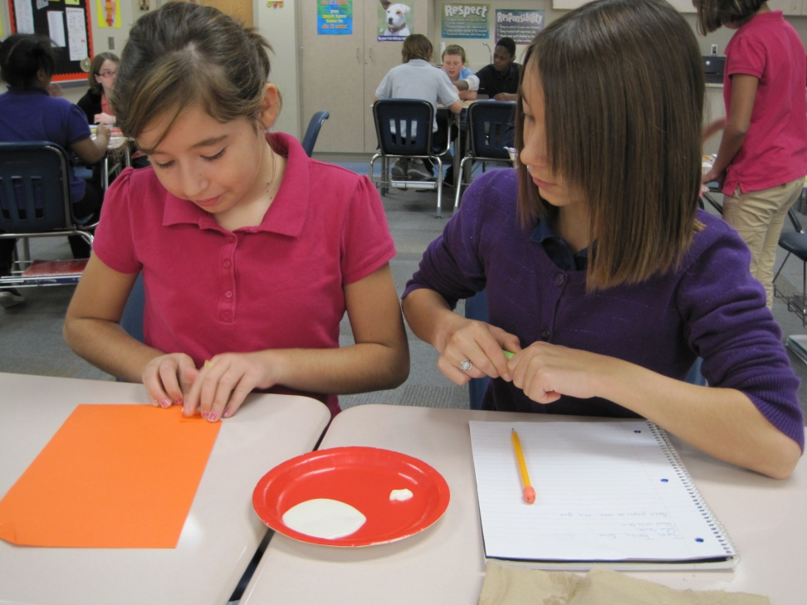
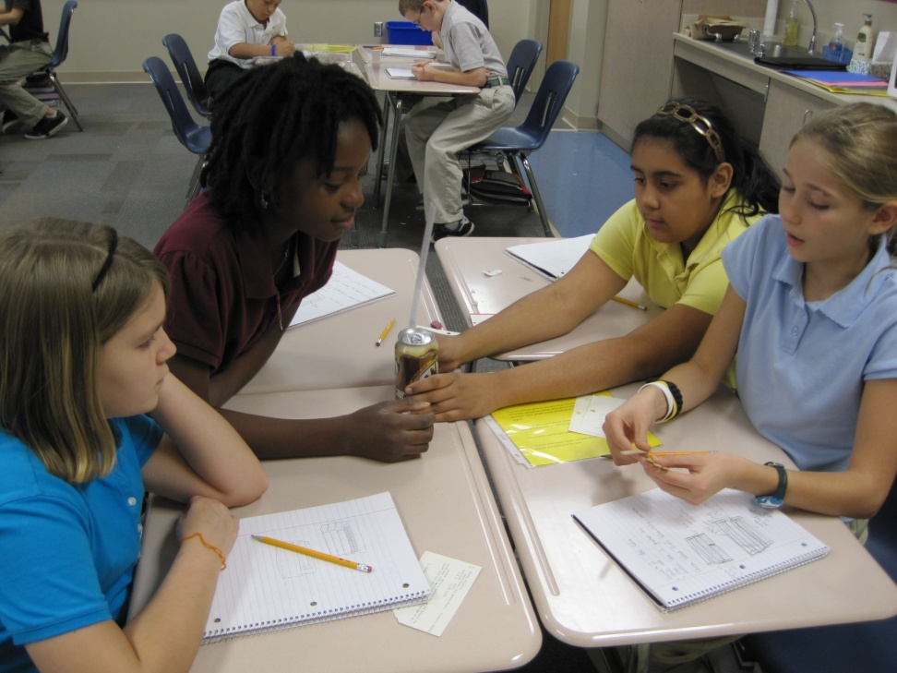
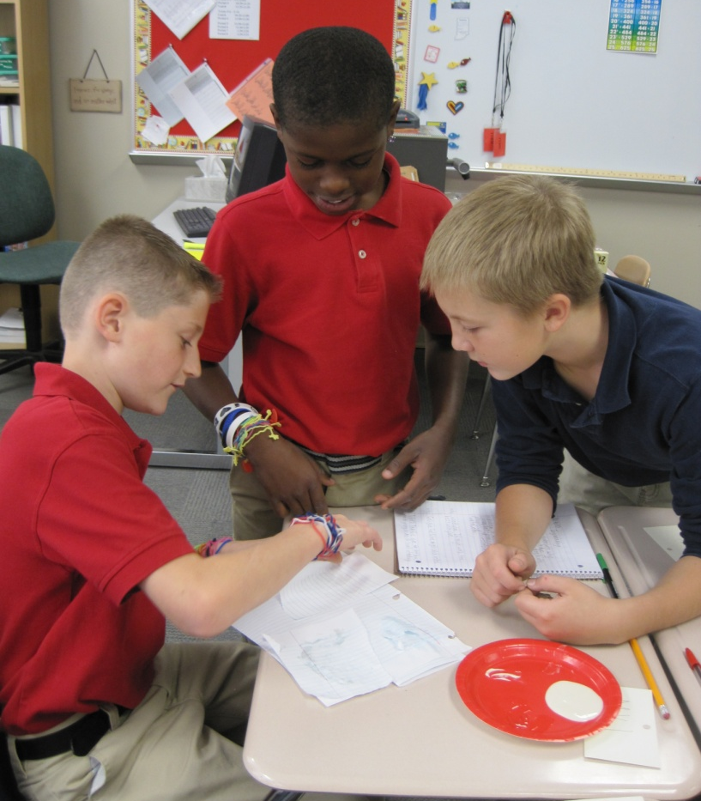
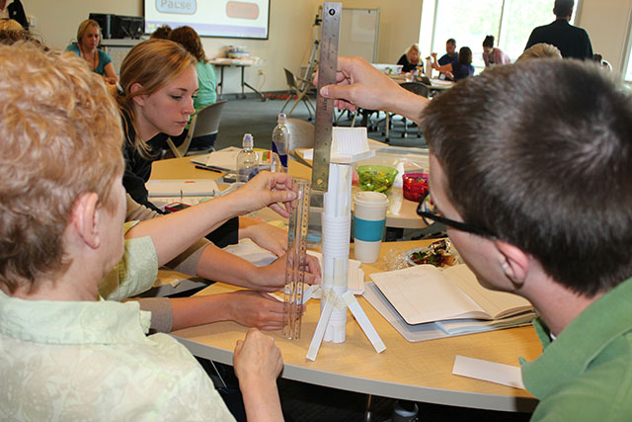
Welcome to the SLED project!
Notes:
This is a brief overview of the SLED project. It is intended as an introduction for the new participants and a refresher for those who participated last year.

Slide 6
What is SLED?
SLED, Science Learning through Engineering Design, is a partnership project of Purdue, participating Indiana school districts, and community partners designed to help improve students’ science learning in grades 3-6.
The SLED project is supported by the National Science Foundation through its Math Science Partnership program.
Notes:
This project is receiving significant funding from NSF and has high visibility nationally. You are part of an important effort, and there is an expectation that all of the partners will work together to help this project succeed.

Slide 7
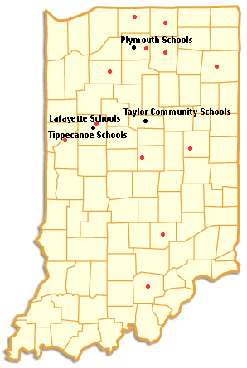
SLED Partners
Purdue Colleges of
Education, Engineering,
Science, Technology
Discovery Learning Research Ctr.
Lafayette School Corp.
Tippecanoe School Corp.
Taylor Community Schools
Plymouth Community Schools
and additional school partners
Community Partners

Slide 8
Targeted MSP
NSF’s Math Science Partnership (MSP) program supports linkages of higher education institutions with schools and other partners to improve K-12 mathematics and science education.
Targeted partnerships study and solve issues within a specific grade range or at a critical juncture in education, and/or within a specific disciplinary focus in mathematics or science.
Notes:
SLED is targeted both by grade level, 3 through 6, and by disciplinary focus, science and engineering design.

Slide 9
Goal of the SLED Partnership
Our aim is to increase grade 3-6 student learning of science by developing an integrated, engineering design-based approach to elementary school science education.

Slide 10
Why Engineering Design?
Indiana’s elementary science standards now address elements of engineering design.
One basic rationale from the standards:
“As citizens of the constructed world, students will participate in the design process. Students will learn to use materials and tools safely and employ the basic principles of the engineering design process in order to find solutions to problems.”

Slide 11
Indiana Academic Science Standards
The Design Process (adopted 2010)
Identify a need or problem to be solved.
Brainstorm potential solutions.
Document the design throughout the entire design process.
Select a solution to meet the need or problem.
Select the materials to develop a solution.
Create the solution.
Evaluate and test how well the solution meets the goal.
Communicate the solution with drawings or prototypes.
Communicate how to improve the solution.

Slide 12
The Nature of Science
Use a scientific notebook to record predictions, questions and observations about data with pictures, numbers or in words.
Conduct investigations that may happen over time as a class, in small groups, or independently.
Generate questions and make observations about natural processes.
Make predictions based on observations.
Discuss observations with peers and be able to support your conclusion with evidence.
Make and use simple equipment and tools to gather data and extend the senses.
Recognize a fair test.

Slide 13
Next Generation of Science Standards (NGSS, 2013)
Science education in grades K-12 should be built around three major dimensions:
Scientific and engineering practices
Crosscutting concepts that unify the study of science and engineering through their common application across fields, and
Core ideas in four disciplinary areas: physical sciences; life sciences; earth and space sciences; and engineering, technology, and applications of science.

Slide 14
SLED Partnership Objectives
Create the partnership of university faculty, school teachers and administrators, and community partners
Enhance the preparation of in-service and pre-service teachers to integrate engineering design in science teaching
Adapt, refine, and test project- and design-based curricular materials/tasks
Generate evidence of how well this works with teachers and students

Slide 15
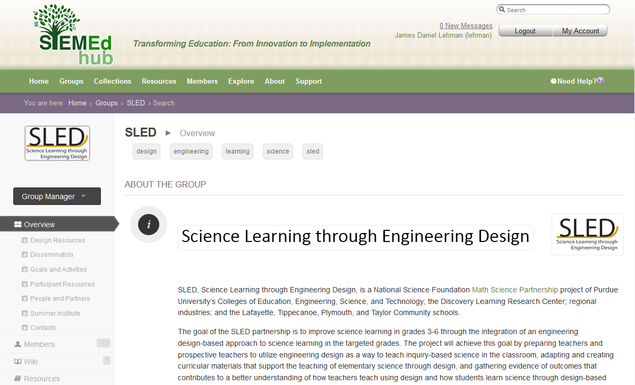
Component: Partnership
SLED is organized to work as a community of learners involving all project partners.
SLEDhub serves as an online locus for project resources and communication.
sledhub.org

Slide 16
Component: Teacher Development
In-service teacher professional development and support
  Summer Institute and follow-up professional development
  Work with disciplinary faculty
  SLEDhub online resource repository
Pre-service teacher preparation
  Special elementary science methods course focused on design
  Summer Institute participants
  Linking pre-service teachers with SLED participating schools and teachers

Slide 17
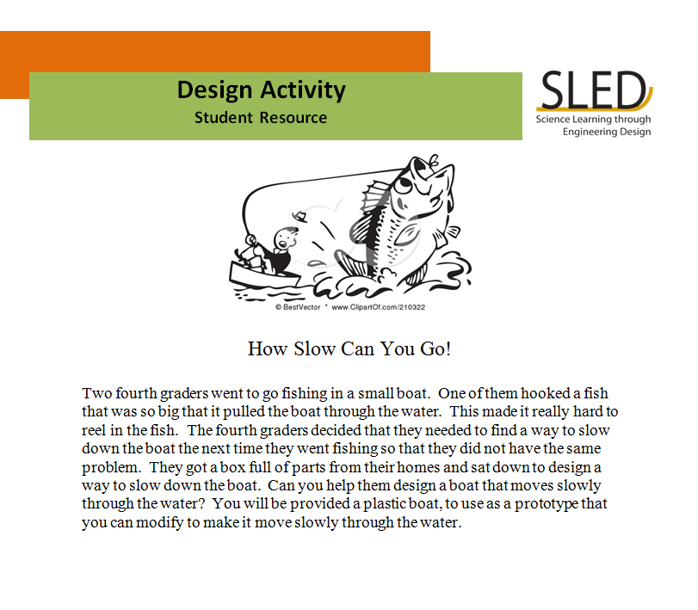
Component: Curriculum
Adaptation and/or development of engineering design activities for grades 3-6
  Faculty design teams have created design activities for the classroom that you will try out as part of the summer institute and implement with your students

Slide 18
Component: Evidence
Research and dissemination
  Research addresses three key aspects of the project: the partnership, teacher implementation, and student learning.
  Dissemination includes presentations at professional meetings, writings about the project, media exposure, and use of the SLEDhub site.

Slide 19
SLED Intended Outcomes
A sustainable partnership supporting on-going use of engineering design in the classroom;
A model for high quality teacher professional development in engineering design for pre-service and in-service elementary educators.
A library of tested, design-based curricular materials to support teaching science in
grades 3-6; and
New understandings of how teachers teach science through the engineering design process and how young students learn science through design-based activities.

Slide 20
Implementation Timeline
Years 1 and 2
  Development and integration of engineering design-based activities for grades 5 and 6.
Years 3 and 4
  Development and integration of engineering design-based activities for grades 3 and 4.
Year 5
  Expansion of the partnership and integration of engineering design-based activities for grades 3 – 6 in all schools.
You are here!

Slide 21
Great Expectations

Slide 22
What is Expected of You?
Participation in the project for at least this summer and the coming academic year.
Academic year integration will consist of implementing at least 2 SLED design-team developed activities (one fall and one spring) with your students.
Other activities include: follow-up activities, participation in the online community, and participation in research and evaluation.

Slide 23
Benefits
You will receive a stipend, paid in separate installments, for your participation.
You will receive 35 PGP points for completing the summer institute and additional points for follow-up activities.
You will have an opportunity to apply for a mini-grant for your school.
You will have fun while learning!

Slide 24
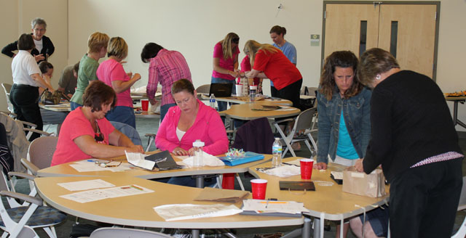
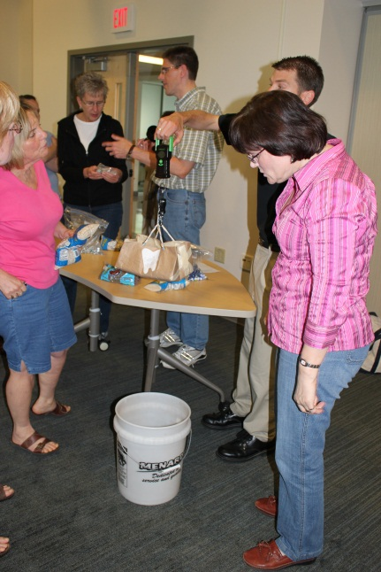
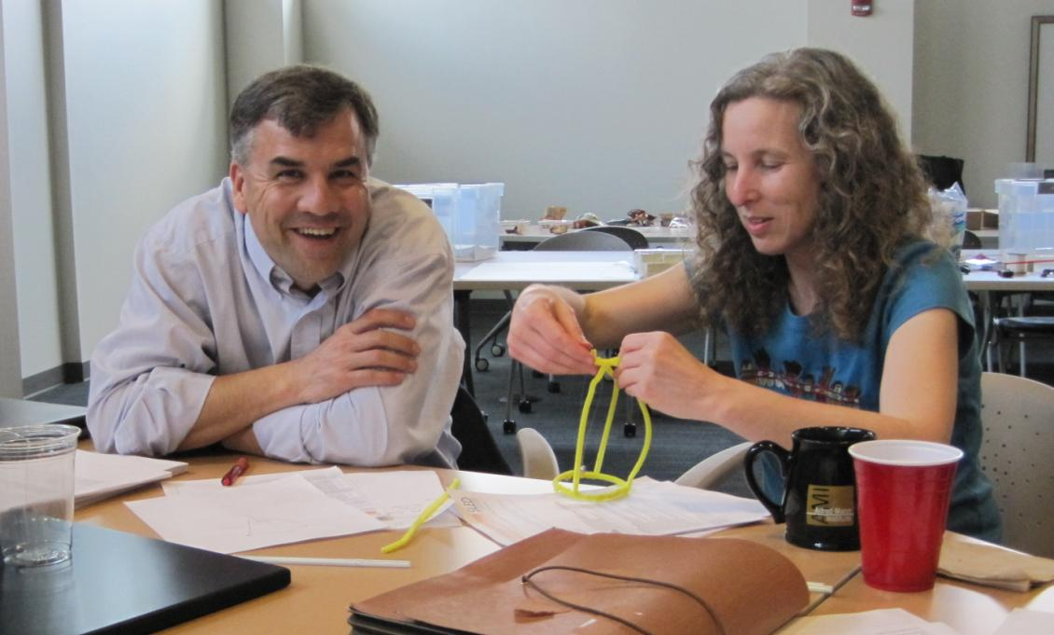
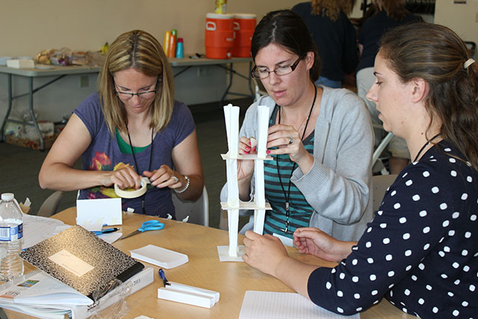
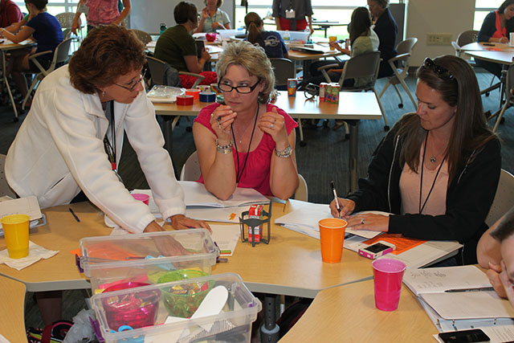
Summer Institute

Slide 25
SLED Summer Institute
Schedule
Monday, June 8 | Tuesday, June 9 | Wednesday, June 10 | Thursday, June 11 | Friday, June 12
AM Welcome and introductions Introductory inquiry task | AM SLED Design Challenge #1 | AM SLED Design Challenge #3 | AM Curriculum mapping and developing lesson plans | AM Review of activities for coming year Finalize lesson plans for coming year
PM Introductory design task Day’s debriefing and wrap-up | PM SLED Design Challenge #2 Day’s debriefing and wrap-up | PM SLED Design Challenge #4 Day’s debriefing and wrap-up | PM Mini-workshops on selected topics | PM Group sharing of lesson plans Summer institute wrap-up and reflection

Slide 26
What Will You Need?
Comfortable clothing
Something to write with
Curricular materials from your school (e.g., textbook, other materials) when we begin curriculum mapping and lesson planning
Laptop – if you wish to bring your own, we can provide wireless network access
An adventurous spirit!

Slide 27

Summer Logistics
Chell Nyquist

Slide 28
Summer Institute
Plan on a daily schedule of 8:30 a.m. –
3:30 p.m.
NSF requires us to take attendance daily. Full compensation and PG points are conditional on full attendance. Please make sure to sign an attendance sheet every day.
Working lunch (and light breakfast items) will be provided daily.

Slide 29
SLED Binder
Schedule
List of participants/partners/personnel
Resources
  Short readings
  IN Science and Math Academic Standards Gr 2-5
  Design Lesson Plans
  SLED Implementation Plan Template

Slide 30
When reading the SLED Lessons…
Guiding question
Time (estimated)
Objectives
Standards
Relevant concepts and vocabulary
Equipment and materials
Special notes (materials, prep, or comments)
Notes:
Each lesson plan has been formatted in the following way:
Guiding question
Time (estimated) → based on pilot testing, teacher feedback
Procedure → purposeful steps to follow
Examples of Ask questions → questions you can ask to foster student thinking; reinforce key concepts or principles
Design notebook entries
Sequenced → inquiry into design; or design into inquiry → in short, we tried to embed inquiry and design in several of lessons
Assessment includes examples of both formative and summative → we hope that you will develop your own forms of assessments; we will also have knowledge tests available for your own purposes
All include a design challenge (can find that at the end of each lesson plan) plus handouts

Slide 31
Procedure (purposeful steps)
“Ask” questions
Design notebook entries
Sequencing of inquiry and design (vice versa)
Assessment
Design challenge and handouts
Notebook materials are available electronically at sledhub.org

Slide 32

Summer Logistics
Parking
  Blue or Red “AB” or “ABC Permit” signs (lot behind DLR)
  White “Residence Hall” signs
    Not in Purdue Village (next to DLR)

Slide 33
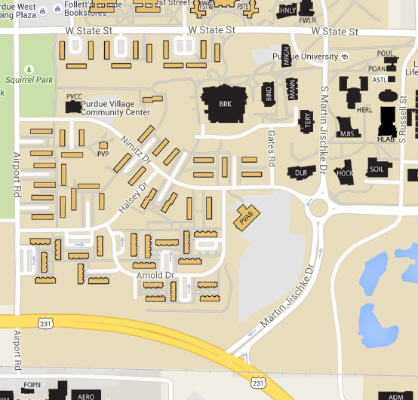

Slide 34
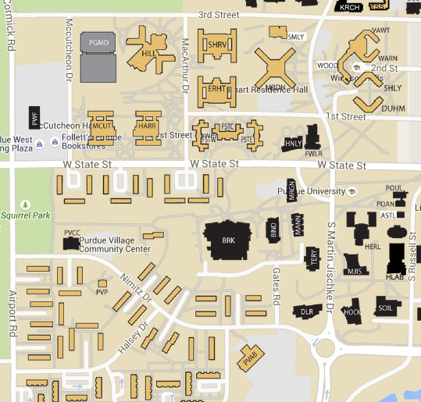

Slide 35
Summer Logistics
Payment
  Receive check in mail approximately 3-4 weeks after conclusion
  Include stipend and mileage
  Mileage
    $0.56 per mile
    Calculated from school to DLR

Slide 36
Building Emergency Info
In the event of a fire alarm, evacuate the building. Gather in the on north side of DLR, near police station. If there is inclement weather go to Mann Hall (north of the police station).
If you hear an All Hazards Siren, shelter in place inside. In this building, go to the basement corridor which as accessible from stairs on the east and west ends of the building. You can also shelter in first floor restrooms or the hallway.

Slide 37

Questions?

