Slide 1
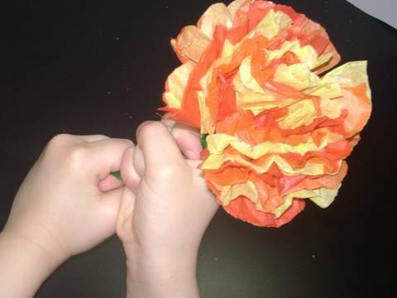
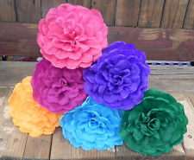
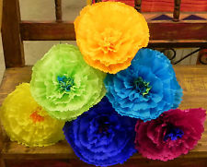
Bio Inspired Design Paper Flower
Notes:
Bryan

Slide 2
Main Lesson Objectives
Identify the common structures of a plant
Understand how these common plant elements function
Describe how the flower was colored through capillary action
Design a root system that uses wicking/capillary action to dye a paper flower.
Notes:
Bryan

Slide 3
Indiana Standards
Primary
Life Sciences 3.3.1
Identify the common structures of a plant including its roots, stems, leaves, and flowers
Notes:
Evan

Slide 4
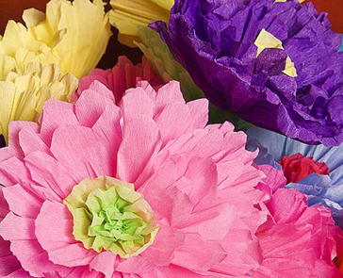
Planned outdoor event at high school has to be relocated inside
Notes:
Tahira

Slide 5
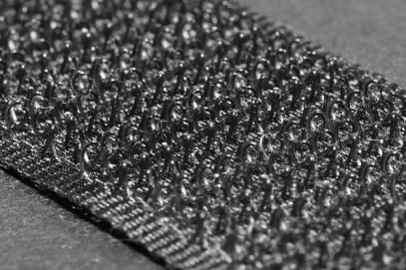
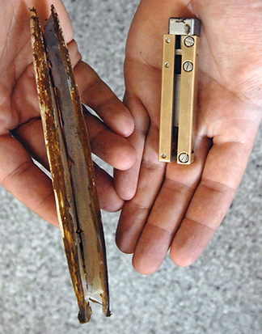
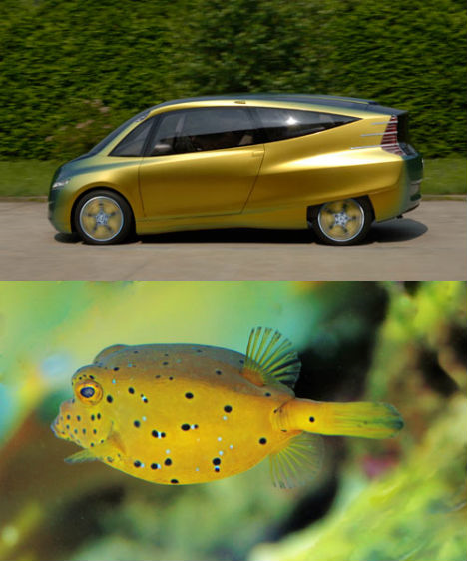
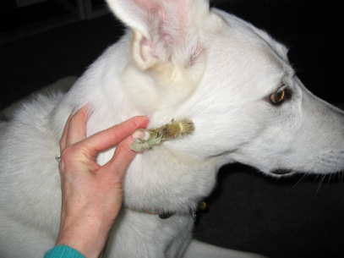
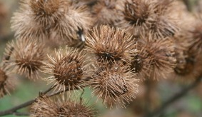
Bio-Inspired Looking to Nature for Design Ideas
Velcro
Razor Clam Digger
Mercedes / Box Fish
Notes:
Tahira

Slide 6
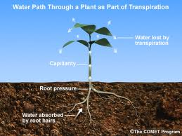
A Plant’s Root System
Notes:
Kari

Slide 7
Problem: Design a dyed flower similar to real flower
Setting: Special event
Goal: The goal is to have a better understanding of common structures of a plant including its roots, stems, and flowers
Who is the client: Student council members needing flowers for their event
End-User: The local community/those who will enjoy the flowers
What is the design: A bio inspired paper flower
Criteria: Flower must be colored by water absorption of dye through various strings and yarn andmust have a stem
Constraints: Material provided, minimal time (must be ready for use within 2 days)
Notes:
Nancy

Slide 8
Tie Dye a Real Flower
Did the flower change colors?
Where did the color come from?
How was the colored water transferred from the cup the ends of the flower.
Notes:
Bryan and Alyssa

Slide 9
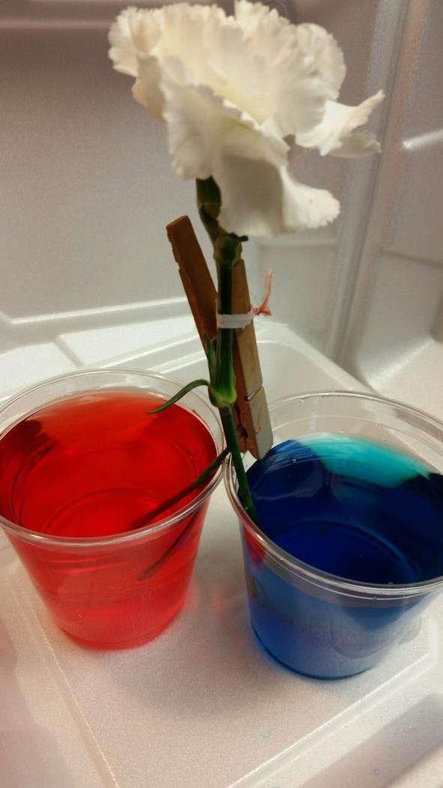

Slide 10
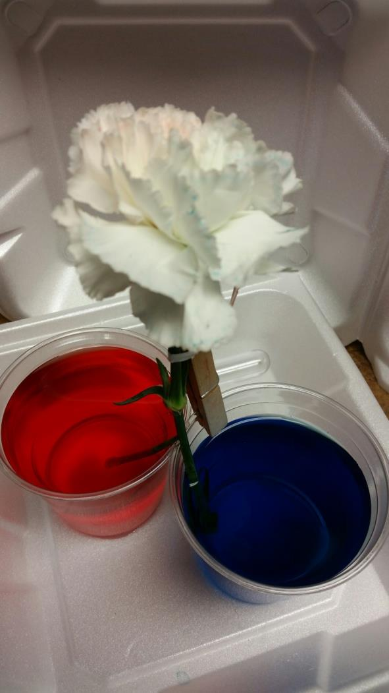

Slide 11
Material for flower
Liquid eye dropper test
Notes:
Nancy

Slide 12
Discussion on what would make a good root system
Notes:
Nancy

Slide 13
Choose Best Yarn for Task (Root System)

Slide 14
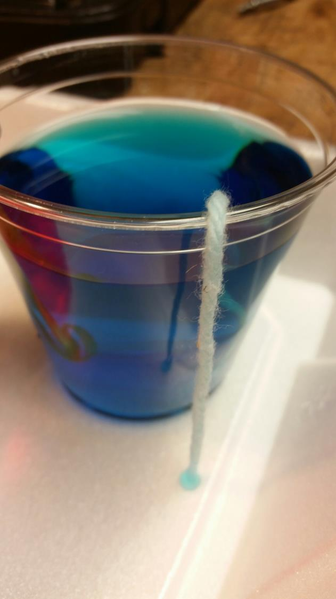

Slide 15
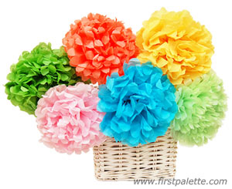
http://www.firstpalette.com/Craft_themes/Nature/mexicantissuepaperflowers/mexicantissuepaperflowers.html
Notes:
Bryan

Slide 16
Design Task
Design a paper flower with a stem
The flower is to have a “Tie Dyed” look like the natural flower
Notes:
Alyssa

Slide 17
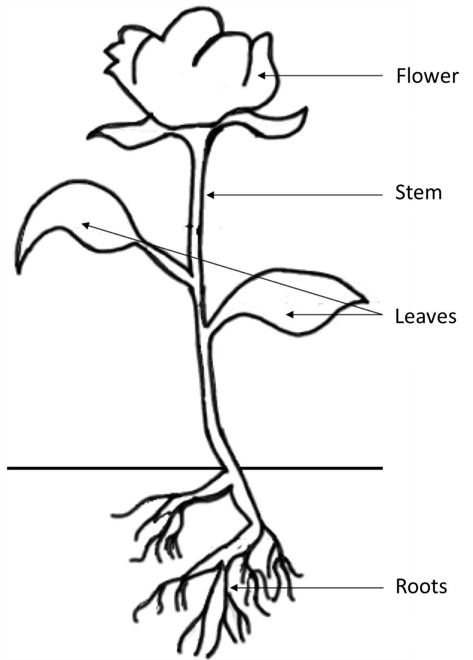

Slide 19
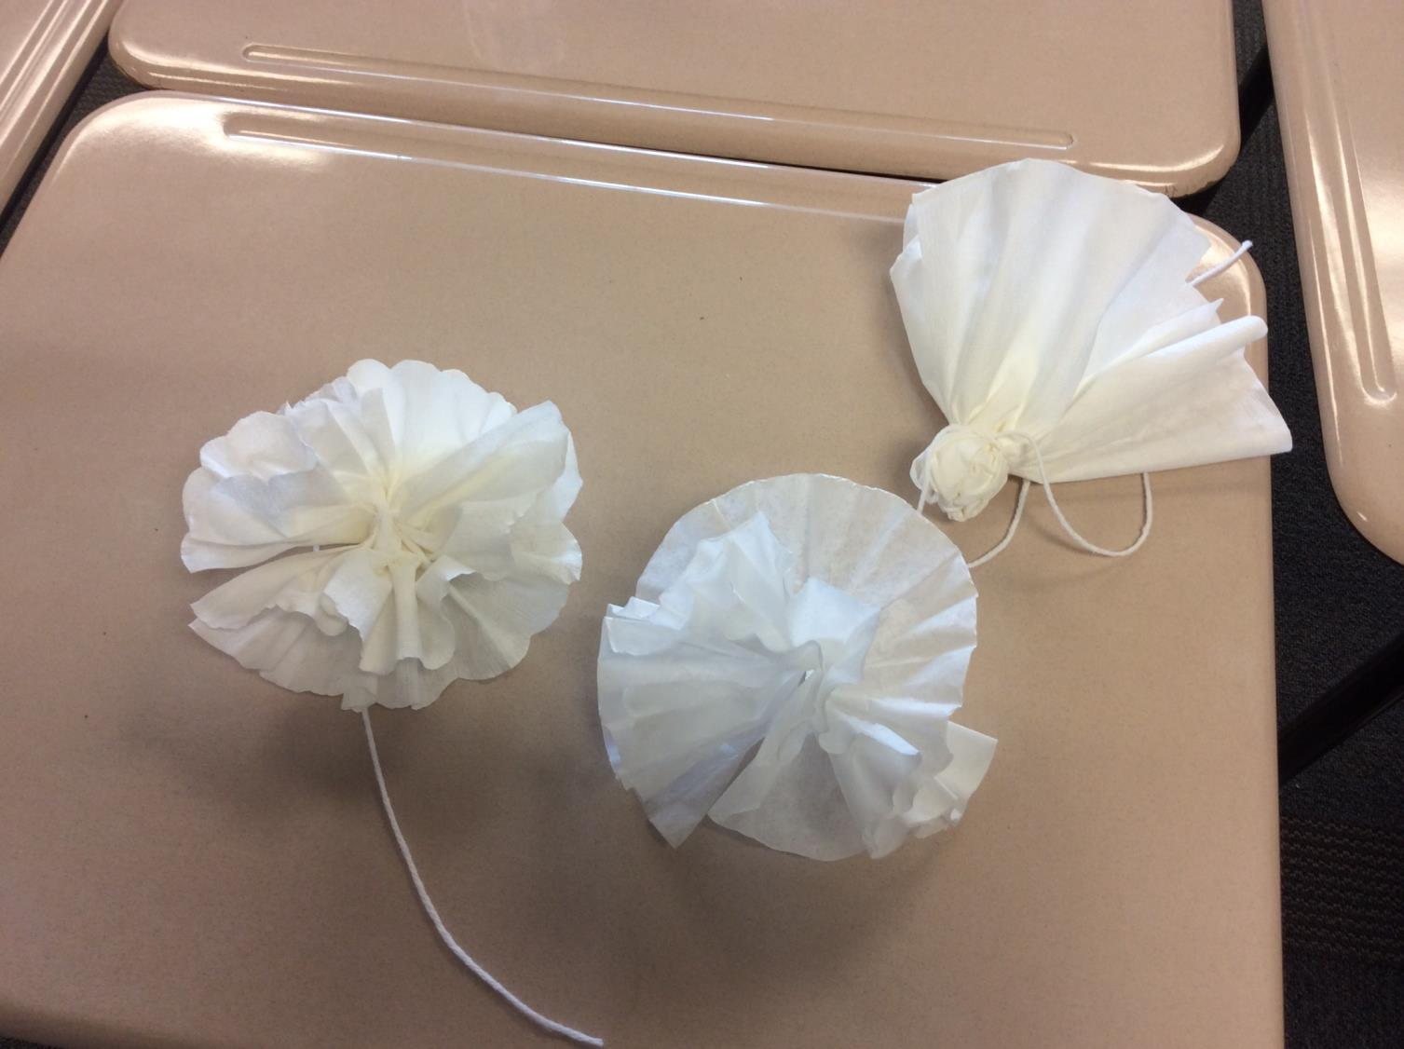

Slide 20
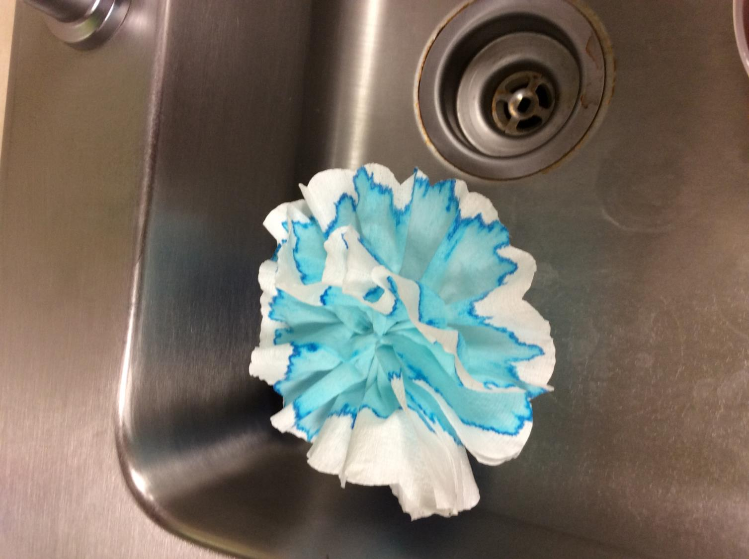

Slide 21
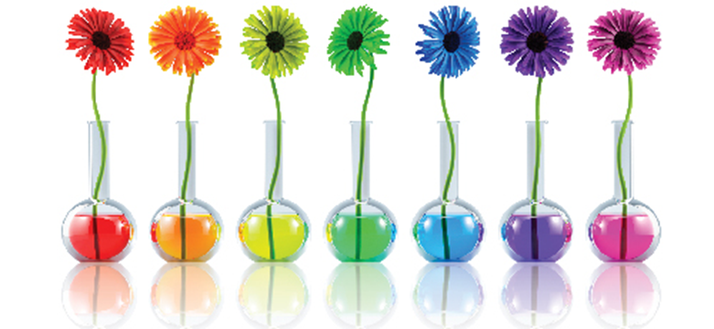
http://www.orlandofamilymagazine.com/wp-content/uploads/2014/03/flowers.jpg

