Slide 1
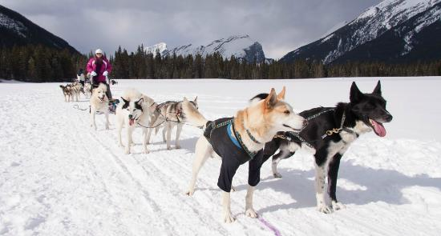
Establishing the SLED Team
Cooperative Learning Techniques for Engineering Design

Slide 2
How a dog sled team is formed

Slide 3
Outline
Introduction to Teaming
Forming, managing, and determining the student team size
Cooperative learning approaches (peppered)
Building a team climate
Brainstorming
Jigsaw activity- simple circuits
Reflection

Slide 4
Traditional vs Teaming Approach
Traditional Classrooms
Often Students are asked to:
Eyes on your own paper
No talking to your neighbor
Do your own work
If you need help ask the teacher
Raise your hand to get the teachers attention
Compete for extrinsic rewards ie: grades
Teaming Classrooms
Often Students are asked to:
Share with peers what each others are doing to learn from one another
Talk to your design team to exchange ideas, debate, explain, suggest, question, and improve.
The design teams work is shared so that the final design is better than the individual parts.
When help is needed, team members ask each other for help before approaching the teacher
Allow each design team member to be a spokesperson for the team
Cooperate for both extrinsic and intrinsic rewards
Adapted from Jacobs, Power, and Inn (2002, p. 4)

Slide 5
Essential Components of Teaming
SLED team formation – developing high functioning design teams
SLED team leadership- team functioning depends of team personality/ability
Materials – design materials
Teacher Role- Teacher as SLED team facilitator
Assessments – Assessing the success of the SLED team
Notes:
There are five essential components of teaming

Slide 6
SLED Team Formation
The SLED team should be formed to:
Heterogeneously mixed by academic ability
Provided equal access to materials
Equal opportunities for learning
Avoid personality and social conflicts
Other factors to consider are English Language Learners (ELL), inclusion, internet access.
Notes:
According to Mandel – when the goal of forming a cooperative group is for students to learn a specific curriculum materials in this case-science through engineering design . Mandel stresses that personalities and social conflicts should be avoided at all costs that often lead to academic disruptions.

Slide 7
Possible Criteria for Heterogeneous Teams
Achievement Levels
Aptitude Levels
Work attitude
Ethnicity
Gender
Personality Type
SES
Special Needs
Social Considerations – close friends, conflicts
Multiple intelligence- learning styles
(Adapted from Mandel, 2002 ; Jacobs, Power & Inn, 2002 )
Notes:
This is not hard and fast rule of criteria. Some of these categories may not be appropriate for your classroom. Keep in mind these categories are suggesting a mix of these criterion, not segregating by these categories. In other words, you want a diverse design team or a mix, not a segregated one. Our world is more and more diverse and we need to help prepare students for a diverse world of work and life.

Slide 8
Managing the Team
As students work cooperative in design teams,
classroom conditions will need to be carefully
monitored, including:
voice levels,
classroom space,
traffic patterns of students
SLED teachers establish a prompt to get students attention.

Slide 9
Design Team Size
Teams larger than four are hard to manage
Teams of four can be broken into pairs and back
Larger than four provide opportunity to hide/neglect
Sometimes limited equipment dictates team size
Several sources recommend four to six member teams

Slide 10
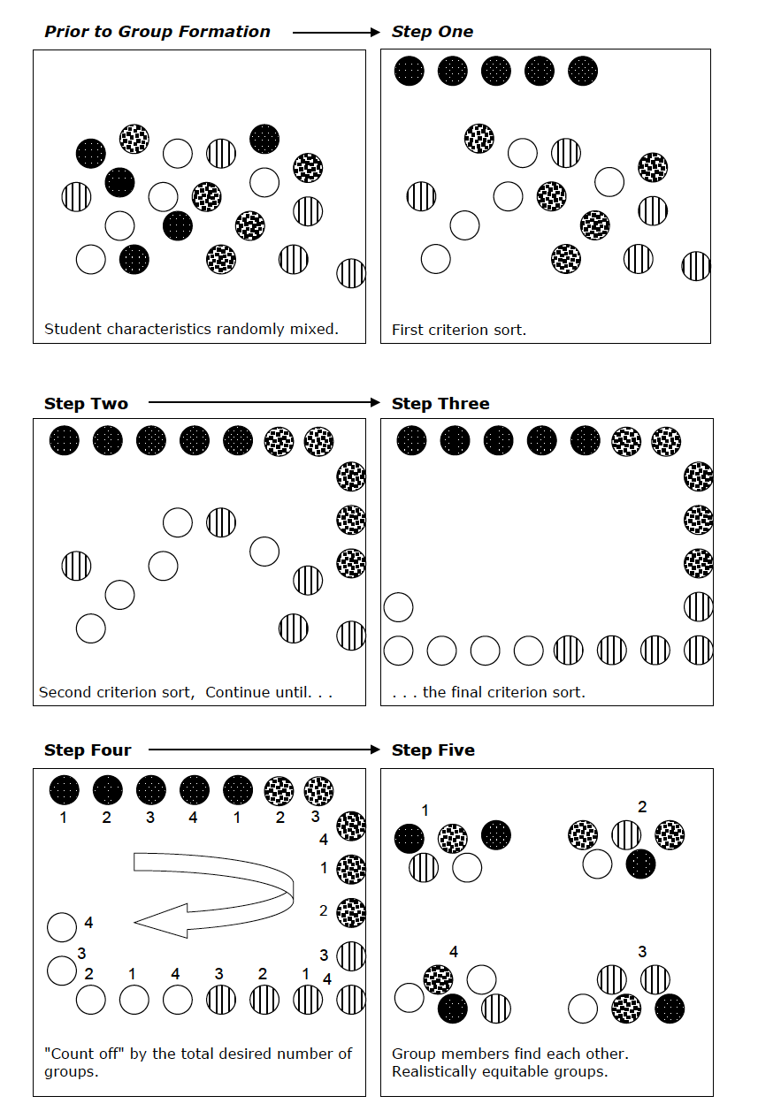
Forming Groups Quickly
Notes:
This is very important and can be confusing: you want to count by the number of groups you want, NOT the number of students you want per group. So with 33 students and a goal of 6 or 7 per group, the students would count off by 5 (not 6 or 7).

Slide 11
Cooperative Learning Techniques

Slide 12
Think-Pair-Share
Step 1 – Students are in pair. The teacher asks a question. Each student spends time to think alone. (no talking, encourage independent thinking)
Step 2. Pairs of students discuss what each person has learned/thought about the topic.
Step 3. The teacher calls students at random to share about the pair discussion. Share the collective thoughts/conversation not just individual thoughts
Notes:
This technique promotes positive interdependence while learning how to listen to others ideas and helps promote a community of learners. This is critical for a SLED lesson to help students learn how to listen to each others ideas and the concept of learning from each other. These will be critical skills when working in design teams.

Slide 13
Practice Think-Pair Share
Teacher Question: What have your experiences been forming student groups?
What has worked well?
What challenges have you faced and how did you overcome these?
Pair up with a partner and discuss
Share with the group

Slide 14
Building a SLED Team Climate
Establishing Team Norms – rules for how the
team will function.
I listen when others are talking
I encourage everyone to participate
I help others without doing the work for them
I ask for help when I need it
I am critical of ideas, not people
I remember that we are all in this together
I value and respect each SLED team member
Mandel, 2002, p. 5-6
Notes:
These are called norms not rules because norms flow from shared values, such as the value of cooperation.

Slide 15
SLED Team: Brainstorming
Criticism is Ruled Out- when brainstorming begins, the group should avoid judging design ideas.
Freewheeling is welcomed- sometimes the ideas are crazy and wild. All ideas should be written down because one idea can spark another.
Quantity- encourage multiple design ideas- the more the ideas the better. If students get stuck, remove some design aspect or add something.
Combination and Elaboration – Encourage design teams to combine ideas or elaborate on existing ideas. These techniques often generate additional ideas.
(Linden, 1992, p. 11-12, from Ames & Linden, 1979)

Slide 16
SLED Team Brainstorming
Practice a brainstorming session
Use Team Norms
Follow Rules of Brainstorming
Generate as many ideas as possible in 2 minutes
Problem: Your classroom is filled with students’ prototypes, how would you display them in a creative way?
Notes:
Find out how many ideas were generated – who had the most, which one is most creative?

Slide 17
Cooperative Learning Activities: Jigsaw
Jigsaw
Step 1 –Home team (four students) are each given a piece of information (their piece) of the “jigsaw”.
Step 2- students leave home team and form “Expert Teams” of members of other home teams that have the same information. The role is to understand their piece of information and teach it to the home team.
Step 3 –Students return to home team, each taking a turn to share their information. Team members ask questions and discuss.
Step 4 – Assessed on understanding information of all four areas of learning.

Slide 18
Jigsaw Example
How does a Flashlight work?
In teams of four (Home Team), each person will get one part of a flashlight circuit
(Expert Team) -Bulb Team, Switch Team, Battery, and Wires.
In your expert groups, You will be given a definition and electrical part sample.

Slide 19
Gathering Information- Expert Group
For each electrical parts write down in your notebook:
Definition
Make a sketch
Explain in your own words what happens when electrons flow to your electrical part (bulb, battery, closed switch, wires connect to a battery)
Identify key facts and conditions for a circuit to work

Slide 20
Sharing with the Home Team
Battery group share, Switch group share, Bulb group share, and Wires group share
Explain the entire system circuit- completed or closed circuit. Suggestion. Hold hands and begin at the battery and say:
“ I am a …(battery, switch, bulb, wire) as electrons flow to me… ‘explain what happens to your component”

Slide 21
Complete the Circuit Handout

Slide 22
Write-Pair-Switch
Step 1 – Each student works independently to respond to a question or writing prompt.
Step 2 – Students pair up and discuss their responses.
Step 3 – Students switch partners and form new member pairs and tell their “new” partner the response of their “former” partner.

Slide 23
Reflection
How could this approach change your teaching practice?
What advantages can you identify?
What concerns do you have with this approach?
Final Comments

Slide 24
References
Cooperative Learning
Jacobs, G.M., Power, M.A., & Inn, L.W. (2002). The Teacher Source Book for
Cooperative Learning. Thousand Oaks, CA: Corwin Press, Inc.
Mandel, S.M. (2002). Cooperative work group: Preparing students for the real world.
Thousand Oaks, CA: Corwin Press, Inc.
Linden, K.W (1996). Cooperative Learning and problem solving, (2nd ed.). Prospect
Heights, IL: Waveland
Ames, R., & Linden, K.W.(1979). Problem solving activities for applied educational
psychology: A three stage model approach (2nd ed.). Prospect Heights, IL: Waveland
Science Concepts
Glover, D. (2001). Experiments in Science: How does it work? London: Dorling
Kindersley

