Slide 1
STEMEdhub.org a Group Approach to Hubs
Hubbub 2012
Ann Bessenbacher
Discovery Learning Research Center
Purdue University

Slide 2
Overview
Background of STEMEdhub
The Groups of STEMEdhub
Lessons learned
Ideas for future improvements

Slide 3
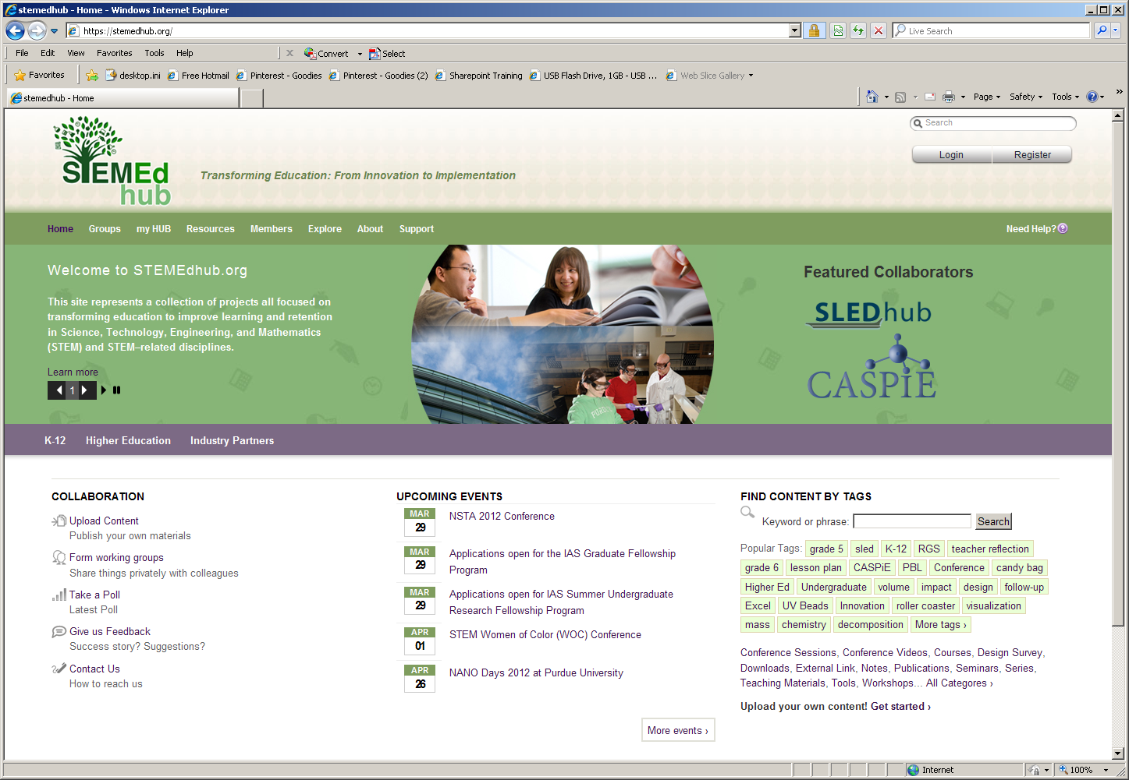
STEMEdhub.org
Notes:
Brings together researchers in STEM disciplines with teachers through Projects and groups.
- Broad focus on STEM (Science, Technology, Engineering and Math) education at all levels of education.

Slide 4
Background of STEMEdhub
Learn from experience of Nanohub.org
Use many smaller grants to help fund the hub
Many projects were coming to the DLRC wanted to start their own hubs
Support for the hub beyond the end of a grant
Created April 2011, 2012
One hub administrator/technology steward with many group administrators

Slide 5
Background of STEMEdhub

Slide 6
Background of STEMEdhub

Slide 7
Groups of STEMEdhub
K-12 Education
Undergraduate Education
Education Conferences
Notes:
Domain-STEM Education
Shared Practice- Teaching
Community of People- STEM teachers
K-12
SLEDhub - Science Learning through Engineering Design for grades 3-6
Research Goes to School - sustainable biofuel energy into high school science, technology, and math classrooms
Undergraduate
HHMI Bio- Integrating Statistical Analysis and Experimental Design into Life Science Education
CASPiE - The Center for Authentic Science Practice in Education is a multi-institutional collaborative effort designed to address major barriers to providing research experiences to younger undergraduate science students.

Slide 8
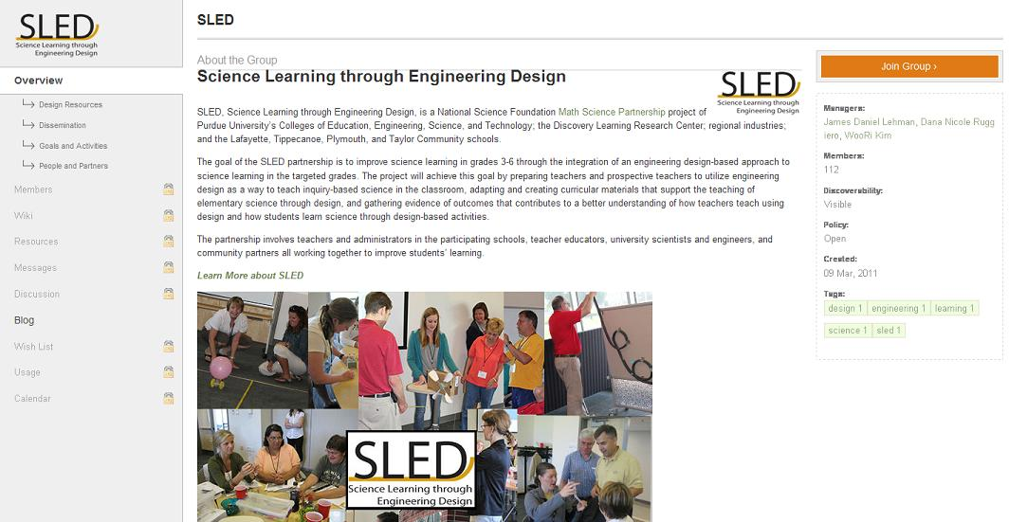
Groups of STEMEdhub
K-12 Education
Notes:
Domain-STEM Education
Shared Practice- Teaching
Community of People- STEM teachers

Slide 9
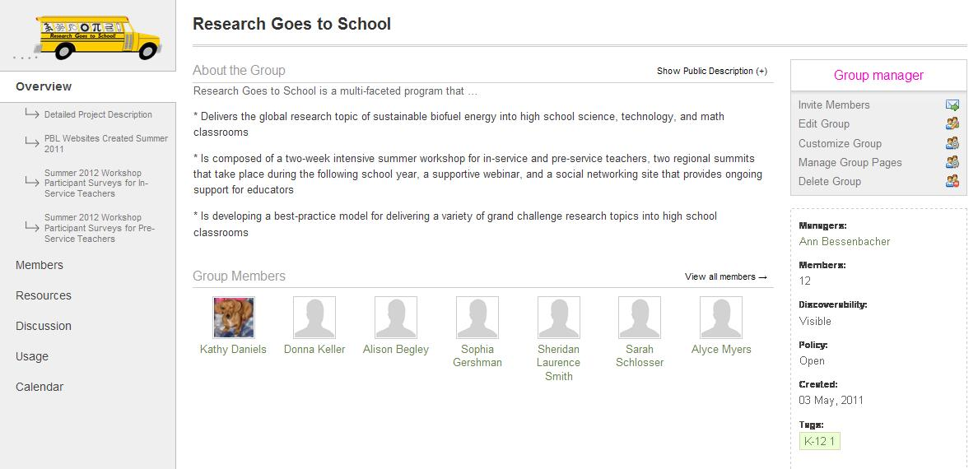
Groups of STEMEdhub
K-12 Education

Slide 10
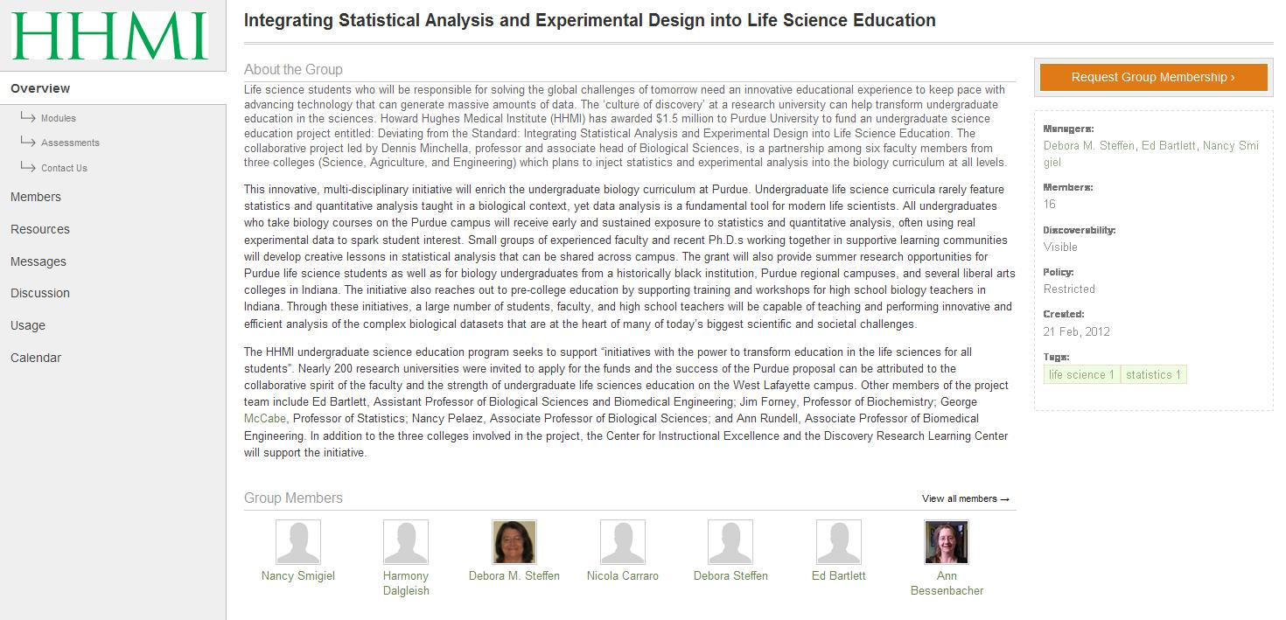
Groups of STEMEdhub
Undergraduate Level Education
Notes:
Technology Steward is best defined as a person or group who adopts a community’s perspective to help a community choose, configure, and use technologies to best suit its needs (Wenger 2009).
Content Orientation- having a focus on creating, sharing, and facilitating access to information, documents and tools (Wenger 2009).
Access to Expertise- having a focus on quick access to expertise in the domain both internally and externally (Wenger 2009).

Slide 11
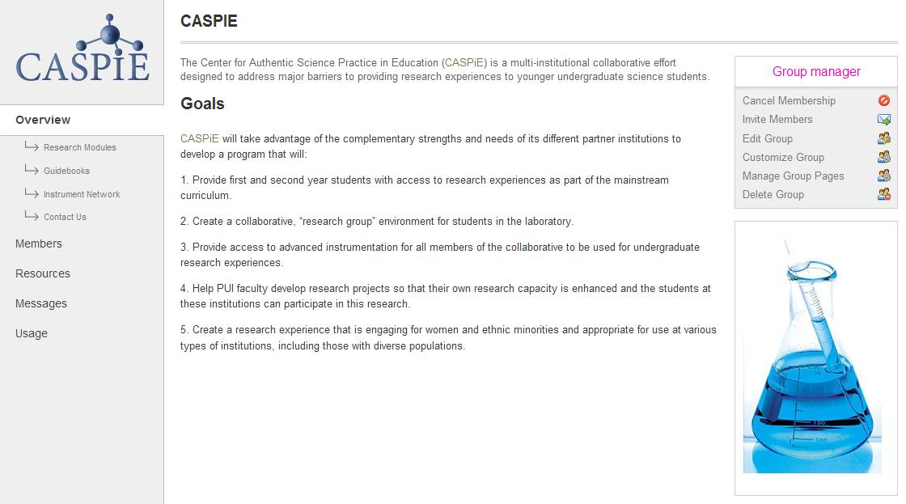
Groups of STEMEdhub
Undergraduate Level Education

Slide 12
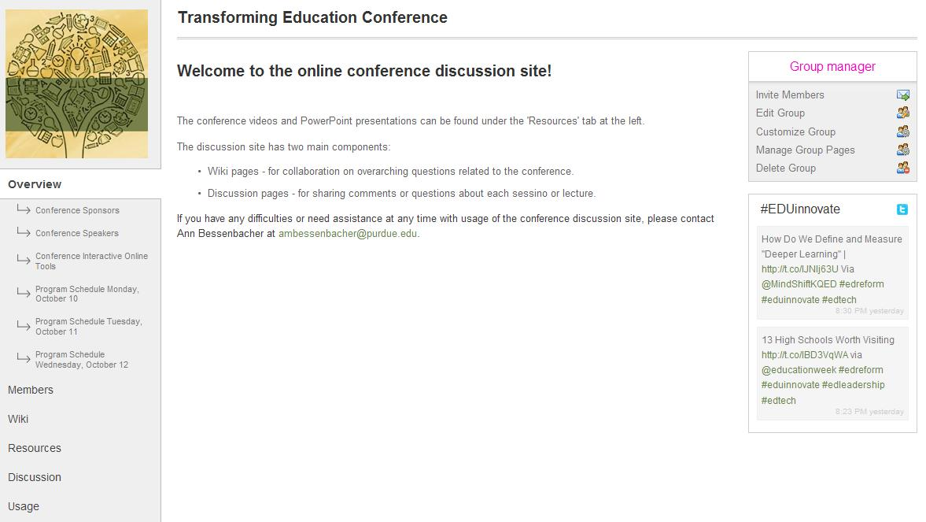
Groups of STEMEdhub
Education Conferences

Slide 13
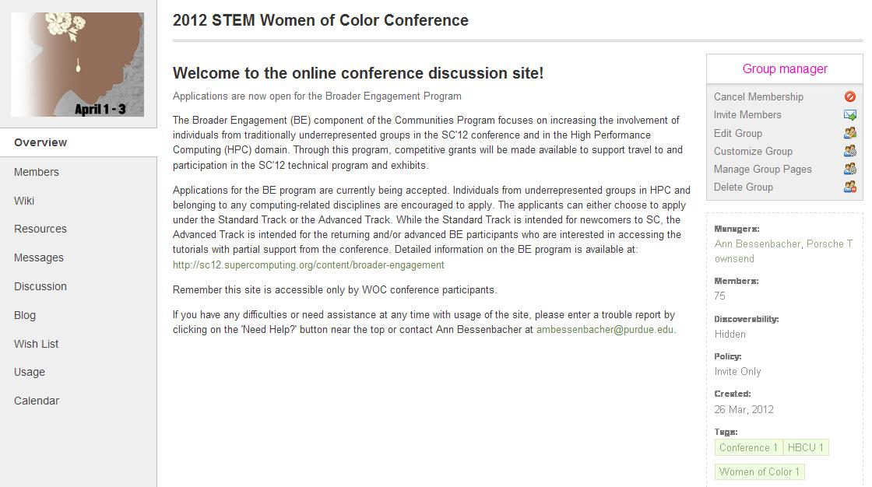
Groups of STEMEdhub
Education Conferences

Slide 14
Lessons Learned
K-12 Education
Wikis
Not user friendly for lay audiences
Discussions
Not threaded
Resources
Teachers have trouble uploading resources
Multiple step procedure
License agreements
Hard to find resources in traditional hub delivery
Notes:
- Teachers are used to one-step procedures for uploading documents and the multiple steps required on the hub take too long.
Licensing agreements are wordy and teachers are reluctant to agree to them.
The traditional method for organizing resources for download make it difficult to find

Slide 15
Lessons Learned
Undergraduate Education
Researchers are interested in the hub but they lack of time to get involved.
They want to get email updates from the hub, but it’s unclear on how to set those up.
They have great resources, but need the help of someone to put them together in cohesive sets.
Notes:
-Looking for incentives for researcher involvement
- Messages set-up is under my account

Slide 16
Lessons Learned
Education Conferences
Pre register participants on the hub as users.
Use member roles based on registration information so participants can find people with similar interests.
Give demos of hub during conference so users know how to use it. (It doesn’t hurt to begin and end with this.)
Load presentations as resources for participants to download.
Upload notes from individual sessions to discussions so participants can continue them later.
Include links to twitter if it’s used during the conference so users can get all information in one place.

Slide 17
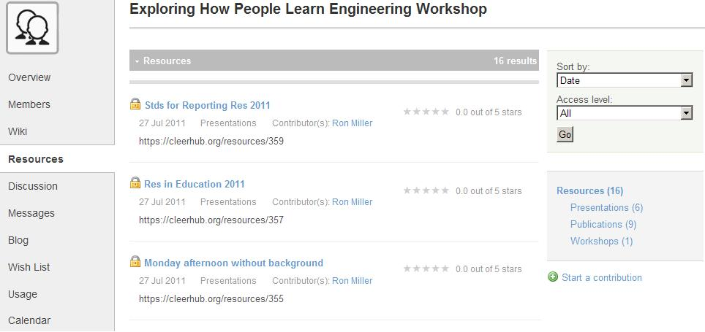
Recent Improvements
Traditional Group Resource Organization

Slide 18
Recent Improvements
New Group Resource Organization

Slide 19
Future Improvements
Split Resources into Publications and Contributions
Threaded Discussions
Questions and Answers in a group level
Suggest Tags on resource upload
Wikis – Make them more user friendly
Calendars (promote group items to main calendar)
Digest emails from group updates
Add option of group chats
Attribute points for all hub activities
Funding for hub participation incentives
Make support tickets visible to all users
Notes:
Contributions would include a one-step upload process

Slide 20
Thank you
Erich Huebner – Hubzero
Deborah Steffen – DLRC
Gabriela Weaver – DLRC
Wilella Burgess – DLRC

