Slide 1




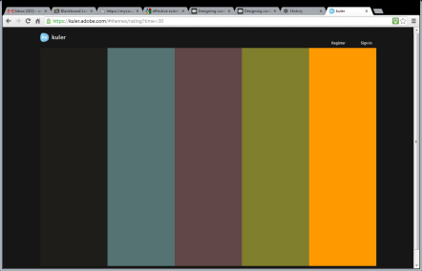








Title title title title title title title title title title title title title title title title title title title title title title title title title title
Author, Author, and Author
Address(es)
Introduction
Replace the “blah, blah, blah” with your own “blah, blah, blah.”
Current Results/ Future Work
Blah, blah, blah
Conclusions
Blah, blah, blah
Make it your own!
This is a template. Move things around. Get creative with graphics. Consider the fields provided as a guide to what you should include, but don’t feel too constrained by it.
Colors
Why use the same old MS color palates? Find creative palates to match the spirit of your work here: https://kuler.adobe.com
Once you find one you like, in PowerPoint you can go to the Design tab, choose Colors, select Create New Theme Colors, and manually match the colors from your selected palate.
NOTE: Colored backgrounds do not print well and use a lot of ink. Accent with color, but don’t drown your poster in it.
Graphics
Two to four high-resolution photos – Preferably of the “project in action”. Include photo reference information such as the photographer, date, and place taken. If you are not using original photographs, please provide a reference/link to the original work.
Three figures and/or info-graphics – e.g. renderings, schematics, graphs. If you are not using original figures or graphics, please provide a reference to the original work.
Source: Who took the photo, when?
Methodology
Blah, blah, blah
Poster dimensions
This template is 36-in wide by 48-in tall.
You may use a portrait or landscape poster, but its dimensions must not exceed 48” by 36”.
To change the dimensions of this poster, go to Design, Customize, Slide Size, Custom Slide Size, and enter the dimensions you prefer.
Include a title, or an explanation of what’s relevant about the figure. Reference any data sources.
Literature Cited
Blah, blah, and blah. 2012. Blahing, blahing, and more blahing. Journal of Blahology 1:1-2.
Blah, blah, and blah. 2012. Blahing, blahing, and more blahing. Journal of Blahology 1:1-2.
Blah, blah, and blah. 2012. Blahing, blahing, and more blahing. Journal of Blahology 1:1-2.
Blah, blah, and blah. 2012. Blahing, blahing, and more blahing. Journal of Blahology 1:1-2.
Blah, blah, and blah. 2012. Blahing, blahing, and more blahing. Journal of Blahology 1:1-2.
Blah, blah, and blah. 2012. Blahing, blahing, and more blahing. Journal of Blahology 1:1-2.
Acknowledgements
Blah, blah, blah. This file from http://colinpurrington.com/tips/academic/posterdesign. You can erase that URL, of course.
PROJECT IMPACT
© Bla

