Slide 1

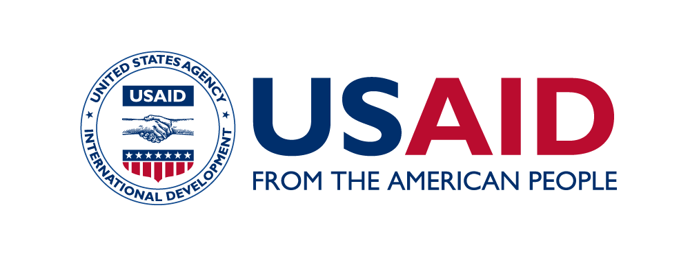





A Case Study of Kenya’s Tusome Early Grade Reading Program: The Journey From Pilot to National Scale
Authors: Julius Ssentongo¹, Justus O. Inyega², Hellen N. Inyega², Aminata Jalloh³, Meghan Armistead³, Dorothy Okello¹, Deborah Naatujuna¹, Betty Bugusu⁴, Andrea Burniske⁴ , Yuehwern Yih⁴, Nathan Tumuhamye¹, Roy William Mayega¹, William Bazeyo¹
1. Makerere University-ResilientAfrica Network 2. University of Nairobi 3. Catholic Relief Service (CRS) 4. Purdue University
Corresponding Author: Julius Ssentongo (jssentongo@ranlab.org)
Introduction
Early grade reading scores in many low- and middle-income contexts are significantly lower than in high-income countries, yet it is a fundamental skill which is linked to future academic success and life outcomes.
Tusome Early Grade Reading is an initiative of Kenya’s Ministry of Education, Science and Technology (MoEST) that is implemented nationwide, with support from USAID and DFID. Tusome aims to improve English and Kiswahili reading outcomes for students in Classes 1-3.
Tusome is a Kiswahili word for “Let’s Read.” The objective of this research is to provide a detailed account and analysis of Tusome and how it has been sustainably scaled. The Tusome case study is providing a detailed account and analysis of Kenya’s early grade reading program from 2011 to 2018 and the context within which it happened to enable USAID to better understand what took place and why, and ultimately to be better able to design and implement equally, if not more, successful programs in other countries
Desk Review Insight: To-date, we have completed conducting a desk review of the literature on Tusome. This section provides the current results from this review. The Tusome program was designed based on findings from the Primary Math and Reading (PRIMR) program which was a Randomized Controlled Trial (RCT) funded by USAID. Over 3 years, PRIMR tested several implementation scenarios relevant to the Kenyan context.
In 2015, Tusome began to scale PRIMR’s most effective components in all of Kenya’s public primary schools, as well as in 1,500 low-cost private schools. By December 2019, Tusome will have reached approximately seven million pupils.
The Tusome midline evaluation showed a significant increase in reading performance among pupils in Tusome schools. For example, the percentage of pupils able to read with fluency (measured at 65 or more Correct Words Per Minute- CWPM) tripled in Kiswahili and more than tripled in English as seen in the table below. Further, the percentage of nonreaders (i.e zero CWPM) has been halved for both English and Kiswahili.
Overall, social economic status did not have a strong association with oral reading fluency, except for the highest income households. This shows that Tusome is increasing educational equity at a national level.
Factors that have contributed to the success of Tusome
Tusome is on course to improve literacy levels for approximately 7 million Kenyan children in Grades 1–3. This is attributed to a number of factors including the following: Conducive policy environment, under the leadership of the Ministry of Education, Science and Technology; Tusome design and leverage of government systems and structures; Availability of teaching and learning materials with a pupil to textbook ratio of 1:1; Leverage of result-oriented and research-based ICT methods; Teacher training and supervision through curriculum support officers; Economic factors/Government buy in and will to spend on the education sector; Improved infrastructure such as electricity, computer rooms, and other programs such as school feeding; Learner factors such as pupils of the correct age range (5 to 9 years old) enrolled in Classes 1 and 2 show better learning outcomes compared to older pupils. A key factor still to be assessed by the case study is whether the development of training materials and the provision of training considered treatment of and potential biases that might impact girls’ and boys’ learning differentially? Additionally, was there a difference in reading outcomes for boys and girls?
Conclusions
The Tusome program is having a significant and positive influence on reading outcomes as evidenced by the results from the midline evaluation. The nationwide scale of Tusome is hoped to sustain and further improve on these impressive gains in reading.
There is a need to sustain some critical project activities such as curriculum support officer observations of schools, in-service training and access to materials, since these are highly associated with higher oral reading fluency scores.
Table 1: Reading Performance for Class 2 (Oral Reading Fluency)
 | Baseline (65+ CWPM) | Midline (65+ CWPM) | Baseline (zero CWPM) | Midline (zero CWPM)
English | 12% | 47% | 38% | 12%
Kiswahili | 4% | 12% | 43% | 19%
Methodology
Desk review: Through emails and online search engines, we have searched and reviewed documents related to policies, strategies, reports, protocols, regulations, and studies conducted on early grade reading programs in Kenya.
Key Informant Interviews and Focus Group Discussions: KIIs and FGDs will be held with key Tusome stakeholders within Kenya.
Site visits: A 2 week visit to Tusome implementing schools, communities and local governments in 4 Counties will be held to learn more about how the Tusome program was implemented.
Source: This photo of a happy boy reading an English book was adopted from the Tusome External Evaluation Midline Report, 2017.
Acknowledgements
USAID /Washington DC for the funding to conduct the Tusome case study
USAID/Kenya and RTI for sharing information about the Kenya’s Early Grade Reading Programs
University of Nairobi
LASER PULSE Consortium Partners
References
FREUDENBERGER, et al 2017. Tusome External Evaluation-Midline Report
PIPER, et al 2014. PRIMR Initiative: Endline Impact Evaluation
PIPER, et al 2016. Does
technology improve reading outcomes?
RTI 2013. USAID/Kenya PRIMR Initiative: Annual Report
USAID 2017. Tusome Fact Sheet

