Slide 1
Research suggests that program evaluations in STEM initiatives often fail to inform actionable decision-making.
Reeves et al. (2020); Padwick et. al (2023).

Slide 2
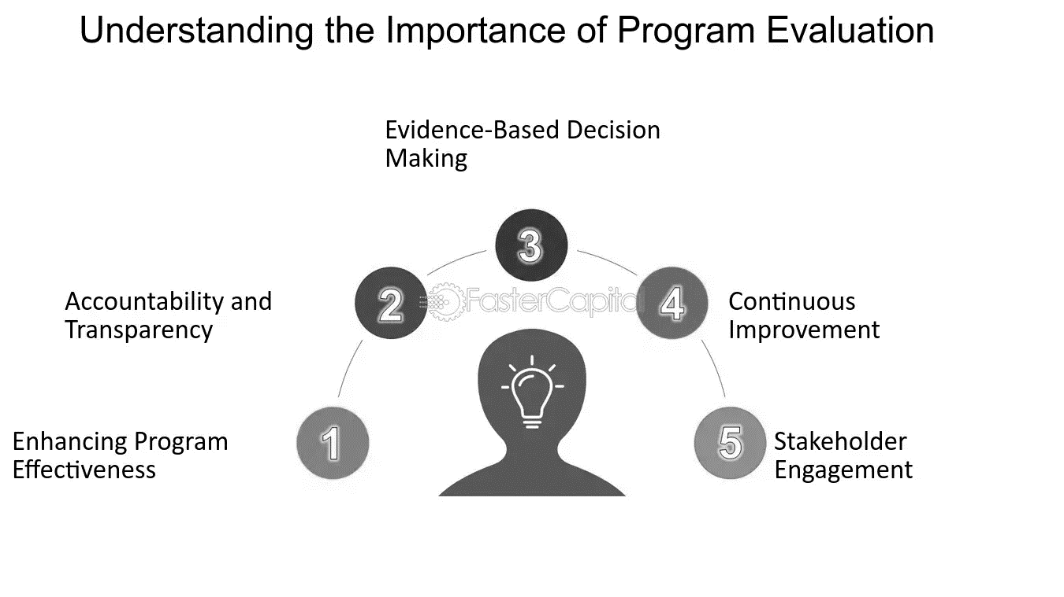
Program evaluations help program managers and funders improve effectiveness, make better judgments, or make programming decisions.
Notes:
Lack of stakeholder involvement during the design phase. Evaluations are often conceived in isolation, leading to reports that collect dust on a shelf rather than catalyzing change.

Slide 3
Unlocking Collective Expertise: Using Collaborative Evaluation Process to Strengthen Evaluation Capacity of Clients.
...Reflections of an Emerging Evaluator
Damilola Seyi-Oderinde, PhD
Evaluation and Learning Research Center, Purdue University

Slide 4
How did I get here?
Counselor
+
Faculty Member

Slide 5
Program Evaluation
Improvement
Design
Evaluation
Learning
Program efficacy depends on the design quality and continuous learning and improvement enabled by a robust evaluation process.
Notes:
Program efficacy depends on the design quality and continuous learning and improvement enabled by a robust evaluation process.

Slide 6
External evaluators often introduce a complex dynamic where they are seen as outsiders and perceived as threats.
This dynamic can jeopardize the effectiveness of the evaluation process due to perceived or actual tensions.

Slide 7
Value of Collaborative Evaluation
Collaborative approaches to program evaluation foster a deeper understanding of the context and elevate multiple perspectives.

Slide 8
Value of Collaborative Evaluation
Ensures data collection instruments are appropriate in content and tone and also represent diverse voices.
Notes:
This approach ensures data collection instruments are appropriate in content and tone, and that diverse voices are heard and incorporated.

Slide 9
Space Grant Consortium & ELRC
Their Goal:
To increase NASA’s educational and outreach activities with the intention of supporting STEM workforce development by studying how authentic experiential learning translates into professional STEM success.

Slide 10
Challenges Implementing Collaborative Evaluation in STEM programming
Technical and interdisciplinary complexity
Limited or non-existing knowledge of program management and evaluation by program leaders
Rapid innovation and changes in the field
Balancing practical vs conceptual program elements

Slide 11
Four-phase Collaborative Evaluation Model
Phase 1
Program Definition and Documentation
Phase 2
Evaluation Planning
Phase 3
Data Gathering and Analysis
Phase 4
Learning and Adaption

Slide 12
Phase 1
Phase 1
Program Definition and Documentation
Phase 2
Evaluation Planning
Phase 3
Data Gathering and Analysis
Phase 4
Learning and Adaption
Key Ingredients:
Activities
Engage Leadership and key personnel
Review documents
Create and review Theory of Change
Establishing Mutual Trust
Communication and transparency
Relationship building
Learning Posture
Active listening
Flexibility and responsiveness
Consensus Program Model

Slide 13
Phase 2
Phase 1
Program Definition and Documentation
Phase 2
Evaluation Planning
Phase 3
Data Gathering and Analysis
Phase 4
Learning and Adaption
Key Ingredients:
Activities
Refine questions and success indicators
Develop or adapt instruments
Develop data collection process
Establishing Mutual Understanding of Objectives
Alignment of expectations
Prioritizing outcomes
Capacity Building
Knowledge transfer
Sustainability focus
Real-time adjustment
Collaborative problem-solving
Comprehensive Evaluation Plan
Notes:
Flexibility to adapt and respond to partners’ needs
Collaborative problem-solving
Real-time Adjustment

Slide 14
Phase 3
Phase 1
Program Definition and Documentation
Phase 2
Evaluation Planning
Phase 3
Data Gathering and Analysis
Phase 4
Learning and Adaption
Key Ingredients:
Activities
IRB approval
Key stakeholder data collection
Begin analysis and report initial findings
Shared Ownership
Equal stakeholder participation
Consensus building
Feedback loops
Continuous improvement
Contextual Sensitivity
Social context
Tailored approach
Initial Evaluation Analysis Presentation
Notes:
Flexibility to adapt and respond to partners’ needs
Collaborative problem-solving
Real-time Adjustment

Slide 15
Phase 4
Phase 1
Program Definition and Documentation
Phase 2
Evaluation Planning
Phase 3
Data Gathering and Analysis
Phase 4
Learning and Adaption
Key Ingredients:
Activities
Facilitate evaluation workshop
Develop evaluation findings, lessons learned, and planned adaptations
Mutual Learning
Self-awareness
Positionality
Knowledge exchange
Shared reflection
Facilitator Neutrality
Objective guidance
Clear documentation and follow-up
Full Evaluation Report
Notes:
Flexibility to adapt and respond to partners’ needs
Collaborative problem-solving
Real-time Adjustment

Slide 16
My Reflections
Balancing the tension between expert knowledge and ensuring all voices are included is key.

Slide 17
My Reflections
Regular communication and transparency kept stakeholders invested and encouraged participation.

Slide 18
My Reflections
Co-developing plans empowered stakeholders and led to more useful and relevant evaluation outcomes.

Slide 19
My Reflections
Dynamic feedback loops facilitated data collection and analysis, providing more actionable insights.
Notes:
A dynamic feedback loop facilitated data collection and analysis process refinement and helped transform our collective evaluative capacities. This growth in evaluative capacity led to richer, more actionable insights.

Slide 20
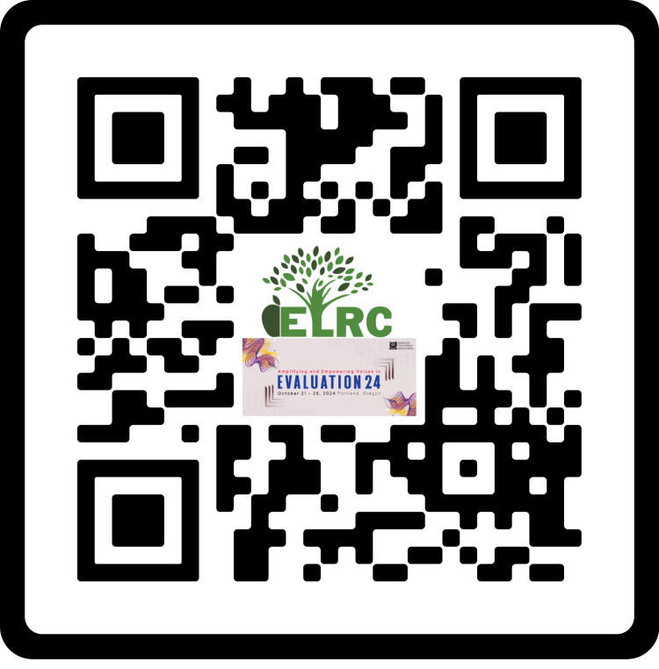
Thank You
Collaborative evaluation unlocks collective expertise and creates impactful outcomes.
Let’s embrace collaboration for stronger, more effective programs.

