Slide 1
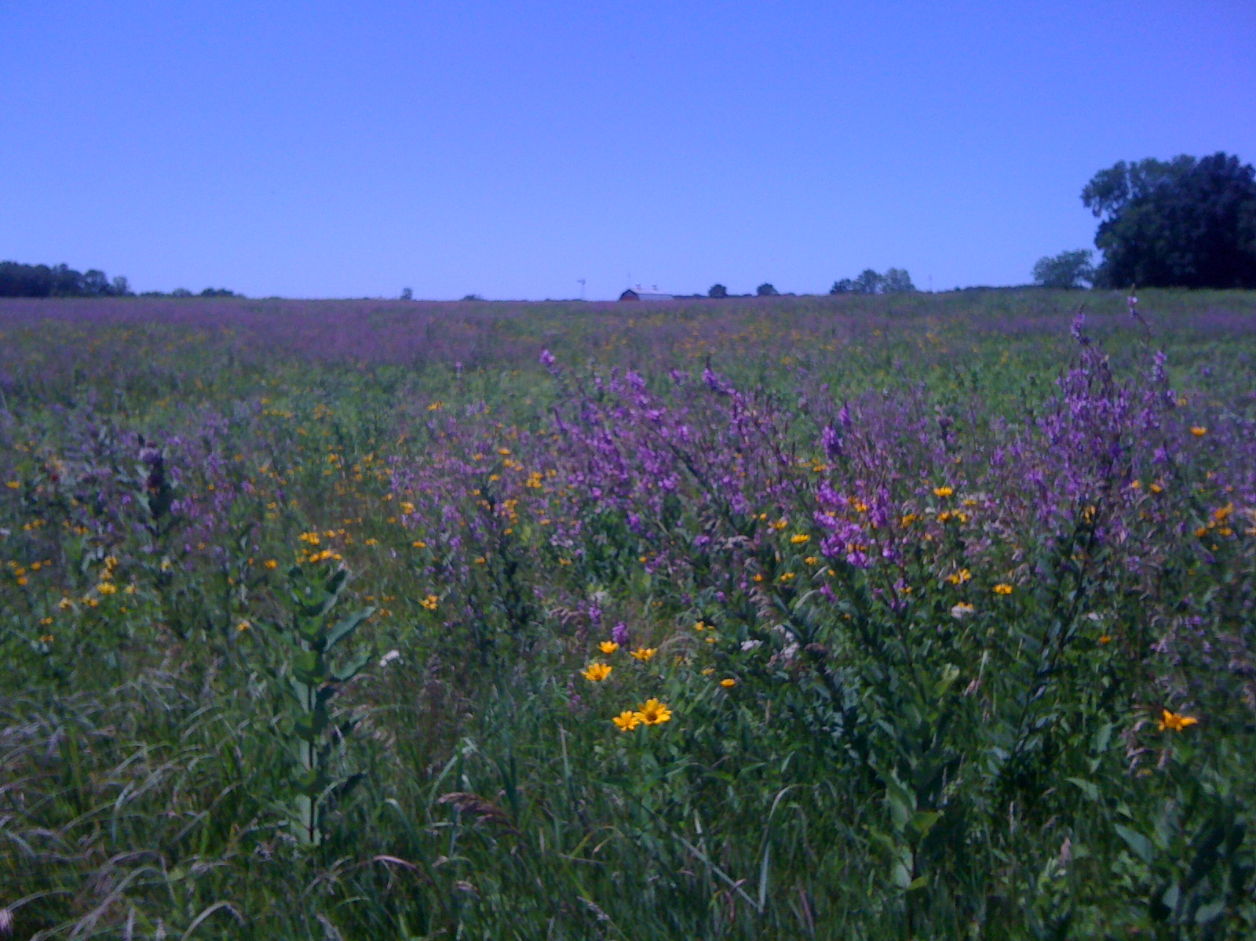
Tallgrass Prairie Module
BIOL 585 – Fall 2011

Slide 2
Tallgrass Prairie Module
Overall objectives:
Understand how disturbance can structure communities
Become familiar with a natural local ecosystem
Work with data: graphing, interpreting, exploring, analyzing
Learn transect-based vegetation sampling technique
Appreciate the complexities of restoration ecology
Schedule:
Week 1: Figure set activity (LAB)
Week 2: Field sampling at Prophetstown State Park (FIELD)
Week 3: Data analysis & interpretation (LAB)
Week 4: Discussion and literature review (LAB)

Slide 3
Grassland Biome
Grasslands are lands dominated by grasses rather than trees or shrubs
Climate:
Generally intermediate between deserts and forests
Highly variable in space and time
Globally, there are two “types”
Tropical grasslands (savannas)
Temperate grasslands

Slide 4
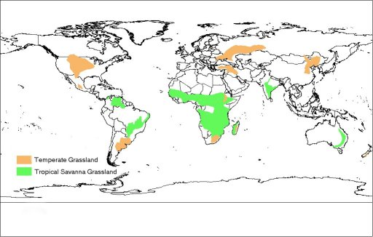
Grassland Biome
http://www.bcgrasslands.org/library/world.htm
Notes:
Tropical savanna grasslands (green):
Occur near the equator: mostly 50-20 degrees N and S
Cover almost half the surface of Africa (about five million square miles, generally central Africa) and large areas of Australia, South America, and India
Rolling grasslands with scattered trees and shrubs
Two distinct seasons: hot, rainy summer (> 35 deg C/95 deg F) and cool, dry “winter” (rarely falls below 10 deg C/ 50 deg F); RAINFALL IS CONCENTRATED DURING 6-8 MONTHS OF THE YEAR, FOLLOWED BY A DRY WINTER PERIOD WHERE FIRES OCCUR
Soils are generally very nutrient poor
Historically characterized by vast herds of grazing herbivores (Most famous: Serengeti Plains of Tanzania!)
Temperate grasslands:
Occur in mid continental regions of mid-latitudes where annual precipitation declines as the air masses move inland from the coastal regions
Drier than savannas and forests but wetter than deserts – the climate is highly variable in space and time
50.8 to 88.9 cm (20-35 in.) annual precipitation
Temperatures between 38° C (100 ° F) in the summer to --40° C (-40 ° F) in winter
Generally no woody vegetation at all
(NOTE: next slide gives more info on Temperate grasslands)

Slide 5
Temperate grassland ecosystems
Originally covered >40% of the earth’s land surface
Only about 12% remain due primarily to conversion to cropland and pasture
Flat topography
Lack of woody vegetation / dominated by grasses
Rich soil
Major temperate grasslands of the world:
Prairie of North America
Steppes of Central Eurasia
Pampas of Argentina and Uruguay
Veldts (high plateaus) of southern Africa

Slide 6
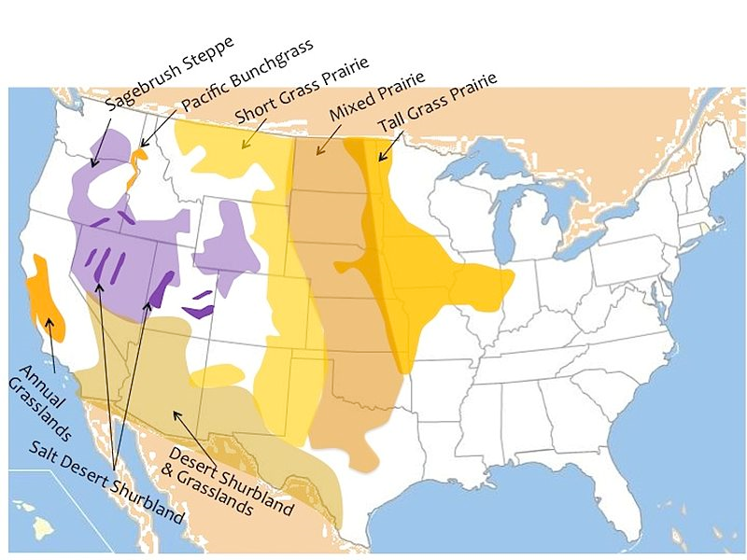
North American Temperate Grasslands
Konza Prairie
Purdue University
& Prophetstown State Park
Increasing precipitation
http://en.wikipedia.org/wiki/File:NAMAP.jpg
Notes:
There are many types of grasslands in North America (see map)
The most prominent are the prairies, which encompass the middle portion of the U.S., east of the Rocky Mountains, north of the desert shrublands and grasslands, and west of the eastern deciduous forest
The North American Prairies can be further subdivided into 3 types:
Shortgrass prairie
Mixed-grass prairie
Tallgrass prairie
(ADVANCE SLIDE TO SHOW GRADIENT)
These prairie types sort across an east-west precipitation gradient: the short-grass prairie is in the driest region, the tallgrass prairie in the wettest region, and the mixed prairie is in mesic areas
(ADVANCE SLIDE TO SHOW OUR LOCATION)
Note where West Lafayette falls on this map: at the very tip of the eastern distribution of the tallgrass prairie. Historically, our landscape was a patchy mix of prairie and forest – makes this a very interesting ecological region to investigate. In this module, we focus on prairie grasslands, and particularly tallgrass prairies.

Slide 7
North American Prairies
Types of plants in the prairie:
Grasses
Forbs – non-woody, non-graminoid
Why are there no woody plants?
Climate
Disturbance (fire)
Herbivory (grazing)
Notes:
The grasslands originated and have persisted due to a complex interplay among variable continental climate, fire and herbivory.
The characteristic feature, of course, is that grasslands are dominated by GRASSES, and not woody trees or shrubs.
What prevents trees from establishing in prairies? A combination of dynamic factors -
Climate: much less precipitation than in the forests north and east of the prairie region in the U.S.; more precipitation than desert scrubland and grasslands to the south. BUT precipitation and temperature alone do not explain the vegetation alone, because warmer, cooler, drier and wetter climates are dominated by woody plants. That is, trees can persist under the climatic conditions of the prairie region in the U.S.
Fire has played a key role in the removal of woody vegetation and maintenance of grass-dominated prairies. Both natural (e.g. by lightening) and - both recently and historically - human-induced fires have kept trees and woody shrubs at low densities.
Similarly, the prairie was historically dominated by large numbers of herbivores, including the large ungulates (like bison) as well as large populations of small mammals, birds, and insects
Important, these processes interact with the morphology and physiology of grasses to facilitate their dominance in the landscape.

Slide 8
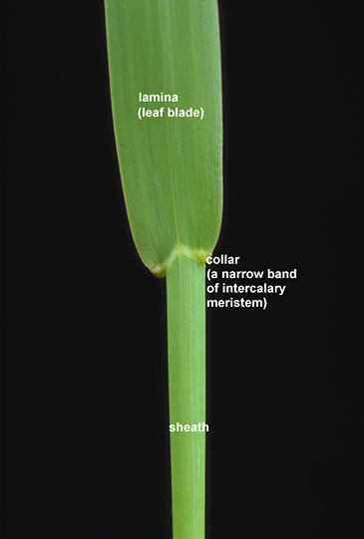
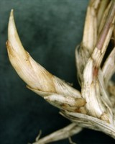
Tallgrass Prairie Plants
Why are grasses so tough?
During their vegetative growth phase -
apical meristem is near or below the ground
leaves grow from base, not tips
“bud bank”
http://www.ext.colostate.edu/pubs/natres/06108.html
www.cnr.usu.edu/htm/facstaff/adler-web/harmony-research
http://www.fsl.orst.edu/forages/projects/regrowth/
Notes:
There are several traits that allow grasses to persist, and even come to dominate in areas where they are eaten, burnt and trampled upon.
1) During their vegetative phase, the primary growing structure of aboveground leaves and stems (the apical meristem) is near the base of the plant, or even underground. In most non-grass vascular plants, this region is at the top of the stem of a plant during vegetative growth, where it is vulnerable to herbivores and fire. If this structure is damaged, the plant cannot continue vertical growth. By keeping this structure close to the ground – or even below ground – during vegetative growth, grasses can grow back even after above-ground tissue is removed by herbivores or fire.
2) Similarly, the region of leaf expansion is near the stem (the intercalary meristem) in a structure called the “collar”. In non-grass species, leaf growth occurs at the tips of leaves. This characteristic of grasses allows them to re-grow leaves after damage occurs to the end of the leaf (such as through grazing or fire)
3) Many grasses also maintain a “bud bank” below ground, which are meristem structures that allow clonal propagation. Thus, even if the primary plant is severely damaged or killed by fire or herbivory, these buds allow rapid clonal growth to replace the original individual.
AS LONG AS GRAZING OR FIRE DISTURBANCE DOES NOT DAMAGE THE MERISTEMS DURING THIS TIME, GRASSES CAN CONTINUE TO GROW AFTER THE DISTURBANCE. OFTEN REMOVING THE FOLIAGE ACTUALLY STIMULATES MORE VEGETATIVE GROWTH.

Slide 9
Tallgrass Prairie Plants
BUT when a grass transitions to flowering mode
the apical meristem elevates and leaf sheath elongates, raising the growing regions off the ground
if the apical meristem is removed, seed production will stop
if the leaf collars are removed, the leaves will not grow back
in general, grasses do not recover well from damage during the transition or reproductive phases
Notes:
HOWEVER, grasses become relatively vulnerable when they transition to the reproductive phase.
At this point, the apical meristem elevates from its previously safe position at the base of the plant, and the leaf meristems also are extended outward from the base of the leaf.
If these meristematic tissues are damaged or removed during fire or grazing, it is relatively difficult for the plant to recover.

Slide 10
Grass Ecophysiology
Cool-season (C₃) grasses:
Begin growth in early spring & flower in early summer
Do not grow during hot midsummer months
May grow again in the fall as temperatures cool and late summer precipitation replenishes soil moisture
Warm-season (C₄) grasses:
Begin growth in late spring & flower in late summer
Use soil moisture more efficiently than cool-season species and often can withstand drought conditions.
Generally more fibrous, contain more lignin, and are less digestible than C3

Slide 11
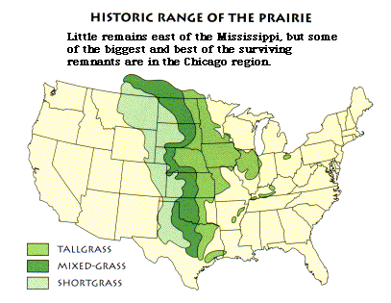
Climate and Grass Ecophysiology
Cool
C₃> C₄
Temperature
gradient
C₄> C₃
Warm
Dry
Wet
Precipitation gradient
http://www2.mcdaniel.edu/Biology/wildamerica/grasslands/graslandoutline.html
Knapp & Seastedt (1998). Fig. 1.2 in Grassland Dynamics, eds. Knapp et al.
Notes:
The differences in C3 and C4 temperature tolerances is reflected in their distributions in North America.
Because C4 grasses are more tolerant of warmer conditions, and C3 grasses are more tolerant of cooler conditions, we see a shift in the photosynthetic physiology along a north-south gradient in temperature across the tallgrass prairie region in North America

Slide 12
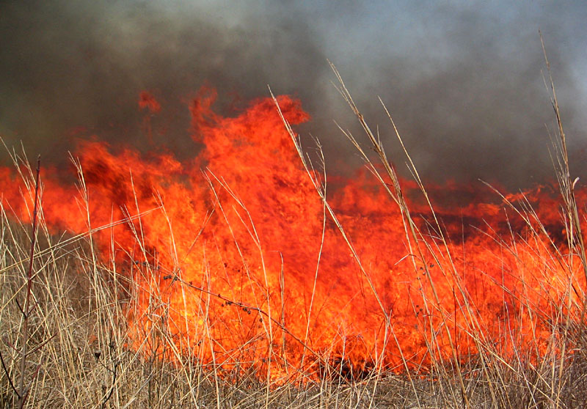
Fire and Grass Ecophysiology
http://academic.emporia.edu/aberjame/ice/lec18/lec18.htm
Notes:
Fire can have many positive effects that benefit plants:
Release nutrients back to the soil
Increase soil temperature
Opens up space
BUT, JUST LIKE GRAZING – THE TIMING IS IMPORTANT OR IT WILL NEGATIVELY IMPACT NATIVE SPECIES.
BUT also can damage plants if occur at the right time of year!

Slide 13
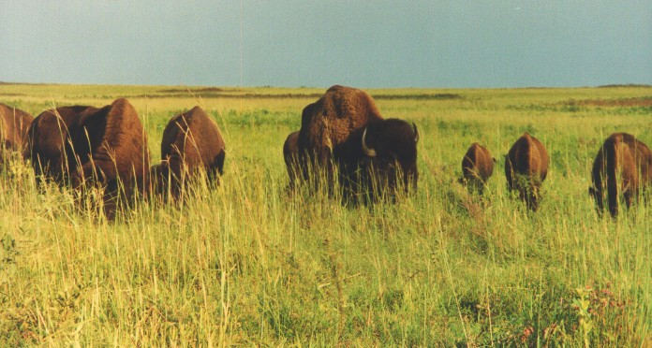
Grazing and Grass Ecophysiology
Grazers generally prefer C₃ grasses over C₄ species at the same stage.
…but they will also prefer new growth to old growth
Grazer preference for C₃ or C₄ can vary with the time of year
Notes:
If a grazer is allowed to choose between a C3 grass and a C4 grass that are at the same development stage, they will generally prefer the C3 grass because it is less defended.
However, grazers also prefer new leaf tissue compared to old leaf tissue (new tissue is more digestible and has higher protein content), so at certain times of the year they will prefer newly growing C4 grasses over older C3 tissue – like in the late summer when the C3 grasses are entering their reproductive period and C4 grasses are just sending up new growth
Grasses are most negatively affected when grazed during their reproductive period and least affected during dormancy.
SO the effects of fire and grazing on C3 vs. C4 plants depends on the time of the year

Slide 14
Effects of Disturbance on Prairie Plants
The effects of grazing and fire on tallgrass prairie plant communities depends on:
(1) the timing of the disturbance
(2) the frequency of the disturbance
(3) the intensity of the disturbance
Notes:
To summarize, the impacts of fire and grazing disturbances on prairie ecosystems depends on the nature of the disturbance:
The timing of the disturbance, particularly relative to the growth status of the plants
The frequency of the disturbance: remember succession? Too much disturbance only allows colonists to persist, while too little disturbance would allow competitive dominants (such as woody species) to take over
The intensity of disturbance: a similar concept to the intensity – a disturbance that is too severe will wipe out everything, or too mild will not differentially affect the species in the community

Slide 15
Effects of Disturbance on Prairie Plants
The effects of grazing and fire on tallgrass prairie plant communities depends on:
(1) the timing of the disturbance
(2) the frequency of the disturbance
(3) the intensity of the disturbance
Notes:
In today’s lab we are going to explore the impacts of the timing of the disturbance on tallgrass prairie plants.

Slide 16
Effects of Disturbance on Prairie Plants
Today’s lab
The ecological question:
How does the timing of fire disturbance impact plant populations and communities in the tallgrass prairie?
Specific objectives:
Develop a quantitative understanding of the effects of disturbance on community structure by examining the data presented in a published manuscript.
Present and interpret data in a graphical format using an existing long-term data set.
Investigate the sources of variation within a data set, and the consequences of grouping biological units into larger entities for the interpretation of results.
Notes:
In today’s lab we are going to explore the impacts of the timing of the disturbance on tallgrass prairie plants.

Slide 17
Effects of Disturbance on Prairie Plants
Next week:
Restoration ecology: using disturbance to manage diversity
Come prepared!
Long pants, long sleeves
Sunblock & hat – or raincoat and umbrella!
Water
Energy & a positive attitude
Notes:
Next week we will go to a tallgrass prairie restoration site at Prophetstown State Park to sample two parcels that experience different burn treatments – one summer and one fall.
Our sampling design will be very similar to the design in the paper that serves as the focus of lab today.
The lab handout will be posted on Blackboard on Monday, including a (very brief) pre-lab assignment that you will turn in at the beginning of lab.

