Slide 1
4th Grade SLED Activity on Transportation Systems
Ann Kirchmaier, PU Biochemistry
John Lumkes, PU Agriculture & Biological Engr
Jaime Peterson, Woodland Elementary
Jill Shambach, Woodland Elementary
Kendra Erk, PU Materials Engineering

Slide 2
Lesson Objectives and Standards
In this lesson, students will be able to:
  Describe the basic forces that act on a moving system and influence its motion
  Design a structure to change the forces acting on a moving transportation system
Indiana Standards:
  Standard 4.PS.1: Investigate transportation systems and devices that operate on or in land, water, air, and space and recognize the forces (lift, drag, friction, thrust, and gravity) that affect their motion.
  Standard 4.PS.2: Investigate the relationship of the speed of an object to the energy of that object.
  Standard 3-5.E.1: Identify a simple problem with the design of an object that reflects a need or a want. Include criteria for success and constraints on materials, time, or cost.

Slide 3
Teacher Notes
Introduction structured in three parts
  General introduction to transportation systems
    Land, water, air, space
      Manmade and examples from nature
  Expansion of land-based examples
    Examples of different vehicles designed for different applications and land surfaces
      Emphasizes how the vehicle interacts with different surfaces to produce forces to move and turn the vehicles
  Transition to inquiry based background
    More specific examples of surface profiles and forces on those surfaces

Slide 4
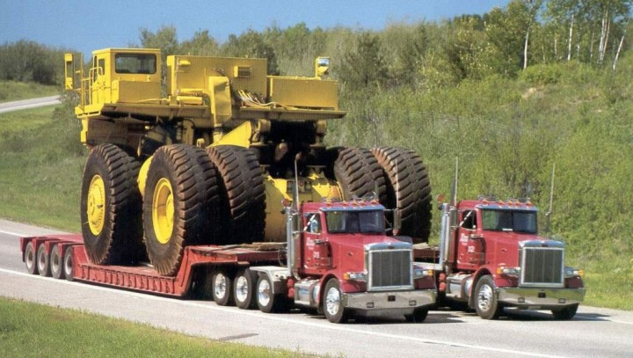
Introduction to Transportation Systems
http://hooniverse.com/2010/11/11/
original source: http://long-haul-truck-insurance.com/yabb/YaBB.pl?num=1236746004/2
Notes:
What two extremes of tire sizes and quantities are in the picture? Why?

Slide 5
Lesson Vocabulary
Force
  Interaction between physical bodies that create a pushing or pulling on the bodies
  A push or a pull
Work
  The product of force and motion
  When a force moves an object
Gravity
  The force exerted by celestial bodies that acts to pull objects to their centers
  The force that keeps us on earth; prevents us from flying into space
Friction
  An force opposing relative motion between objects
  A force that holds back the movement of an object (i.e. skating on an ice rink vs. skating on carpet)
Transportation System
  A system to take people or objects to other places
Motion
  The act of moving or changing places
Direction
  The way in which something travels or faces
Speed
  How fast or slow an object moves during a unit of time
Distance
  Measure of space between things or places
Wheel
  A round object that turns in circles and allows for things to move
Weight
  How heavy or light an object is
Mass
  The amount of matter something contains
Texture
  The feel or look of a surface
Notes:
Add reference…

Slide 6
How do vehicles move?
Force
  Forces acts on transportation system to influence motion and change direction.
Question?
  What are the common environments where we see vehicles in motion?
    Land
    Air
    Water
    Space

Slide 7
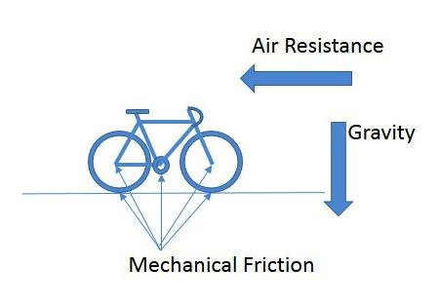
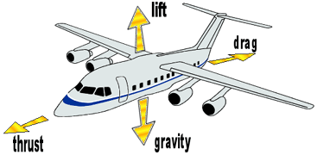
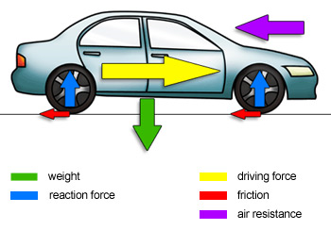
Forces on Transportation Systems
http://breakingmuscle.com/cycling/
http://aermech.com/wp-content/uploads/2014/03/forces1.gif
http://www.bbc.co.uk/schools/gcsebitesize/science/images/carforces.jpg
Notes:
All vehicles move because there are forces acting on the vehicle. Forces can come from contact with air, water, land, etc.

Slide 8
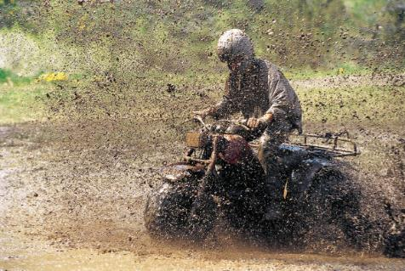
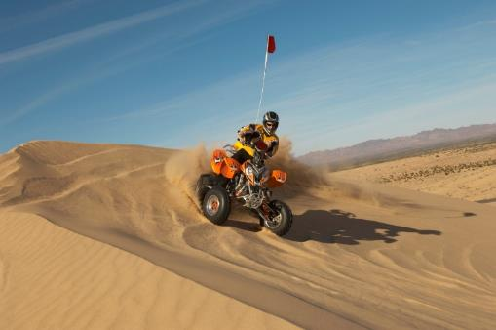
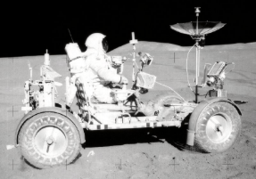
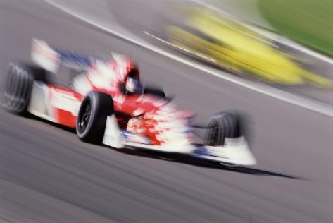
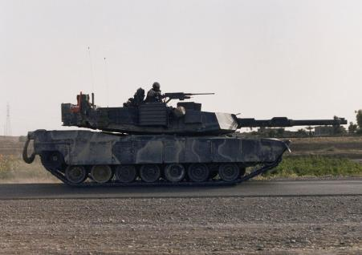
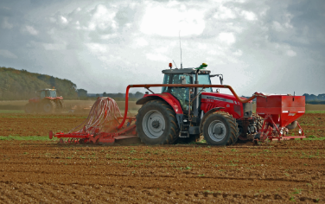
Moving Systems and Forces
Forces between moving systems and LAND
Images from commons.wikimedia.org unless noted

Slide 9
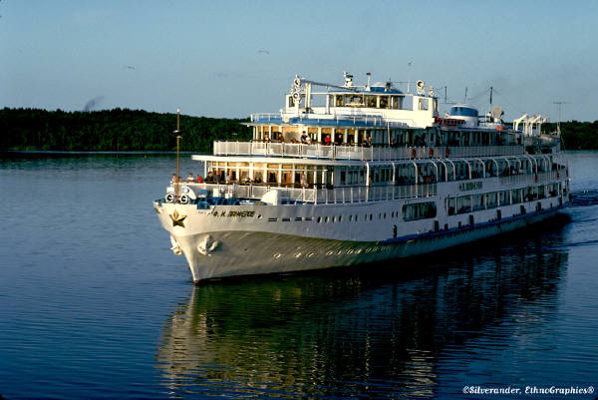
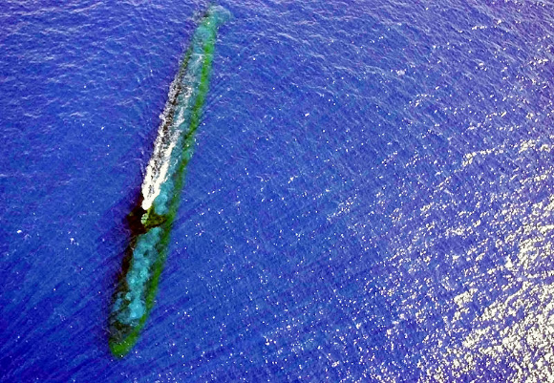
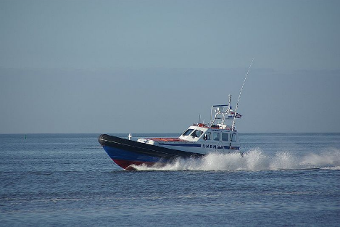
Moving Systems and Forces
Forces between moving systems and WATER
Images from commons.wikimedia.org
Notes:
Forces between the water and boats or submarines allow the vehicles to move and turn.

Slide 10
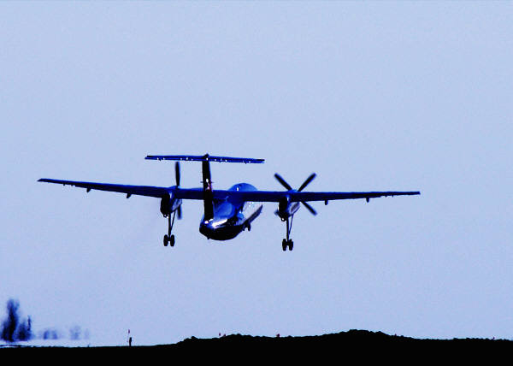
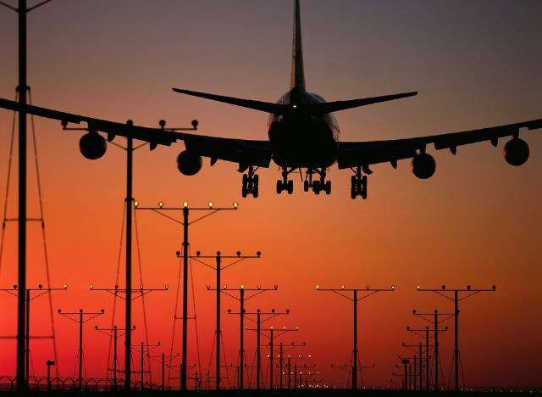
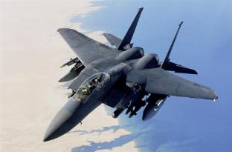
Moving Systems and Forces
Forces between moving systems and AIR
Images from commons.wikimedia.org

Slide 11
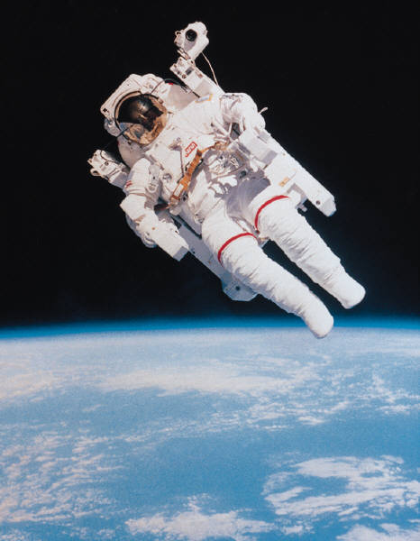
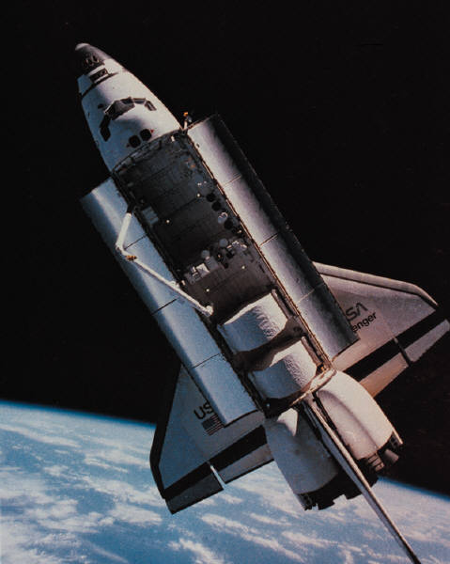
Moving Systems and Forces
Forces between moving systems and SPACE
Images from commons.wikimedia.org

Slide 12
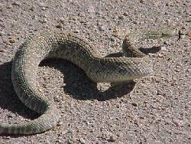
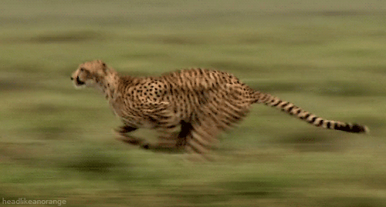
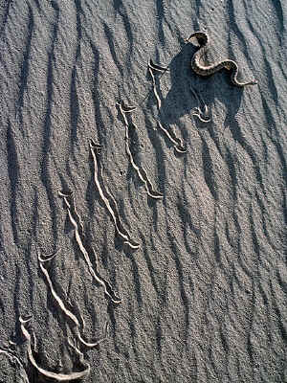
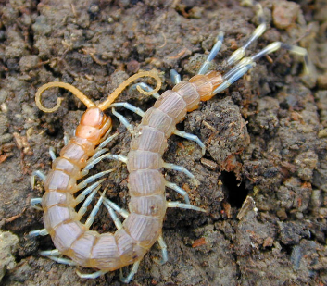
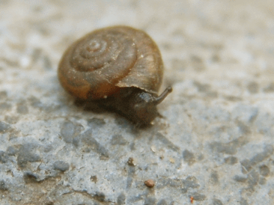
Moving in Nature
Movement in nature on LAND
http://media3.giphy.com/media/7lz6nPd56aHh6/giphy.gif
http://www.kidzone.ws/lw/snakes/facts04.htm
Images from commons.wikimedia.org unless noted
Notes:
Animals on land have many different forces during motion.

Slide 13
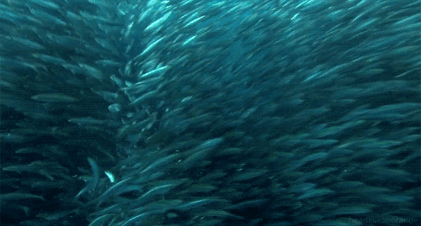
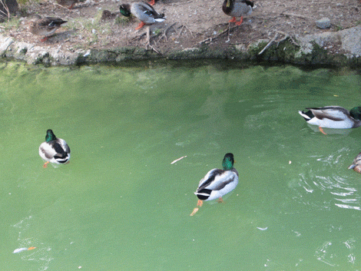
Moving in Nature
Movement in nature in WATER
http://www.vh1.com/celebrity/bwe/images/2011/10/DUCKS-SWIMMING-1317829415.gif
http://www.totalprosports.com/wp-content/uploads/2013/08/school-of-fish-getting-out-of-sharks-way-shark-gifs.gif
Notes:
Notice how fish and ducks have different forces acting on them (interaction with the water around them) to help them move.

Slide 14
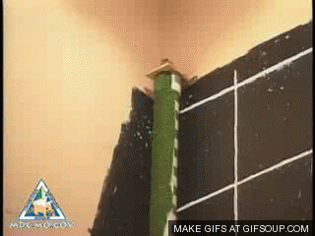
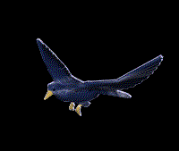
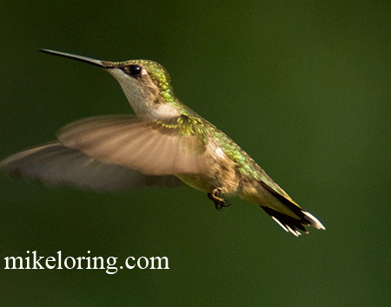
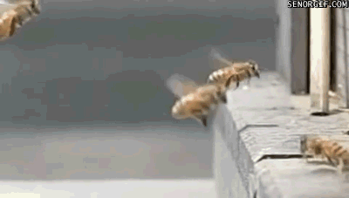
Moving in Nature
Movement in nature in AIR
http://stream1.gifsoup.com/view1/2187590/flying-squirrel-o.gif
http://bestanimations.com/Animals/Birds/Bird-06-june.gif
http://media.giphy.com/media/Wbpn9ztRjA47e/giphy.gif
http://m4.i.pbase.com/o6/51/741251/1/83642104.ebni6mJA.hummingbirdanimation.gif

Slide 15
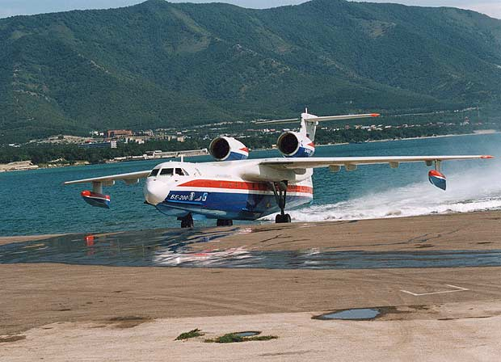
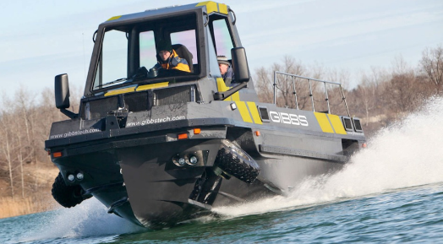
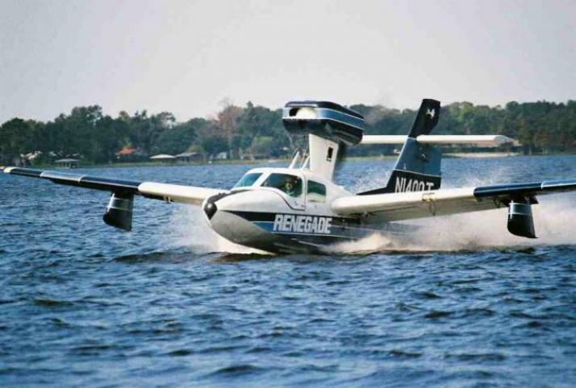
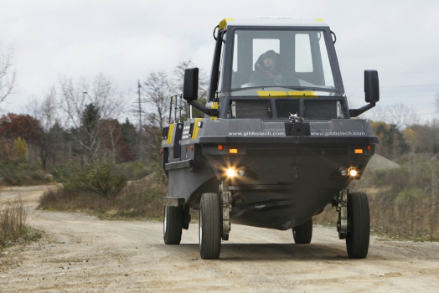
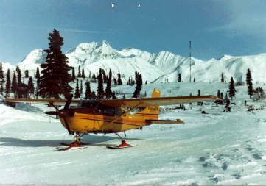
What about?
Land and water, air and water…
http://www.aerospace-technology.com/projects/beriev_be-200/images/be200_2.jpg
http://www.egmcartech.com/wp-content/uploads/2012/02/gibbsAmphibian-03.jpg
http://www.plane-land.net/wp-content/uploads/2012/03/Amphibious-Planes5.jpg
http://i85.photobucket.com/albums/k51/dcogger/Airlpanes/SKIPLANE.jpg?t=1291697752
Notes:
Some vehicles are design to move on different surfaces, like land and water, snow and air.

Slide 16
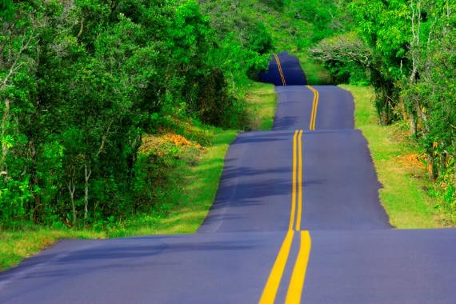
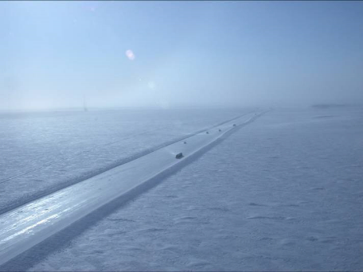
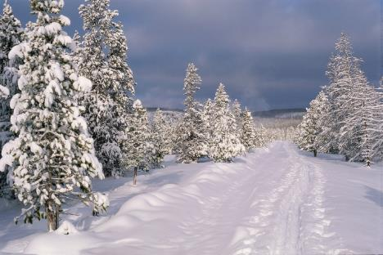
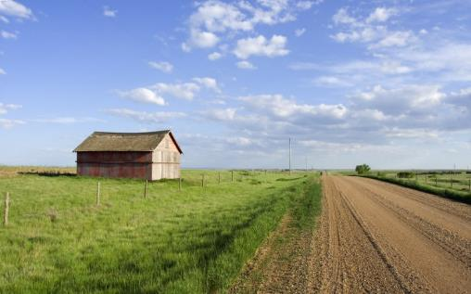
Let’s take a closer look at land vehicles!
How many types of surfaces can you list?
  Roads
    Gravel
    Asphalt
    Concrete
  Off-road
    Sand
    Dirt/mud
    Rocks
    Snow
    Ice

Slide 17
Land Surface Profiles
Paved/concrete roads
Gravel
Rocks

Slide 18
What land transportation systems can you list?
Personal human powered
  Skateboards, roller blades, bicycles (road/mountain)
Off-road vehicles
  Motorcycles (road/dirt), ATV, go-karts, snowmobiles
Vehicles
  Cars, trucks, buses, trains
Utility
  Tractors, construction equipment, ski slopes, forestry

Slide 19
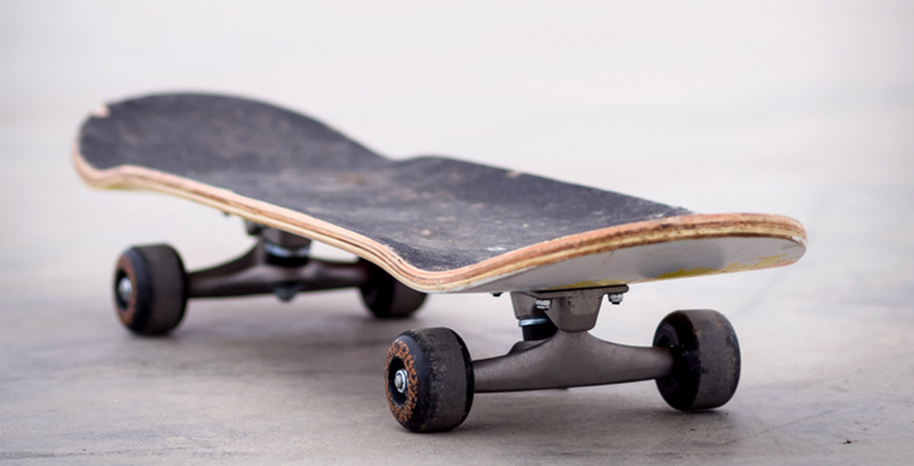
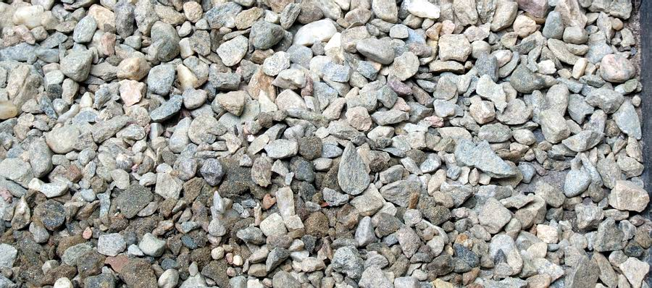
What kind of transportation system would you pick for…and why?
Roads
  Gravel
  Asphalt
  Concrete
Off-road
  Sand
  Dirt/mud
  Rocks
  Snow
  Ice
What happens if you use your skateboard on gravel? Why?

Slide 20
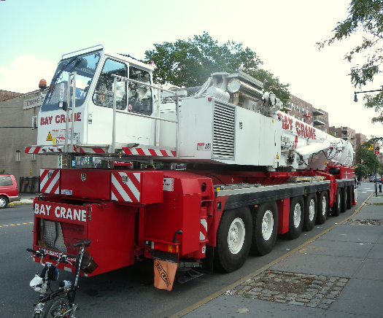
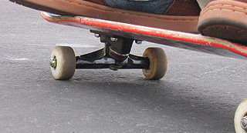
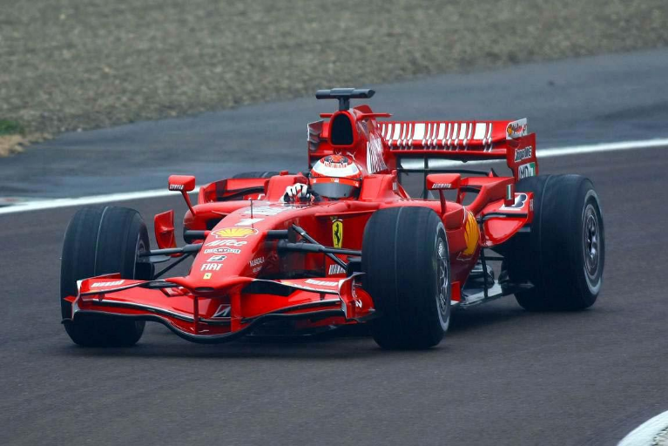
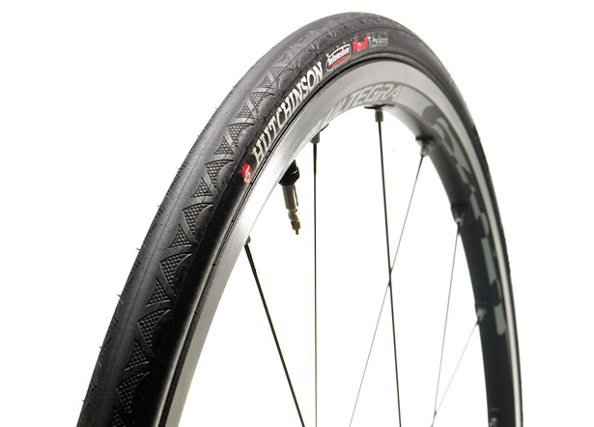
Roads/Sidewalks
http://upload.wikimedia.org/wikipedia/commons/thumb/5/5d/Skateboard.JPG/320px-Skateboard.JPG
http://upload.wikimedia.org/wikipedia/commons/1/18/Bay_Crane_Liebherr_Union_St_39_Av_jeh.jpg
http://www.bicycling.com/sites/default/files/images/Hutch-Tire2.jpg
http://www.wallpapersad.com/wp-content/uploads/2013/02/Ferrari-F1-Racing-Car.jpg
Notes:
We use different vehicles for different surfaces (race cars vs. off road trucks, road bikes vs. mountain bikes, gokarts vs. snowmobiles, etc.)

Slide 21
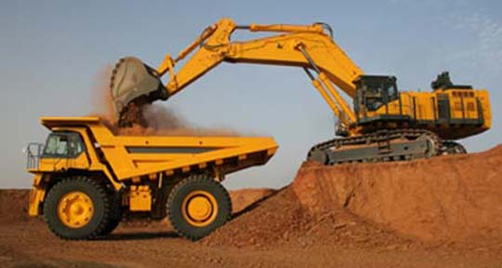
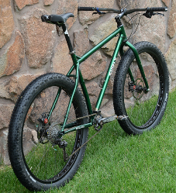
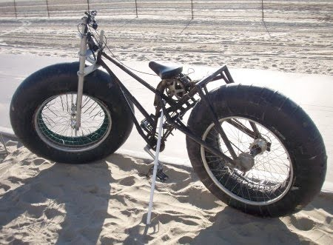
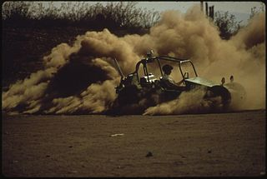
Sand/Gravel
http://theinsurancestores.com/wp-content/uploads/2011/10/Insurance-Solutions_Dirt-SandGravel.jpg
http://gearjunkie.com/fat-tire-29er-mountain-bike
http://upload.wikimedia.org/wikipedia/commons/thumb/a/ae/SAND_VEHICLE...
http://2.bp.blogspot.com/-OIK5OAowFPQ/TaWSb5XILAI/AAAAAAAACMk/kPaJ7BKDnts/s1600/Custom_Beach_Bike.jpg
Notes:
What do you notice about size and thickness of tires vs. how hard the surface is (road vs. sand), or by how rough the surface is (paved road vs. gravel)?

Slide 22
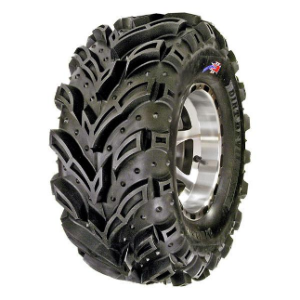
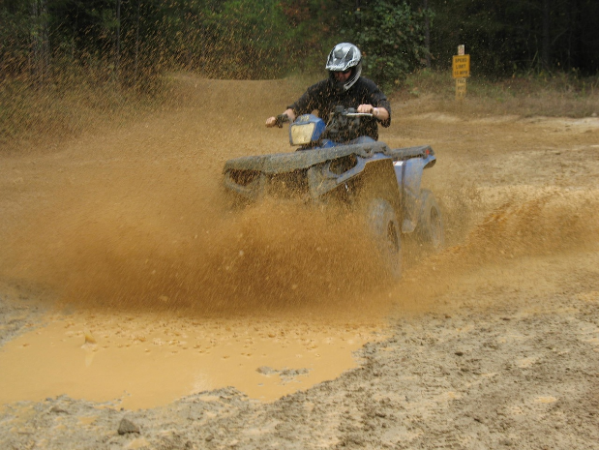



Dirt/mud
http://www.specialtytiresusa.com/atv-offroad-vehicles/
http://0.tqn.com/d/construction/1/0/H/F/-/-/DOZER-ELSIE-ESQ.jpg
http://myamericanodyssey.com/wp-content/uploads/2013/11/Carolina_Adventure_World_8.jpg
http://hewittfarmsinc.files.wordpress.com/2013/05/dsc0293edit.jpg
Notes:
Some vehicles use tracks to produce forces to move on very soft surfaces, or use tires with big bars on the outside.

Slide 23


Rocks
http://www.hobby101.com/rock%20crawling.htm
http://www.charlottemotorspeedway.com/images/CRAWLMFBuggie01_lg.jpg
Notes:
How big are these tires? Why?

Slide 24



Snow
http://theadventourist.com/snowmobiling-the-backcountry-and-beer-tasting-in-central-oregon
http://upload.wikimedia.org/wikipedia/commons/thumb/3/3c/Flickr_-_Israel_Defense_Forces_-_Riding_Stunts.jpg/640px-Flickr_-_Israel_Defense_Forces_-_Riding_Stunts.jpg
http://commons.wikimedia.org/wiki/File:Snow_vehicle_in_Alert,_Nunavut.jpg
Notes:
What would happen if you tried to drive a car, your bicycle, or your skateboard on these surfaces?

Slide 25






Unique animals on land
Elephants
http://www.viralnova.com/hidden-dam/
Alpine ibexes
on a dam,
Northern Italy
http://bookbuilder.cast.org/view_print.php?book=41199
Gecko foot
on glass
http://en.wikipedia.org/wiki/File:Gecko_foot_on_glass.JPG
http://www.core77.com/blog/education/biomimetic_designers_take_note_goat_hooves_confer_ninja-like_climbing_abilities_18851.asp
Notes:
Animals have also adapted different ways to move on different surfaces!

Slide 26
Introduction to Inquiry
Why might we intentionally design a surface to produce forces on a vehicle?
  Can you think of some examples?
  Hint: when we don’t want cars to hit each other or go someplace that is dangerous.
Two common ways:
  Designing a surface
  Design a barrier

Slide 27


Surfaces designed to produce forces to safely stop vehicles
http://upload.wikimedia.org/wikipedia/commons/0/08/Runaway_truck_
ramp_east_of_Asheville,_NC_IMG_5217.JPG
http://upload.wikimedia.org/wikipedia/commons/1/11/A7-Notbremsweg.jpg
http://www.youtube.com/watch?v=6CraHAiYzfU

Slide 28
Designing a Runaway
Truck System
http://www.youtube.com/watch?v=h-VbZb3q_T8
https://www.youtube.com/watch?v=1fcE5Dvf6ew

Slide 29




Systems designed to safely stop vehicles
http://img.archiexpo.com/images_ae/photo-g/road-safety-barriers-88366-6520243.jpg
http://www.energyabsorption.com/products/images/stopgate-1.gif
http://www.energyabsorption.com/products/images/universal-barrel-3.gif
http://www.grandprix.com/jpeg/misc/barriersfig1-lg.jpg

Slide 30
Inquiry Activity
Inquiry activity to introduce students to the effect of different surfaces on the motion of a car or truck.
Toy car
Surface options: bubble wrap, sand paper, towel, marbles…
3’’ binder “hill”
Measure distance travelled on different surfaces
Notes:
Inquiry
Design brief
Design activity
Assessment
Literature
Closing.

Slide 31
Surface & Vehicle | Distance (cm) | Direction Change
Carpet – Car |  | Y N
Carpet - Truck |  | Y N
Foam – Car |  | Y N
Foam – Truck |  | Y N
Marbles – Car |  | Y N
Marbles – Truck |  | Y N
Sand – Car |  | Y N
Sand – Truck |  | Y N
Table – Car |  | Y N
Table – Truck |  | Y N
Towel – Car |  | Y N
Towel - Truck |  | Y N

Slide 32


Slide 33

Design Activity
Problem: A road going down a hill makes a sharp right turn near a riverbank at the base of the hill. This road is a high-risk site for car accidents.
Goal: Improve the safety of the road by designing a way to keep cars from crashing into the river if the drivers do not make the right turn successfully.

Slide 34
Design Brief
…To fix this dangerous problem, the Transportation Department has hired you to design a way to safely prevent vehicles from crashing into the river if they fail to make the turn properly. If your design works well, the Transportation Department will hire you to install your design on other dangerous roads in the area as well.
Your design should keep the people in the car and their cargo safe (no hurt passengers or squished cargo from stopping too quickly!). To do this, your design should include a zone where the car will slow down and a zone where the car will stop. Your design should work for small and large cars.

Slide 35

Design Constraints
Design space: the distance between the road and river bank is the size of two sheets of construction paper, a yellow sheet for the “slow” zone and a red sheet for the “stop” zone.
The hill will be modelled with a 3’’ binder and the small and large cars will be modelled with small and large soup cans.

Slide 36
Post-Activity Discussion
How effective (good) was your design? How do you know?
  Did the vehicle slow down in the “slow zone” and then stop in the “stop zone”?
  Did it work for the small car and the large car?
What would you change in your design? Why?
What inspired you to make your design the way you did?
  Did you apply what you learned from the Inquiry Activity to design your road safety system?

Slide 37


Slide 38


Example Assessments

Slide 39


Slide 40



Literacy Connections
Can tie in with the Indy 500
Discussion of different bicycle tires and bike safety
Many videos of transportation systems, including land-water vehicles
Many relevant non-fiction books … fiction?

