Slide 1
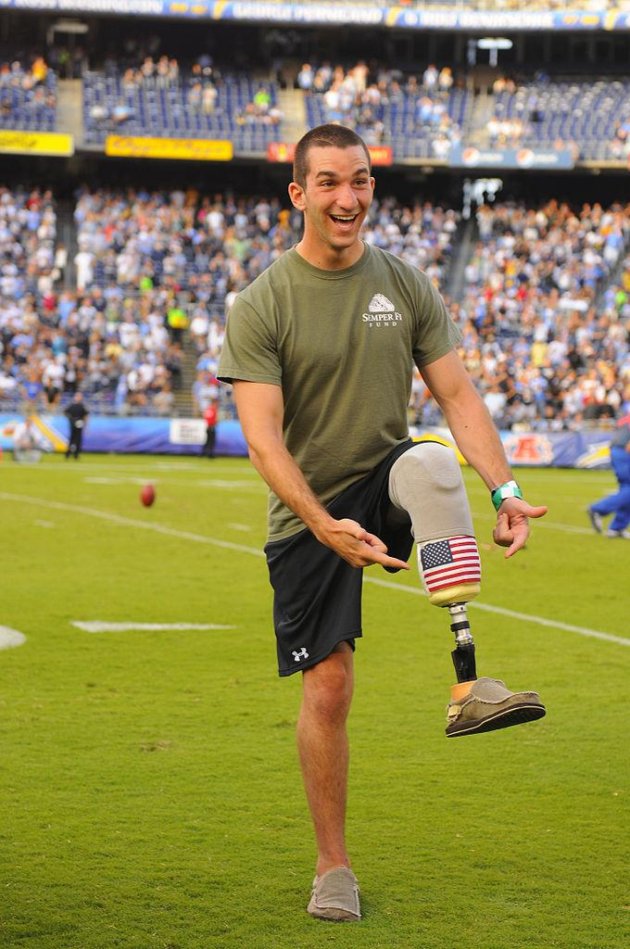
Prosthetic Leg
Engineering Design
LAURI MITCHELL
JESSICA SCHENKEL
PEGGY JOHNSON
NIKKI RUMPLER
STACY VANDERWEELE
This material is based upon work supported by the National Science Foundation under Grant No. 0962840
.

Slide 2
Indiana Science and Engineering Process Standards(adopted 2016)
SEPS.1 – Posing questions (for science) and defining problems (for engineering)
SEPS.2 – Developing and using models and tools
SEPS.3 – Constructing and performing investigations
SEPS.4 – Analyzing and interpreting data
SEPS.5 – Using mathematics and computational thinking
SEPS.6 – Constructing explanations (for science) and designing solutions (for engineering)
SEPS.7 – Engaging in argument from evidence
SEPS.8 – Obtaining, evaluating, and communicating information
Notes:
Our proposal was written in response to Indiana’s new academic standards. We argued that teachers would need the resources, pedagogies, and tools to integrate and meet these standards.
In 2010, Indiana adopted a new series of science academic standards that positioned “The Design Process” on equal footing as “The Nature of Science”

Slide 3
INDIANA SCIENCE STANDARDS (ADOPTED 2016)
5.PS.1 Describe and measure the volume and mass of a sample of a given material
5.PS.4 Describe the difference between weight being dependent on gravity and mass comprised of the amount of matter in a given substance or material.
Notes:
Our proposal was written in response to Indiana’s new academic standards. We argued that teachers would need the resources, pedagogies, and tools to integrate and meet these standards.
In 2010, Indiana adopted a new series of science academic standards that positioned “The Design Process” on equal footing as “The Nature of Science”

Slide 4
INDIANA ENGINEERING STANDARDS (ADOPTED 2016)
3-5.E.1 Identify a simple problem with the design of an object that reflects a need or a want. Include criteria for success and constraints on materials, time, or cost.
3-5.E.2 Construct and compare multiple plausible solutions to a problem based on how well each is likely to meet the criteria and constraints of the problem.
Notes:
Our proposal was written in response to Indiana’s new academic standards. We argued that teachers would need the resources, pedagogies, and tools to integrate and meet these standards.
In 2010, Indiana adopted a new series of science academic standards that positioned “The Design Process” on equal footing as “The Nature of Science”

Slide 5
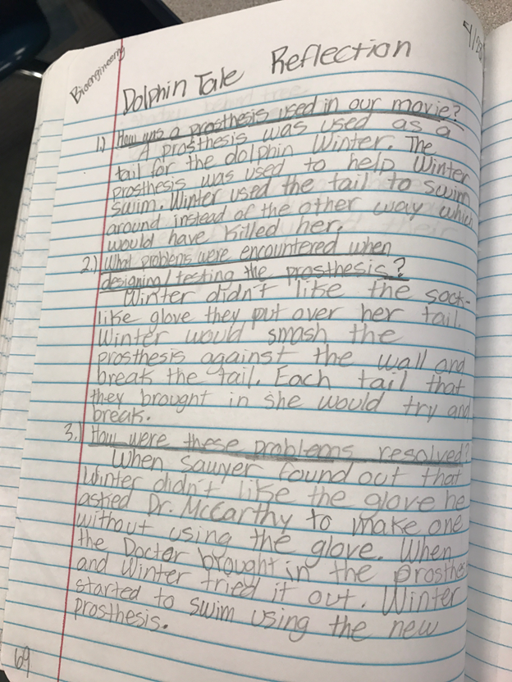
INTRO ACTIVITIES

Slide 6
INTRO ACTIVITIES
VIDEO LINKS:
PROSTHETIC HAND
https://www.youtube.com/watch?v=FGSo_I86_lQ
AMY PURDY PROSTHETIC LEG
http://time.com/75685/amy-purdy-prosthetic-feet-dancing-with-the-stars/
ARTIFICIAL HEART http://abcnews.go.com/Health/11-year-boy-youngest-artificial-heart/story?id=44853771

Slide 7
INTRO ACTIVITIES
FLEXION VS. EXTENSION https://www.youtube.com/watch?v=P9VPVg7WY9Y
BILL NYE JOINTS https://www.youtube.com/watch?v=o6uog6zt79Y
KNEE LIGAMENT ANATOMY https://www.youtube.com/watch?v=RTV5Yo3E7VQ
HUGH HERR PROSTHETIC LEG https://www.ted.com/talks/hugh_herr_the_new_bionics_that_let_us_run_climb_and_dance#t-74921

Slide 8
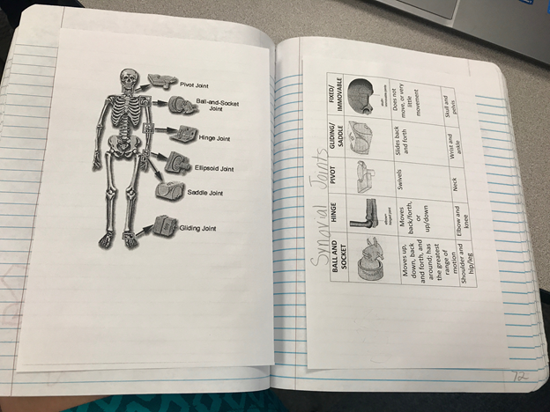
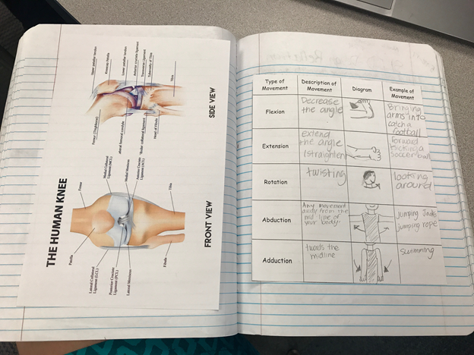
INTRO ACTIVITIES

Slide 9
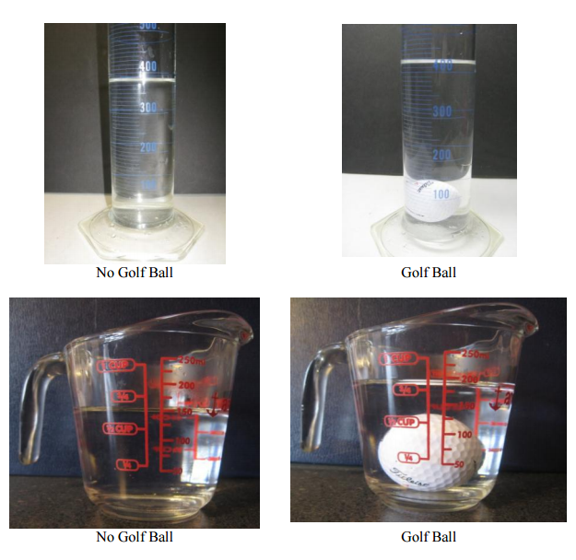
INQUIRY ACTIVITIES
MEASURING THE VOLUME AND MASS
OF A GOLF BALL
CALCULATING DENSITY
COMPARING DENSITY
GOLF BALL TO BOWLING BALL
HOLLOW GOLF BALL TO SOCCER BALL

Slide 10
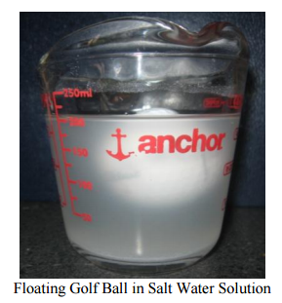
INQUIRY ACTIVITIES
CAN YOU MAKE A GOLF BALL FLOAT?

Slide 11
PROSTHETIC LEG – DESIGN TASK
Boiler BioTech, a company in Warsaw, Indiana, needs assistance in designing a leg for a young child. The prosthetic leg will need to be designed so that it will be able to kick a soccer ball. Everyone faces challenges every day. To help us, engineers have designed glasses for people who need help seeing, hearing aids for people who need help hearing, crutches and canes for people who need help with bearing weight, and artificial limbs for people who have lost a limb. Designing aids for all of these human needs requires understanding what function you are augmenting and lots of creativity. In this unit we are going to learn about the musculoskeletal system and then you will be given an opportunity to test your design skills by building a prosthetic leg and test it by using it to kick a ball.

Slide 12
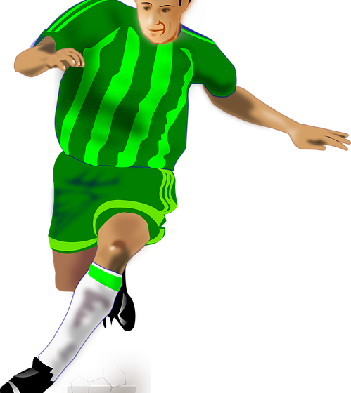
PROSTHETIC LEG – DESIGN TASK
Criteria (features)
The leg should hinge like a real joint (move back and forth), but it cannot hyperextend past 180▫.
The leg is being designed to strike a ball (move the ball or propel it on it’s own).
Students do NOT have to mimic anatomy
Constraints (limitations)
Only use materials provided
There is a time limit of 20 minutes to build.

Slide 13
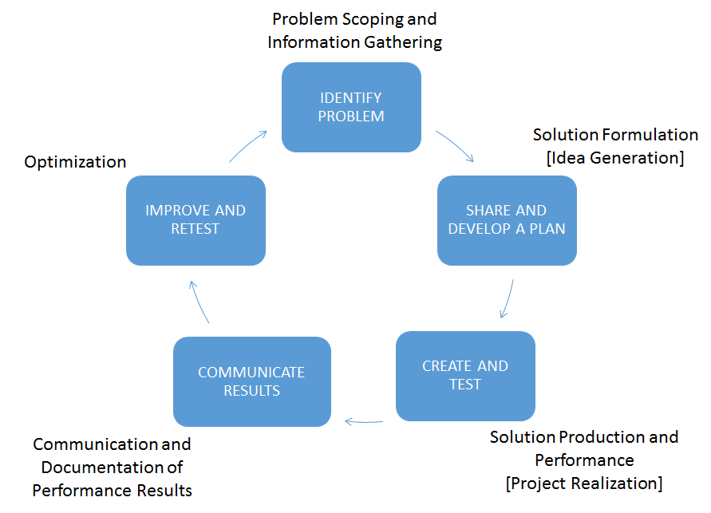
PROSTHETIC LEG – DESIGN TASK
Boiler BioTech, a company in Warsaw, Indiana, needs assistance in designing a leg for a young child. The prosthetic leg will need to be designed so that it will be able to kick a soccer ball. Everyone faces challenges every day. To help us, engineers have designed glasses for people who need help seeing, hearing aids for people who need help hearing, crutches and canes for people who need help with bearing weight, and artificial limbs for people who have lost a limb. Designing aids for all of these human needs requires understanding what function you are augmenting and lots of creativity. In this unit we are going to learn about the musculoskeletal system and then you will be given an opportunity to test your design skills by building a prosthetic leg and test it by using it to kick a ball.
Criteria (features)
The leg should hinge like a real joint (move back and forth), but it cannot hyperextend past 180▫.
The leg is being designed to strike a ball (move the ball or propel it on it’s own).
Students do NOT have to mimic anatomy
Constraints (limitations)
Only use materials provided
There is a time limit of 20 minutes to build.

Slide 14
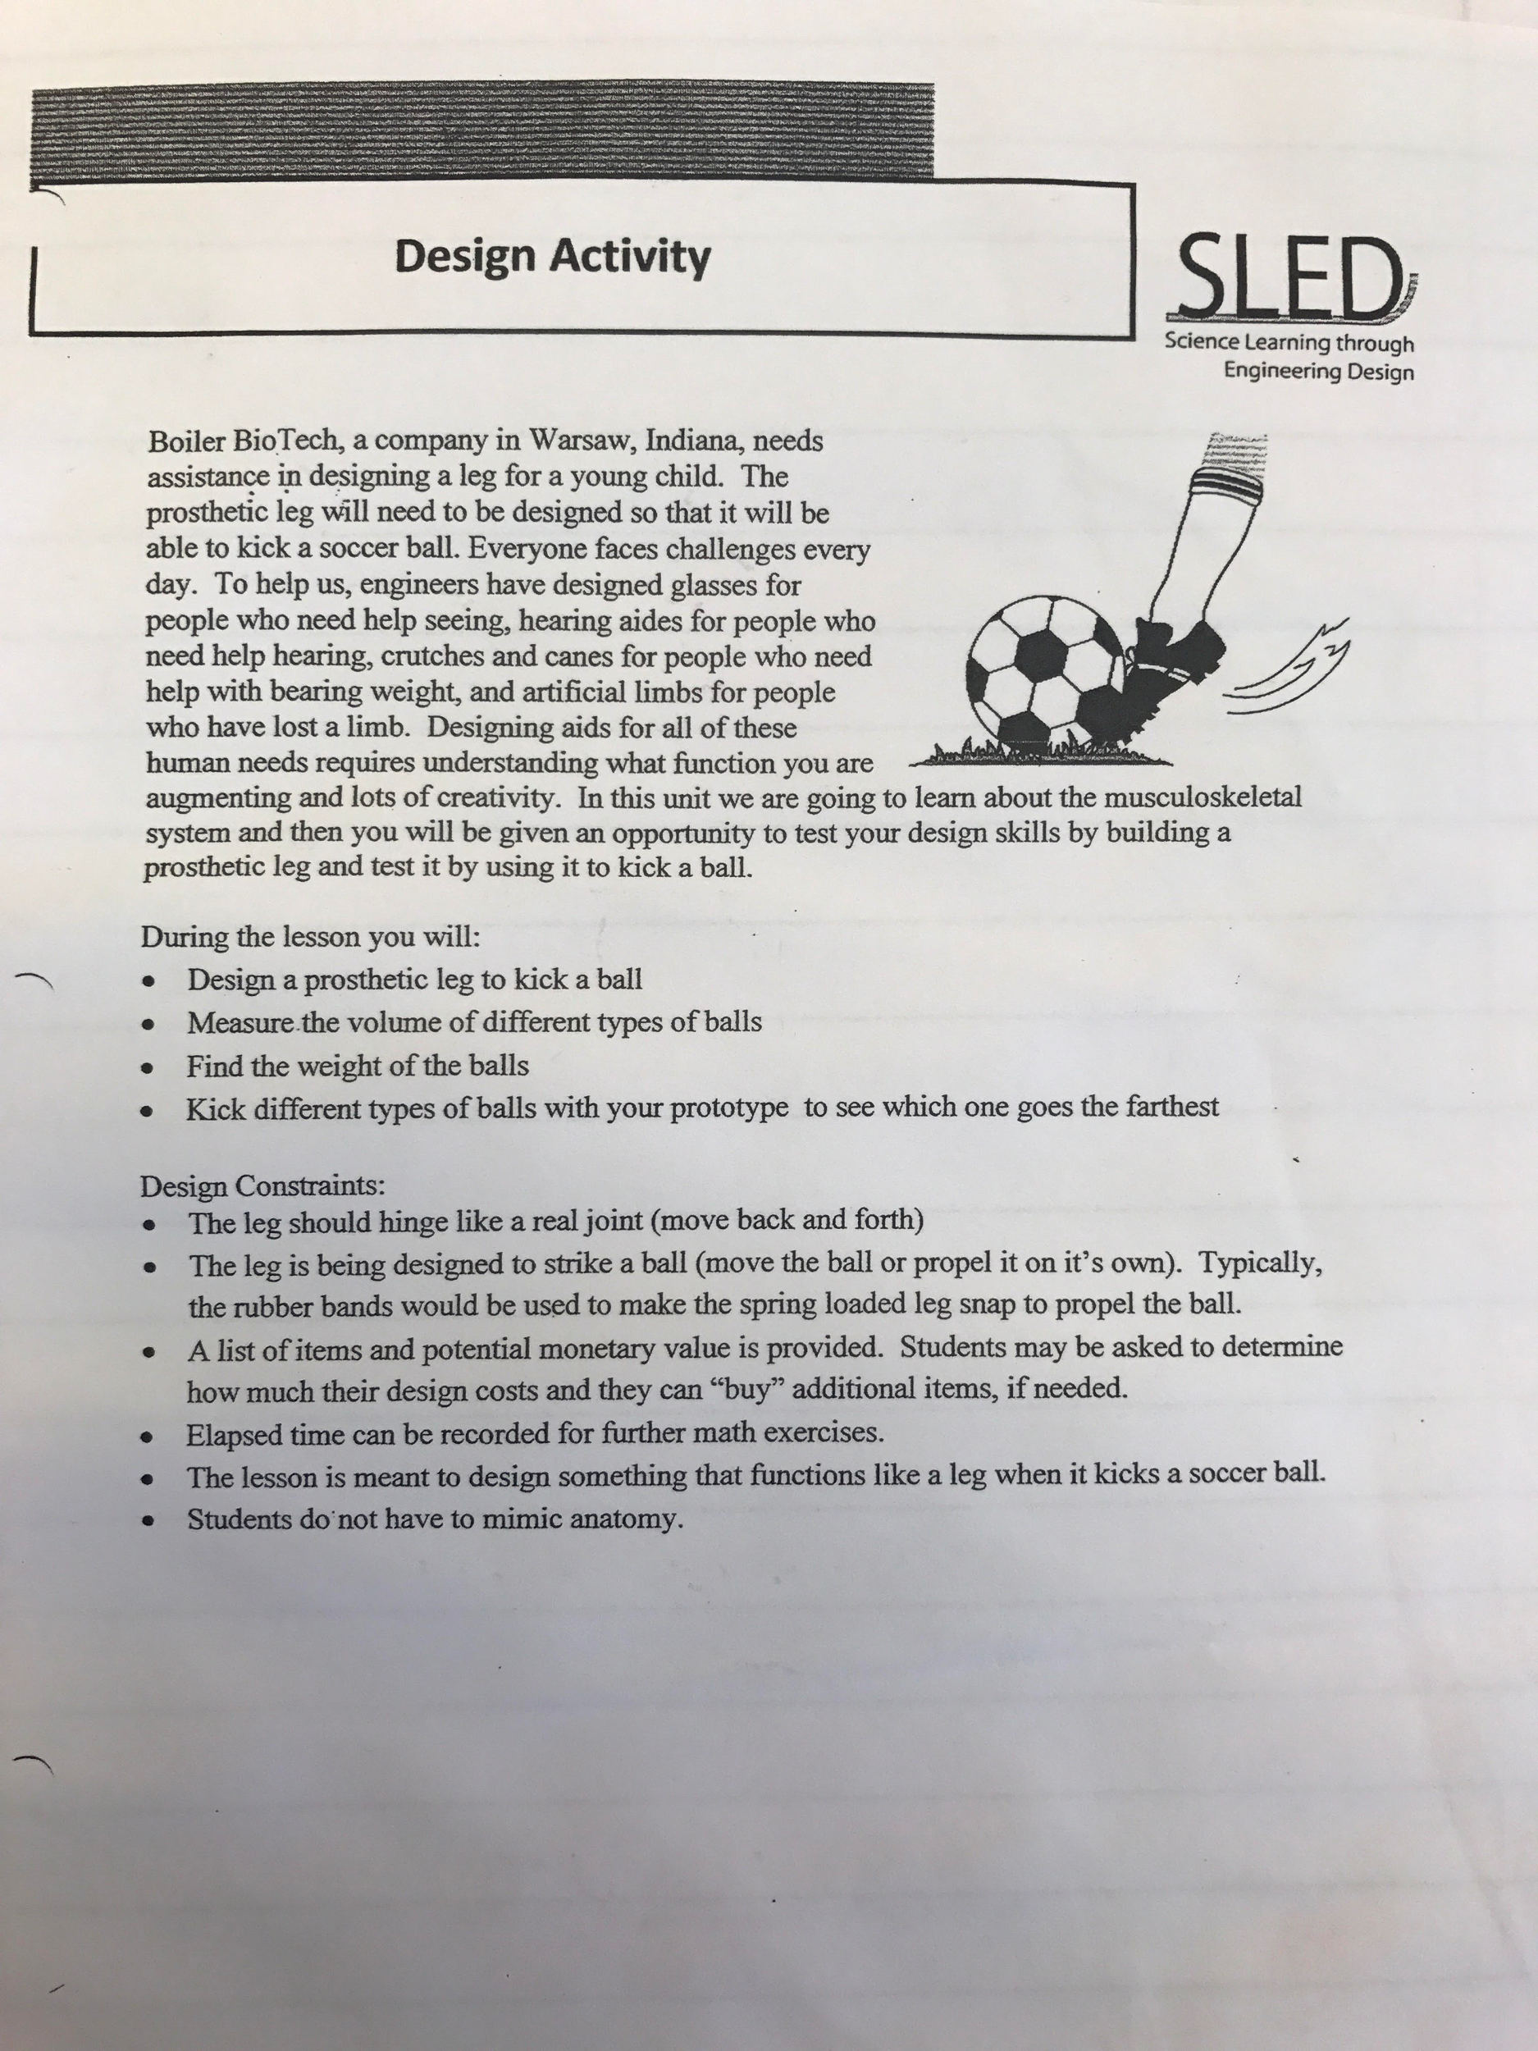
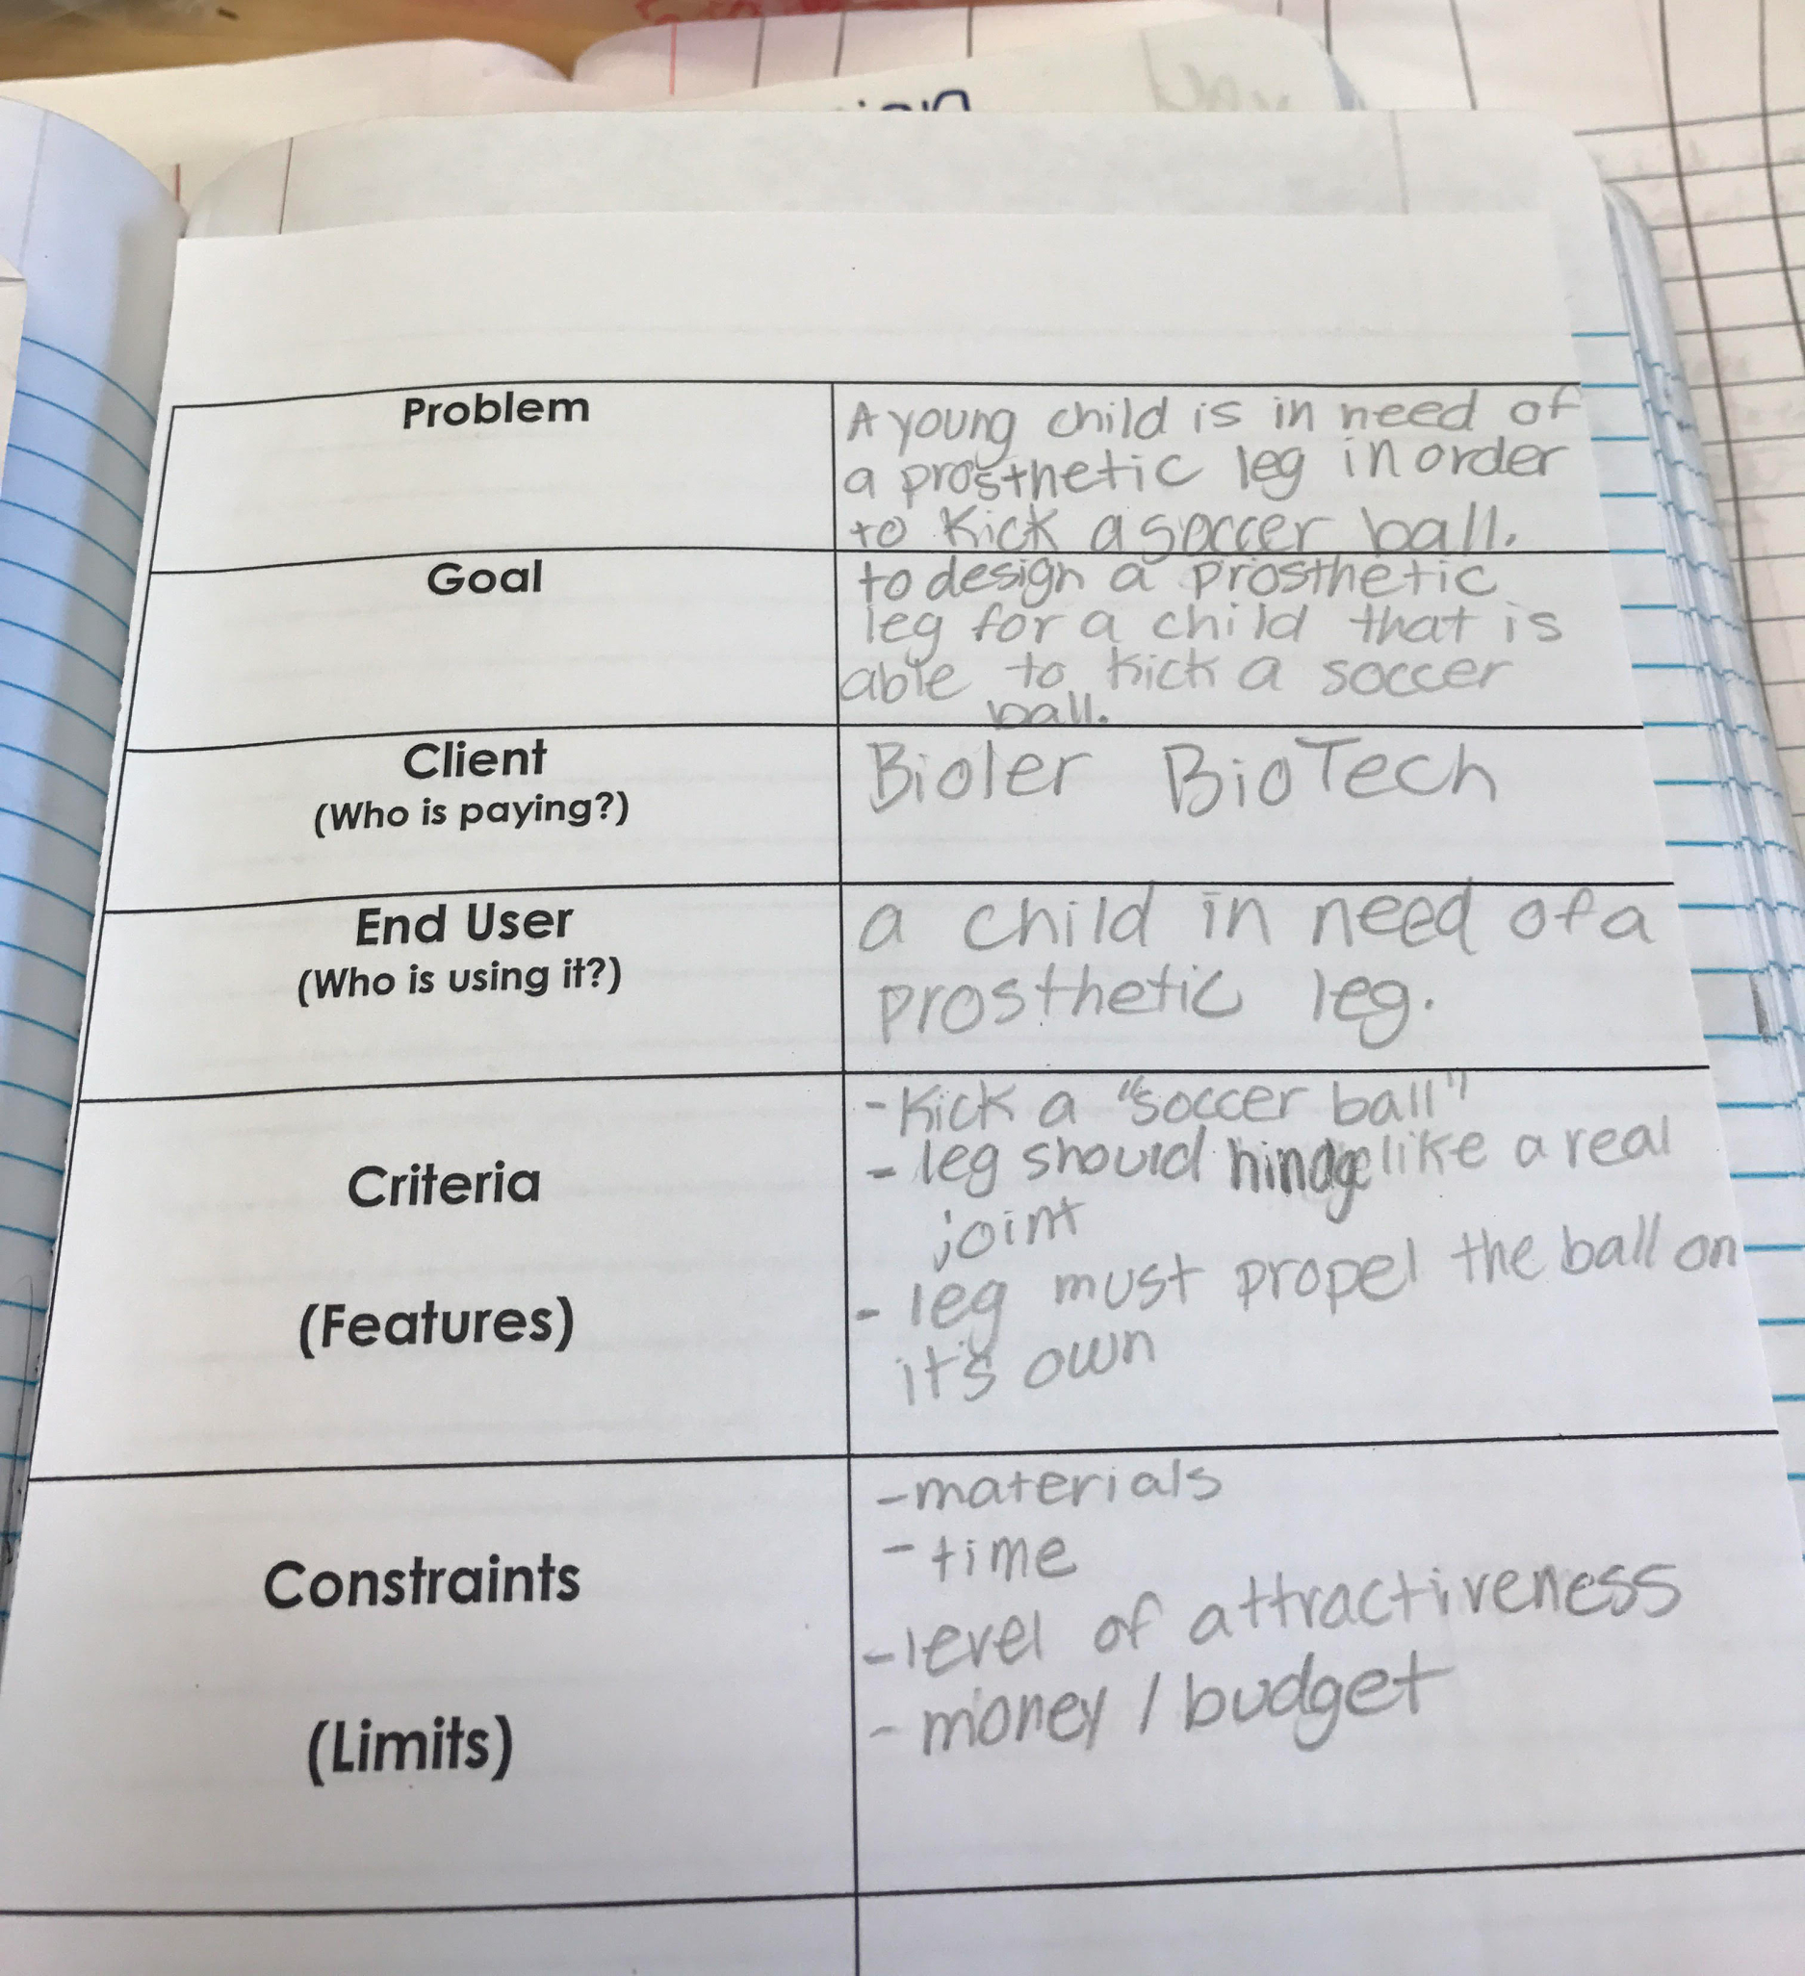
DESIGN BRIEF TEMPLATE - PROSTHETIC LEG

Slide 15
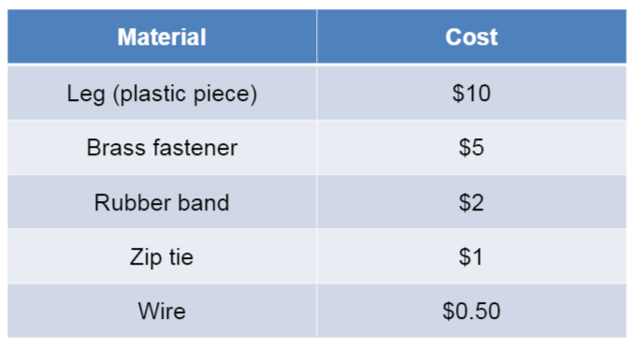
MATERIALS

Slide 16
PROSTHETIC LEG – INDIVIDUAL DESIGN
Now that we know the problem it is time to start sketching out our ideas.
Individual Design
We always start with and individual design so that students may record their OWN thinking before getting in a group.
Here are some helpful tips that students can use in their sketches:
labels
list of materials
descriptions of how it might work
a key

Slide 17
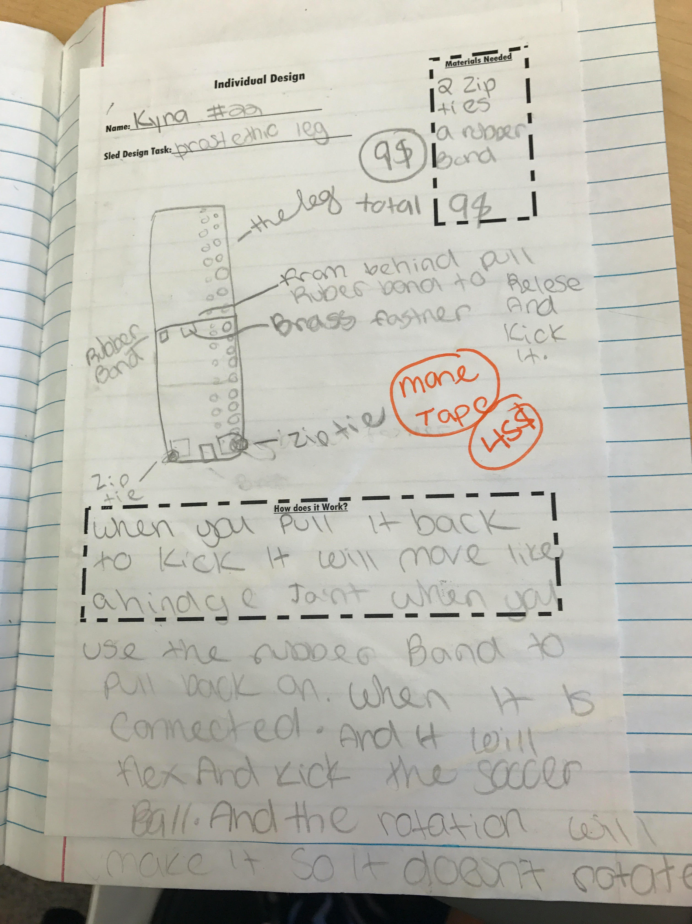
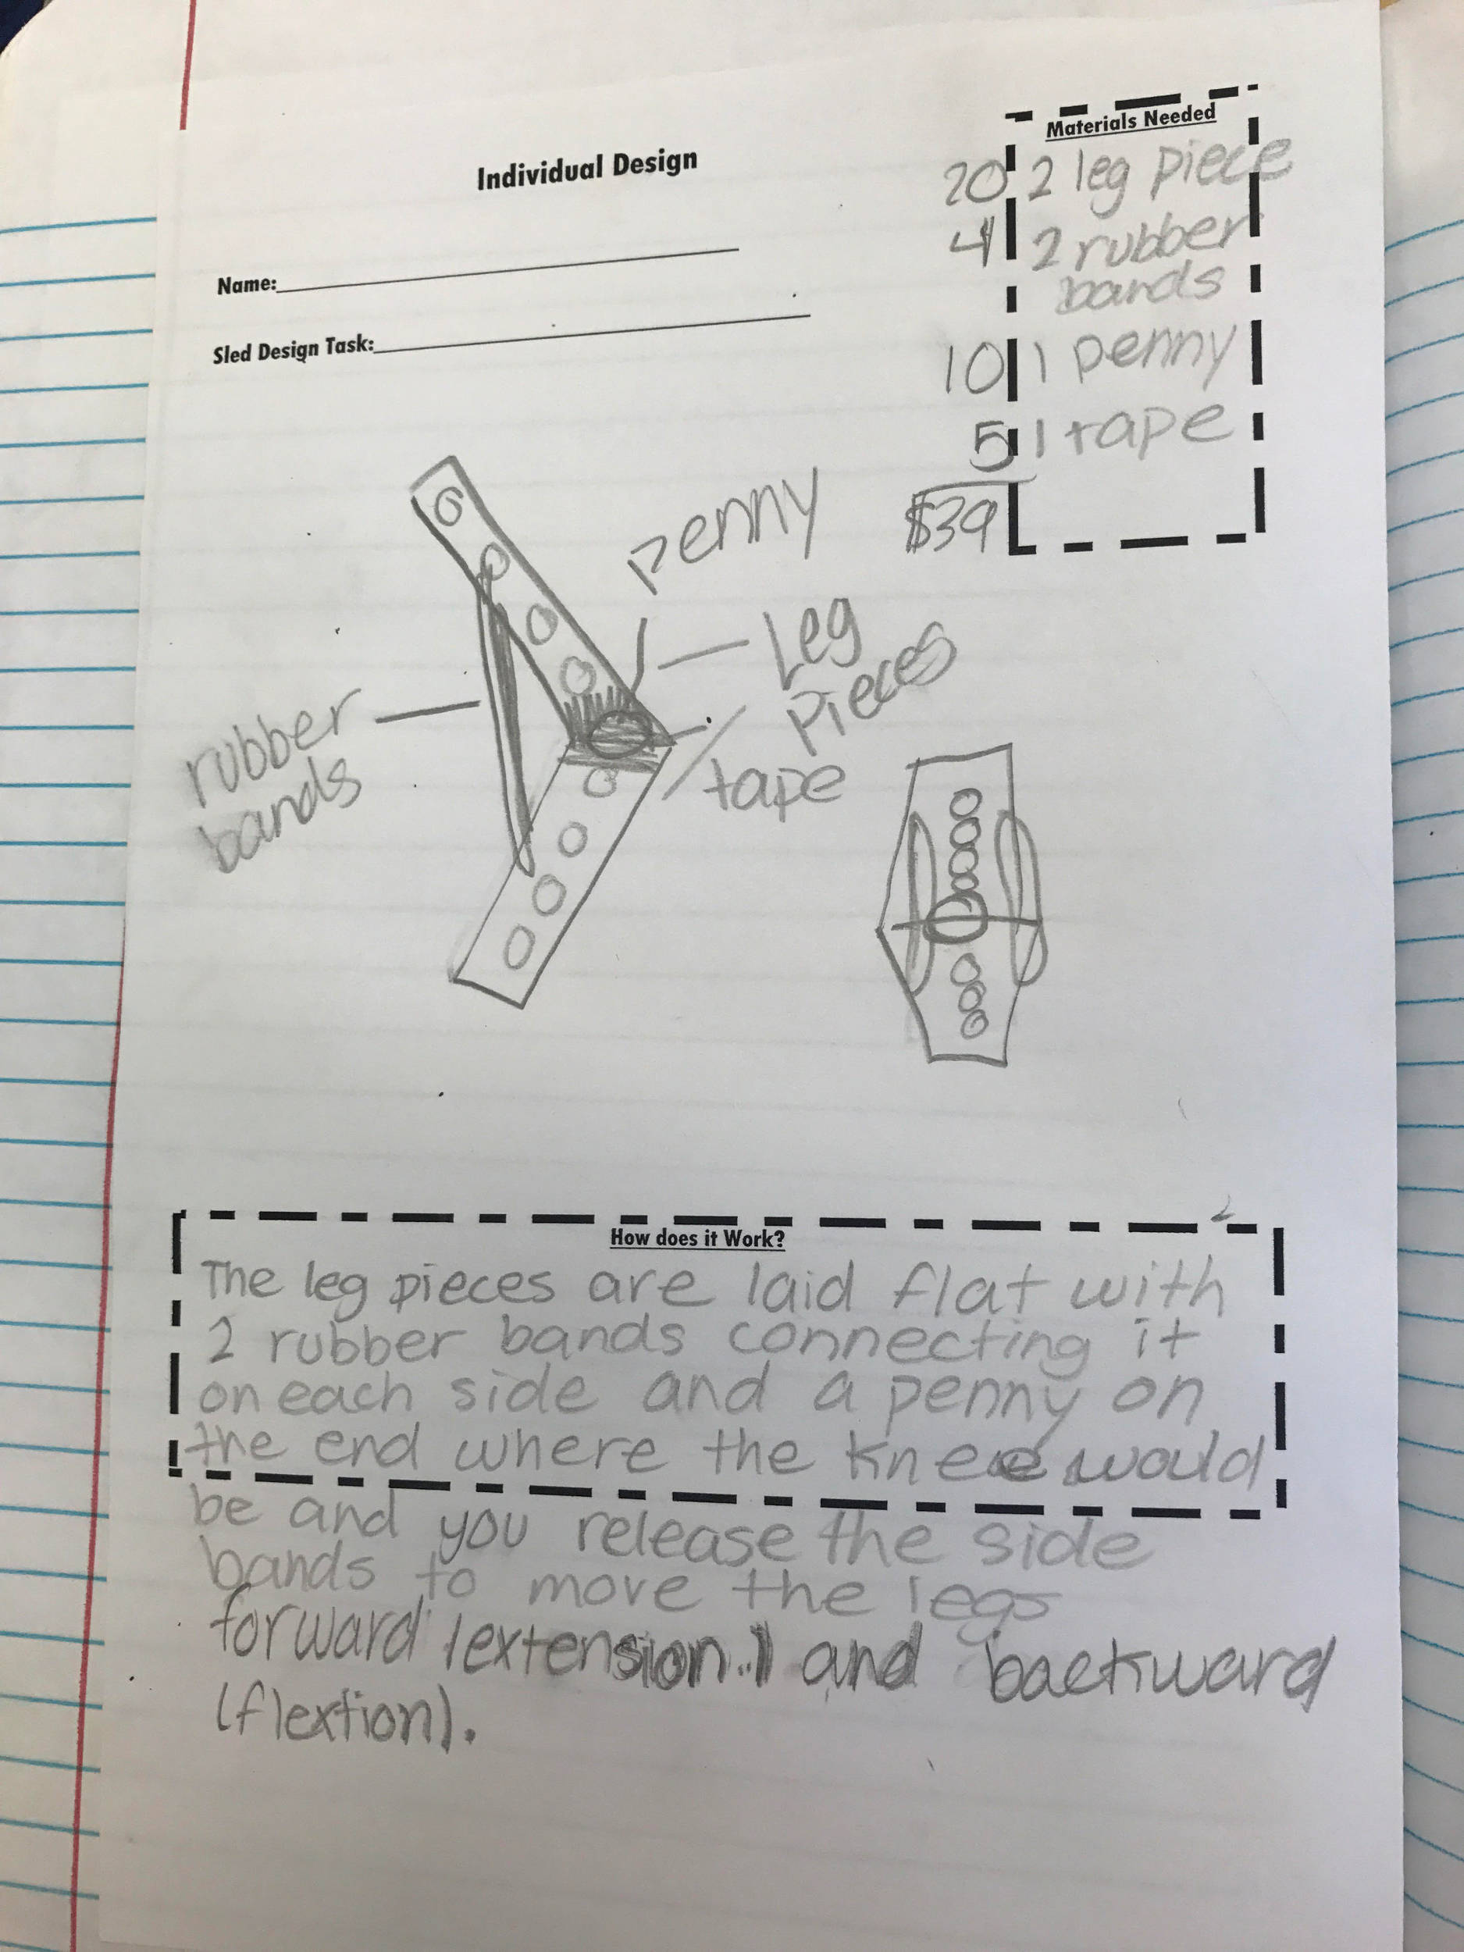
INDIVIDUAL DESIGN - EXAMPLES

Slide 18
YOUR TURN! - INDIVIDUAL DESIGN
REMEMBER…
Makes good use of space
Labels/key
Multiple views
Description of how it works
Key science content terms
Materials
Leg pieces Rubber band
Wire
Zip tie
Brass fastener
Optional:
Pennies
Masking tape
You have 5 minutes!

Slide 19
PROSTHETIC LEG – GROUP DESIGN
Now that we know the problem it is time to start sketching out our ideas.
Group Design
After students have developed their own sketch, they can be placed in teams of 2-3.
Once all ideas have been shared the team must decide on either combining their designs, choosing one of theirs, or creating a whole new one.
Here are some helpful tips that students can use in their sketches:
Labels
List of materials
Descriptions of how it might work
a key

Slide 20
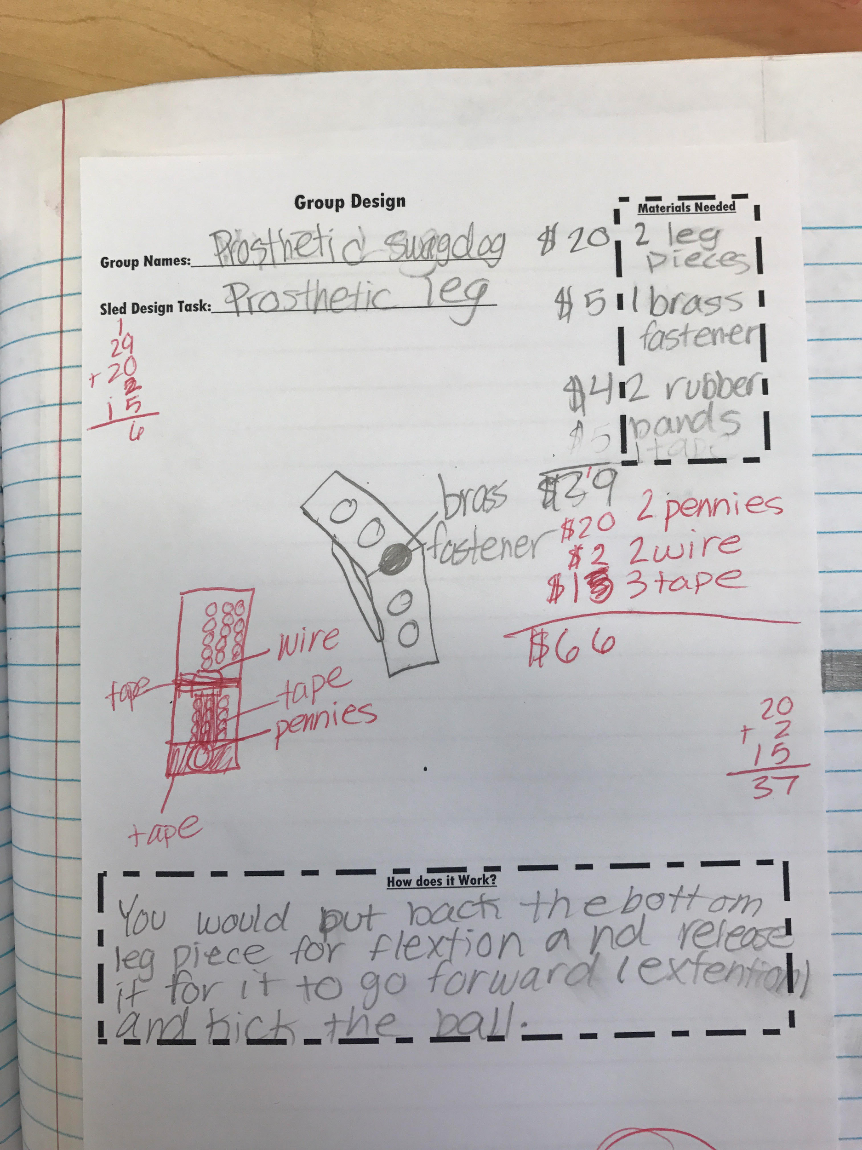
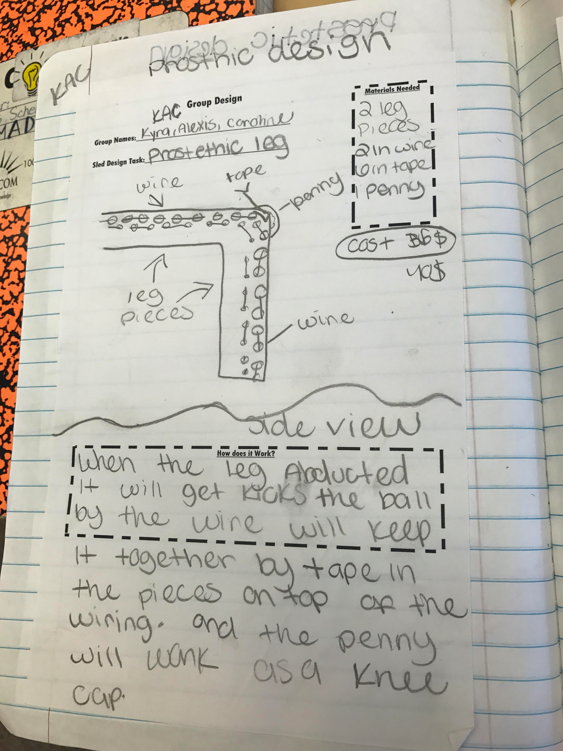
GROUP DESIGN - EXAMPLES

Slide 21
YOUR TURN! - GROUP DESIGN
REMEMBER…
GROUPS OF 2-3
EVERYONE SHARES IDEAS/DESIGN SKETCHES
GROUP CONSENSUS (ALL, PART, NEW IDEAS)
EACH PERSON SKETCHES GROUP DESIGN IN INDIVIDUAL NOTEBOOKS (must all match)
You have 10 minutes!

Slide 22
PROSTHETIC LEG – BUILD/CREATE
Time to Build
Materials:
Appropriate for you grade level
Easy to obtain
Have materials organized to make it more efficient
Building:
Teams work together
Teacher can assign roles (leader, materials, taper, recorder, etc.)
Monitor conversations and assist
Model how to converse
Leader vs. boss
Testing:
Test as a class
Test as you go

Slide 23
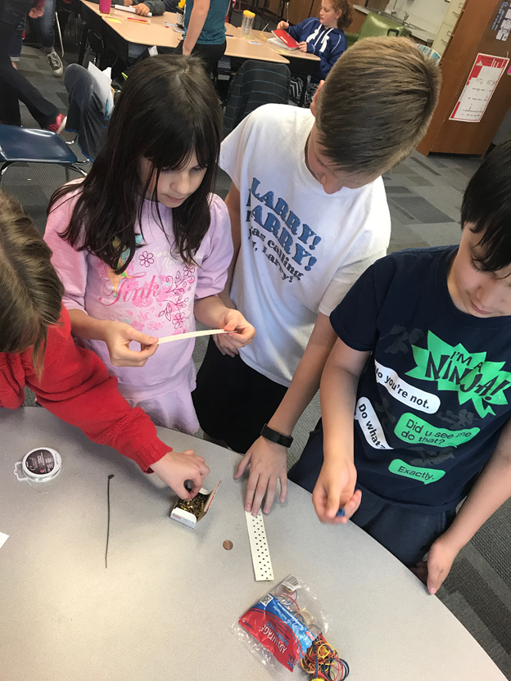
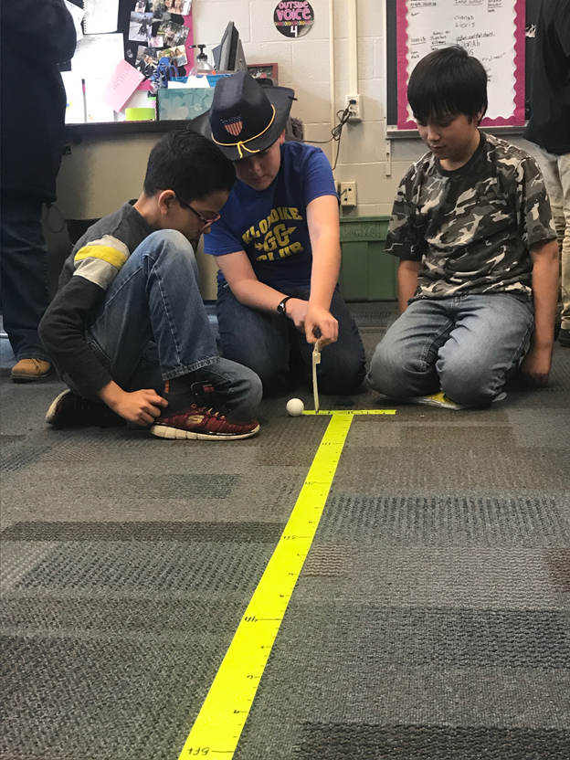

Slide 25
YOUR TURN! - GROUP BUILD/TEST!
REMEMBER…
Try to stick to your group design!
If you adjust record it, on your design sketch in a new color.
Test your design and see if it meets the criteria.
Record your data on the chart. (Report to computer)
Was your team successful?
You have 20 minutes!

Slide 26
 | Cost | Hinge Joint Yes or No | Trial 1 | Trial 2 | Trial 3 | Average
Team 1
Team 2
Team 3
Team 4
Team 5
Team 6
Team 7
Team 8
Team 9
Team 10

Slide 27
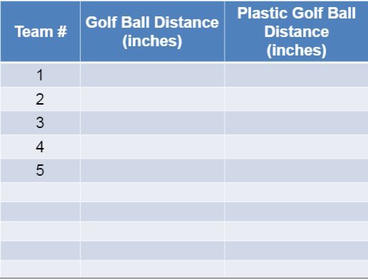

Slide 28
PROSTHETIC LEG – COMMUNICATE RESULTS
Evidence of student learning
Design notebook entries
Student use of science content vocabulary (when working with team or communicating results)
Pre/Post assessment results (SLED)
Self/Team rubric
Short video clip of a student talking aloud their ideas

Slide 29
Evidence of student learning

Slide 30
PROSTHETIC LEG – IMPROVE/REDESIGN
Reflect and Improve
This is the time when students get to talk with the class and their group and reflect on if their design was successful.
Teams then go back to the drawing board and re-sketch and improve their first design.
Even teams that were successful can improve
Why do you think we have the iPhone 7? :)

Slide 31
REDESIGN - EXAMPLE

Slide 32
Cross-curricular Connections
Math Connections
Budgeting
Measurement during design and testing (mass/ volume/ length)
Calculations of change during testing
Social Studies Connections
Geography
Environmental concerns
Community awareness (using local sites for design tasks)
Literacy Connections
Reflections and written response
Advertisement (persuasive writing & figurative language)
Trade books (informational text & fiction) Soul Surfer
Famous inventor/field expert biography writing

Slide 33
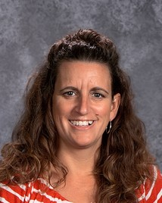
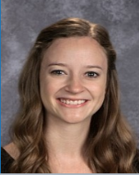
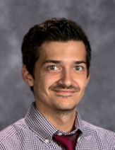
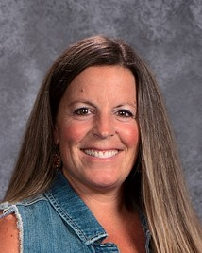
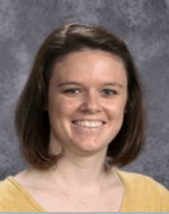
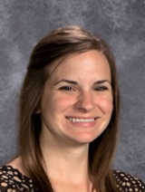
Questions
NIKKI RUMPLER 5th
RIVERSIDE INTERMEDIATE
NRUMPLER@PLYMOUTH.K12.IN.US
LAURI MITCHELL 5TH
KLONDIKE ELEMENTARY
LAMITCHELL@TSC.K12.IN.US
STACY VANDERWEELE 5th
RIVERSIDE INTERMEDIATE
SVANDERWEELE@PLYMOUTH.K12.IN.US
JESSICA SCHENKEL 5TH
KLONDIKE ELEMENTARY
JHSCHENKEL@TSC.K12.IN.US
PEGGY JOHNSON 5TH
MINTONYE ELEMENTARY
PJOHNSON@TSC.K12.IN.US
To learn more about the SLED Partnership, please go to our link at sledhub.org

