Slide 1
SLED Design Project: Simple Machines
Simple Machines, Examples from Nature

Slide 2
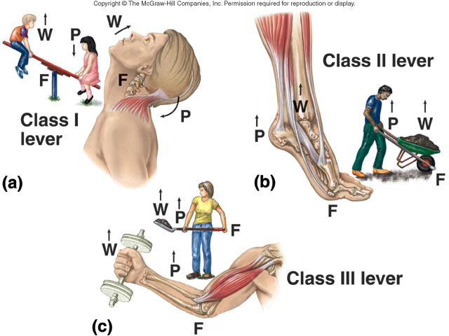
The Lever
Your skeletal muscles work as levers to move your body.

Slide 3
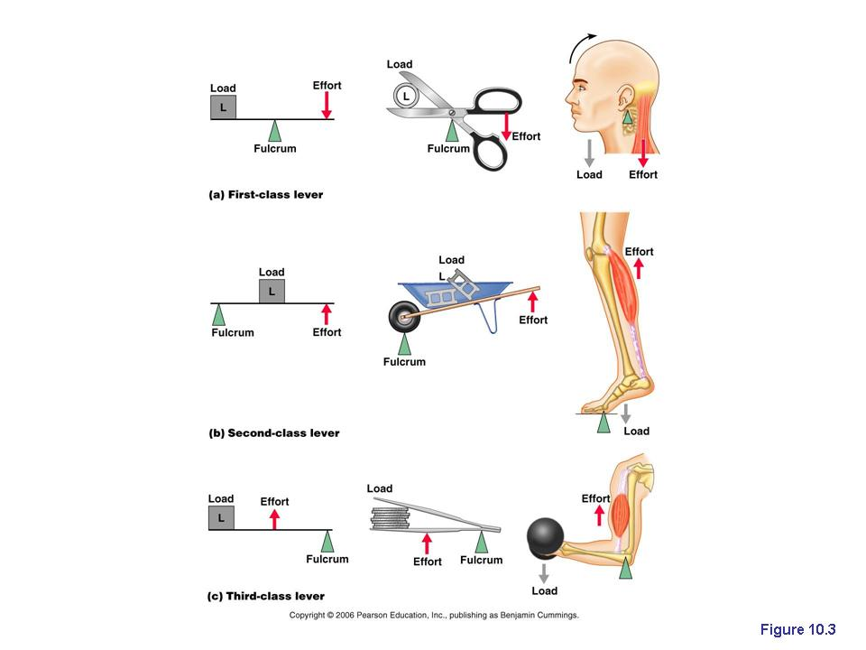
The Lever

Slide 4
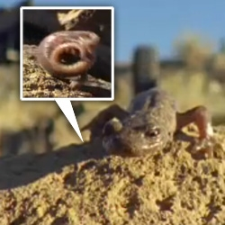
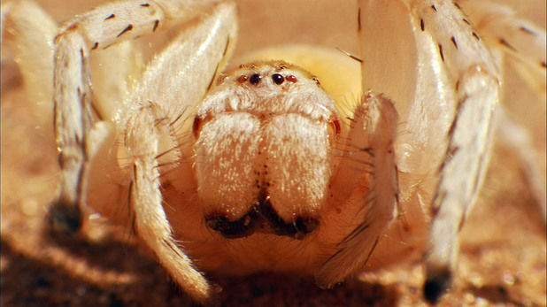
The Wheel and Axle
Salamanders and Caterpillars, oh my!
http://www.youtube.com/watch?v=HmLS2WXZQxU
http://videosift.com/video/Nature-invented-the-wheel
And Golden Wheel Spiders, too!
http://www.youtube.com/watch?v=V4odlo0Afjs

Slide 5
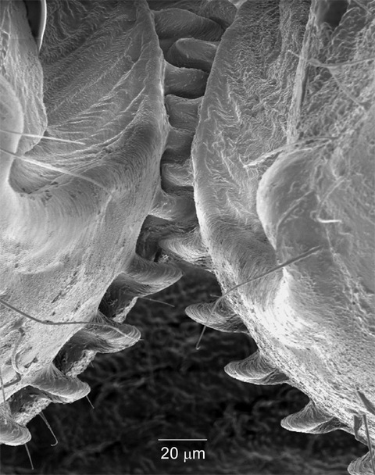
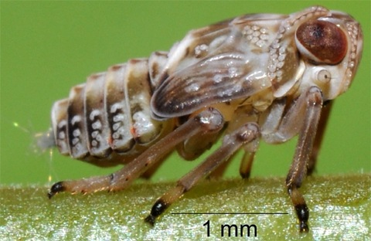
The Wheel and Axle
Planthoppers hop with a modified wheel: The Gear.
Planthopper nymph
http://www.youtube.com/watch?v=cq0Mf2pt2XA
http://www.npr.org/2013/09/13/219739500/living-gears-help-this-bug-jump
Gears on hind legs
Planthopper synchronize their hind leg movements in 30 millionths of a second using small gears on the first segment of its hind legs (similar to the top of your thigh bone).
As one leg prepares to leap, the interlocking gear system causes the other leg to move at the same time. This lets the planthopper to propel itself faster and farther and in a straighter path to escape danger. At such speeds, synchronizing leg movements is very important, as one wrong move could send the insect springing to the side instead of forward.

Slide 6
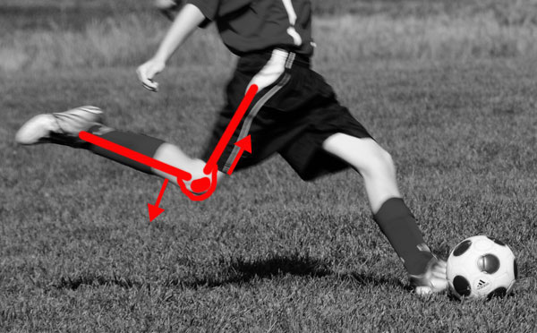
The Pulley
“The pulley is a way of getting force to go around corners…”
“The patella, or knee cap, allows your thigh muscles to lift your lower leg without crushing the knee joint. If the quadriceps were connected directly to your shin, every time it contracted, the bones of the lower leg would grind into the base of the femur, and it would take a lot of effort to move. But by routing the connection over the top of the patella, evolution changed the geometry--when the quad pulls on the lower leg, the force comes from in front of the shin, rather than from directly above, so the shin moves easily.”

Slide 7
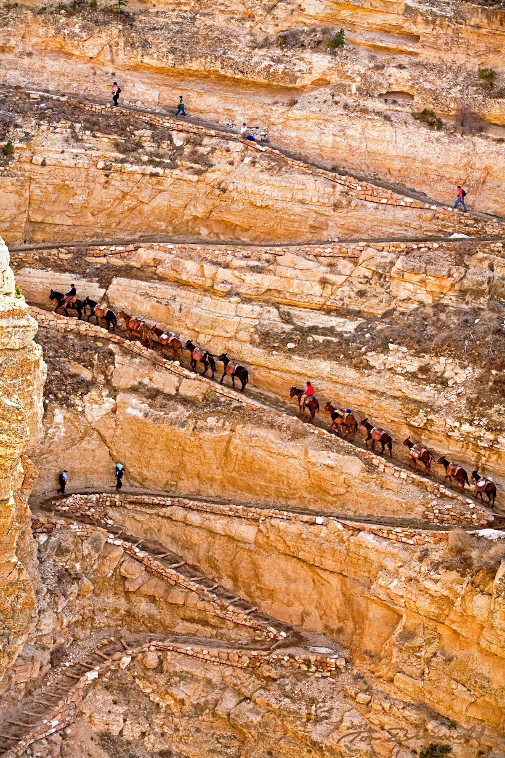
The Inclined Plane
Cats like them.
Penguins, too!
http://www.youtube.com/watch?v=CkMzHGA8GgM

Slide 8
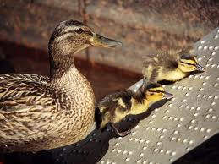
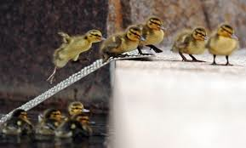
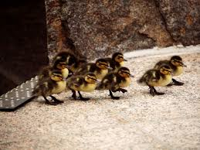
The Inclined Plane

Slide 9
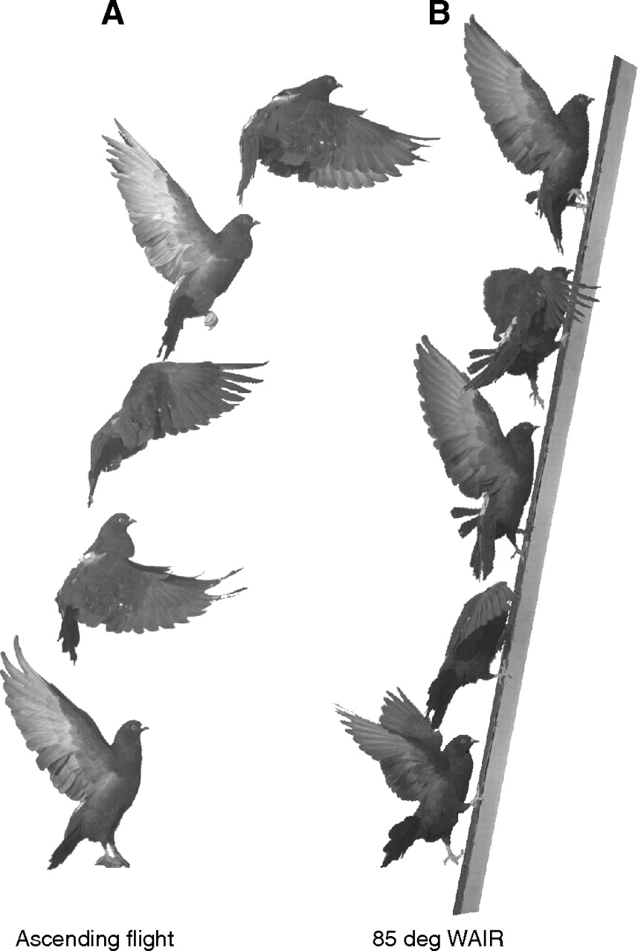
The Inclined Plane
http://www.youtube.com/watch?v=e81J915TEXg
J Exp Biol 214:2354-2361, 2011
Wing-assisted incline running (WAIR): when a bird flaps its wings to aid in climbing a slope. Ground birds use this as an escape strategy.

Slide 10
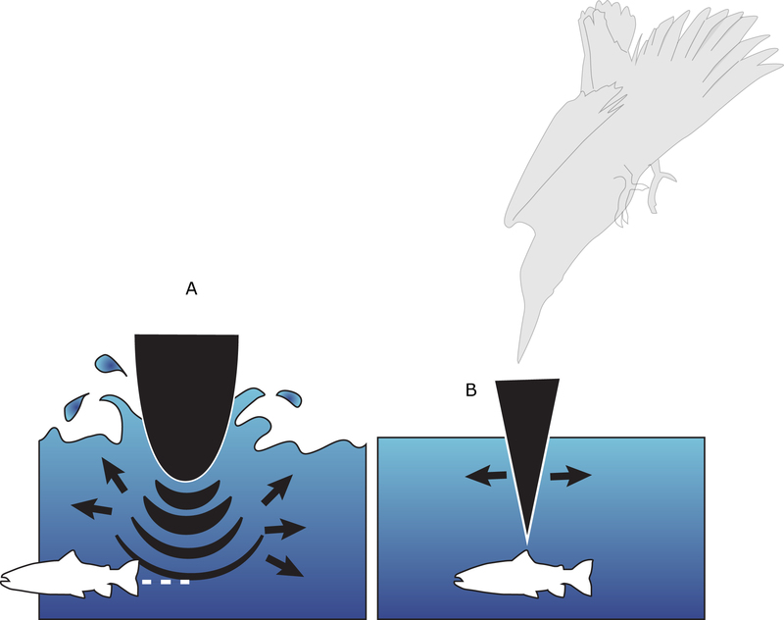
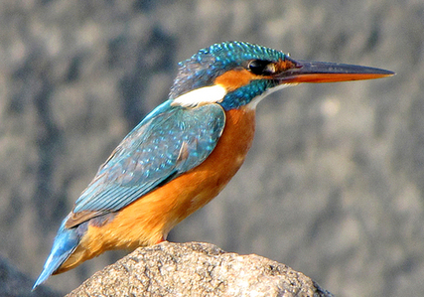
The Wedge
The Kingfisher
“If a kingfisher had a rounded beak, such as on the left, it would push water ahead of it, scaring or displacing the prey. Instead, the wedge-shaped beak and head (right) enters the water without a splash, increasing the changes of a successful hunt. Artist: Emily Harrington. Copyright: All rights reserved.”
http://www.asknature.org/strategy/4c3d00f23cae38c1d23517b6378859ee

Slide 11
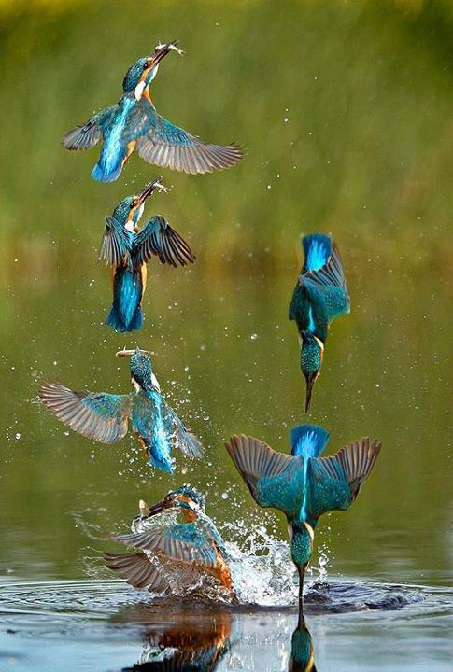
The Wedge
The Kingfisher fishing!
http://www.youtube.com/watch?v=1CsyenHROSE
http://www.youtube.com/watch?v=6YRM0sy3xIY
http://besttravelphotos.me/2012/11/14/airborne-fishing-kingfisher-england/

Slide 12
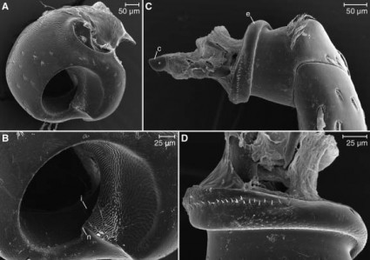
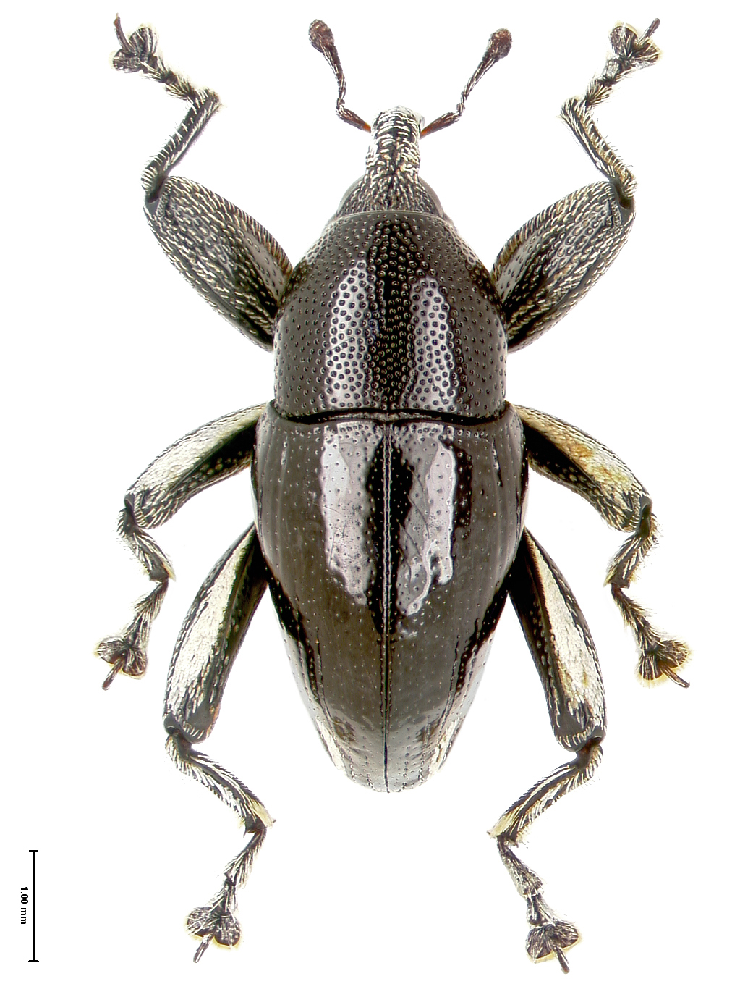
The Screw
Papuan Weevils have leg joints that screw together!
The nut: The outer part of the joint (the coxa) has an inner screw thread (A & B).
The screw: The inner part of the joint (the trocanter) has an external screw thread (C & D).
The beetles’ muscles pull on the leg to turn the screw!

Slide 13
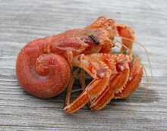
The Screw: Hermit Crabs
As hermit crabs grow, their abdomen grows into a “corkscrew” spiral shape to “screw into the shell” that they are living live in. Most shells contain a right-handed (clockwise) spiral, and most hermit crabs have a “right-handed spiral” for their abdomen. Some species of hermit crabs live in left-handed (counter-clockwise) spiral shells and have a “left-handed spiral” abdomen. As the hermit crab grows, this puts such a hermit crab at a disadvantage in the housing market as left-handed shells are less common.
http://www.youtube.com/watch?v=tGwoOOz2s2g
http://www.youtube.com/watch?v=I8hZ7MM1rOg
A hermit crab out of it’s shell.
http://en.wikipedia.org/wiki/Hermit_crab

Slide 14
Combining Simple Machines:
the hamster trap.
http://www.youtube.com/watch?v=ogCp1W7cRZ4

