Slide 1
Sketching to Design
Notes:
Have you ever tried to tell a story to a friend and struggled to get them to understand what you were telling them? Have you ever tried to communicate with someone who did not speak your language? How did you do it? Were you successful? Share about how my daughter when to Ecuador and how she communicated without words. Another way she could communicate with people who could not speak her language was to draw what she was thinking.

Slide 2
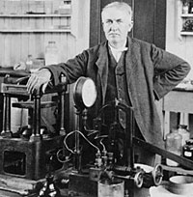
Thomas Edison

Slide 3
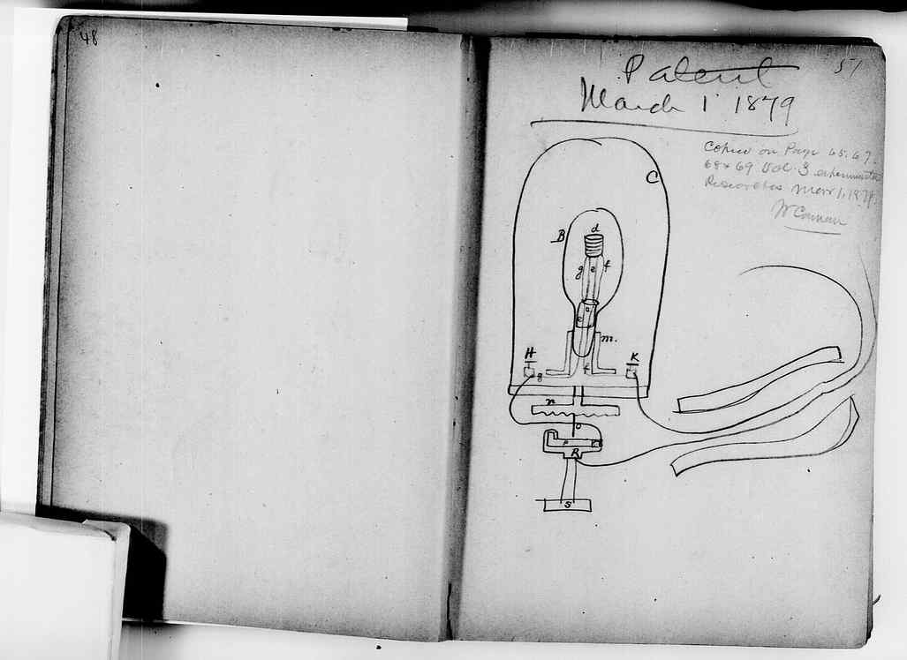

Slide 4
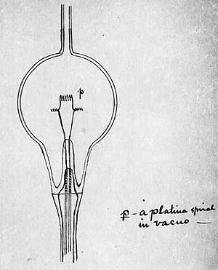

Slide 5
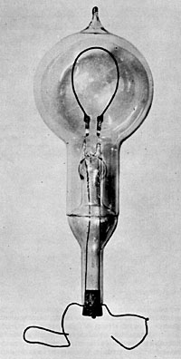

Slide 6
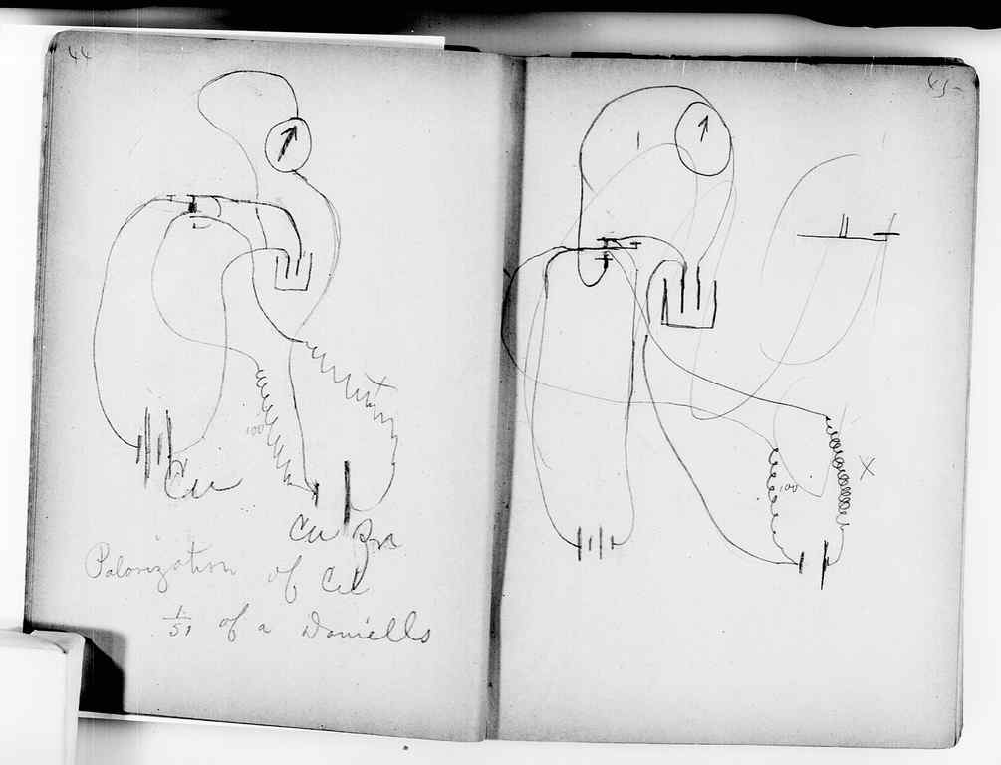

Slide 7
Symbols
You could create symbols for building materials
Color coding with a key could be used to communicate details
= Masking Tape
= Light Bulb
= Masking Tape
= String
= Glue

Slide 8
Drawing Orientation
Label views -Top, Front, Right Side –all views but you should indicate the view you are sketching

Slide 9
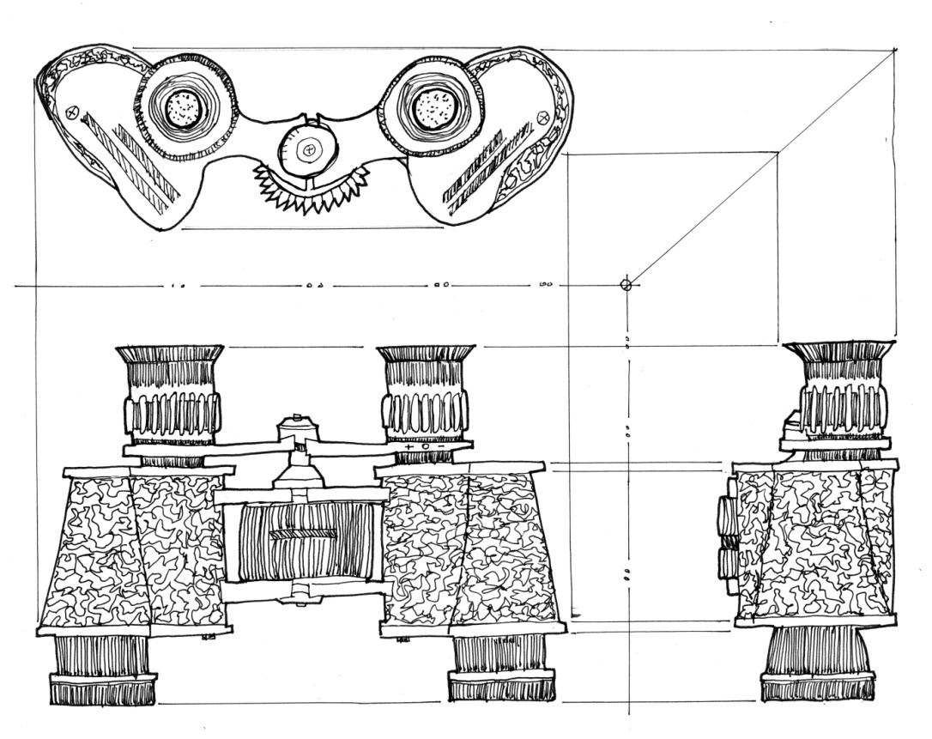
Label The View
TOP VIEW
FRONT VIEW
Right Side VIEW

Slide 10
Remove the eraser!
It is hard to stop using the eraser when you make a mistake .
In practice, Engineer’s notebooks - mistakes remain with only a single line striking out the errir error.
Mistakes can be useful later or lead to a new discovery.

Slide 11
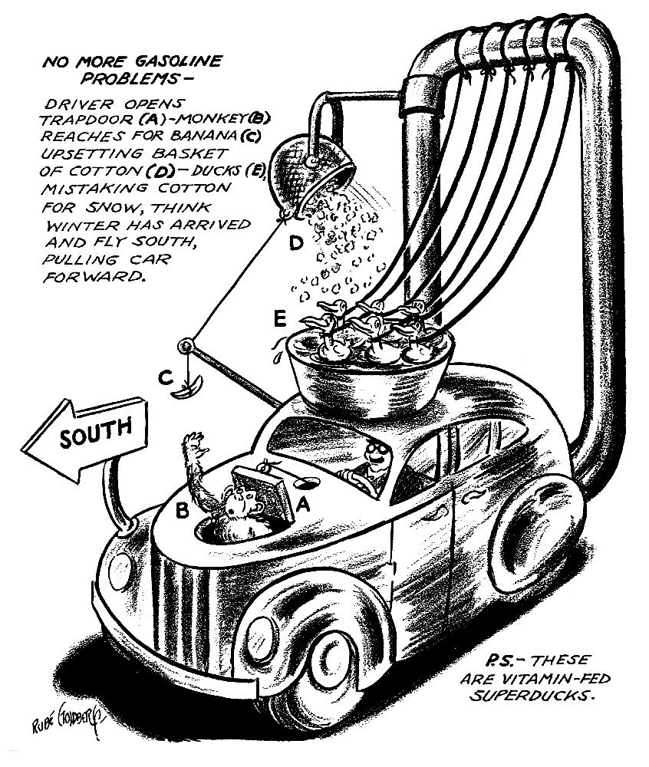
No More Gasoline Problems

Slide 12
Cause and Effect
How do you think the machine starts?
Why does the sign says “South”?
What is in the basket?
Why are the birds tied?

Slide 13
Sketch and Notation

Slide 14
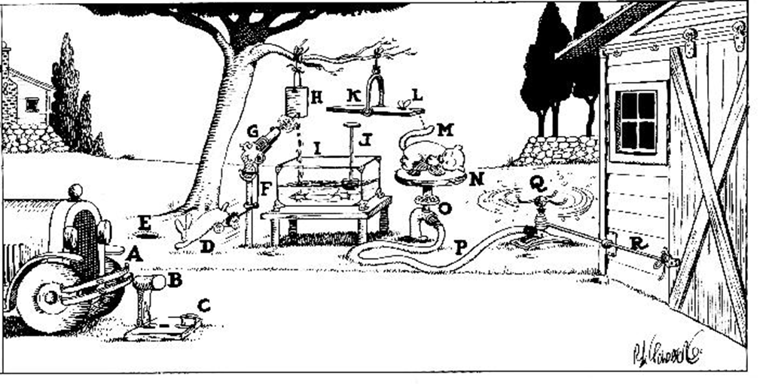
Automatic Garage Door Opener

Slide 15
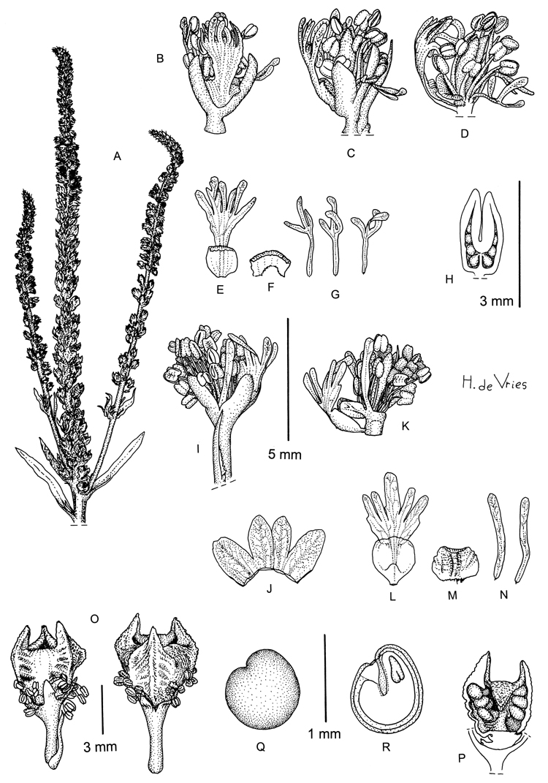
Sketching Plants

Slide 16
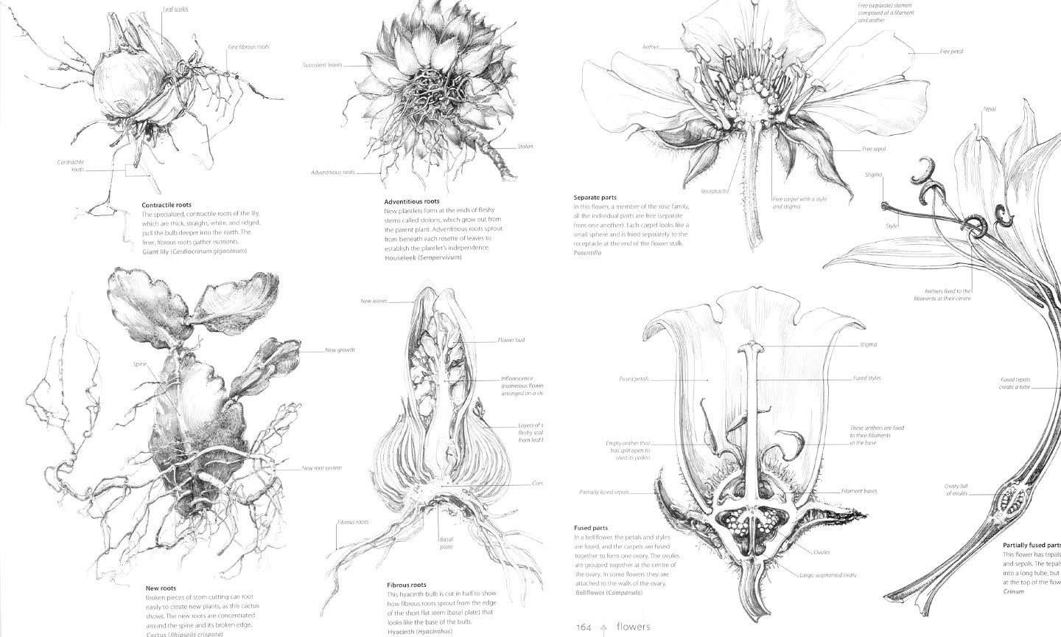

Slide 17
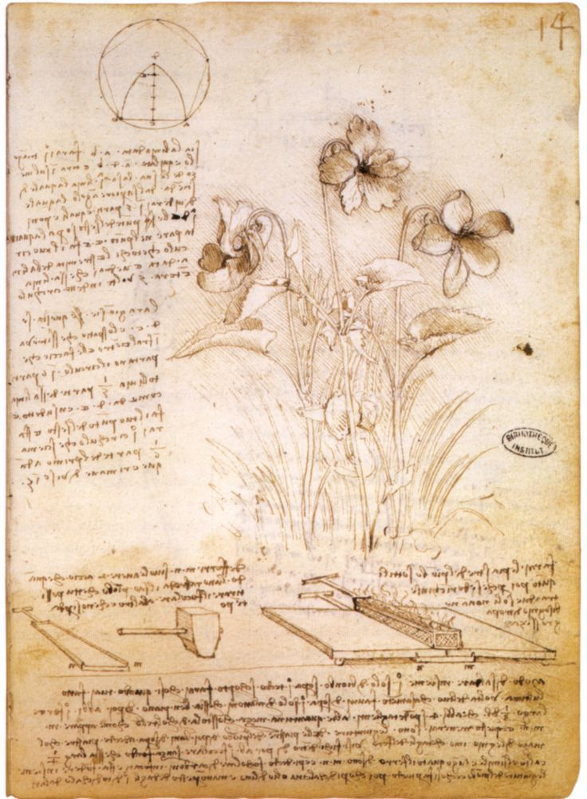
Notes:
Leonardo da Vinci botany study

Slide 18
When You Sketch. . .
Design sketches communicate design ideas
Use symbols to label materials and parts of your prototype
Label Views- Top, Front, Right Side
Share your sketch with your teacher and design team– refine sketch (if necessary)

