Slide 1
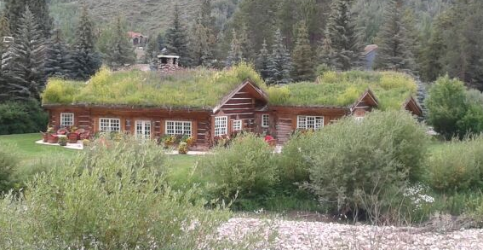
Green Roof Design
Notes:
Bryan – Kick Off

Slide 2
Main Lesson Objectives
Understand how the plants respond to the green roof environment
  reduced depth of soil and sloped surface
Describe how the plant adapted to help them stay on the roof and live in the environment.
Observe how the green roof affects the surroundings that it lives in.
  more green areas in urban and suburban regions
Develop an engineered system to maintain the soil on the roof.
Notes:
Bryan

Slide 3
Indiana Standards
Primary
Life Sciences 4.3.4
Describe a way that a given plant or animal might adapt to a change arising from a human or non-human impact on its environment.
Secondary
Life Sciences 4.3.3
Design investigations to explore how organisms meet some of their needs by responding to stimuli from their environments.
Notes:
Evan

Slide 4
Common Core Mathematics:
CCSS.Math.Content.4.MD.A.3 Apply the area and perimeter formulas for rectangles in real world and mathematical problems. For example, find the width of a rectangular room given the area of the flooring and the length, by viewing the area formula as a multiplication equation with an unknown factor.
CCSS.Math.Content.4.MD.C.6 Measure angles in whole-number degrees using a protractor. Sketch angles of specified measure.
Notes:
Evan

Slide 5
Common Core English and Language Arts
CCSS.ELA-Literacy.SL.4.1 Engage effectively in a range of collaborative discussions (one-on-one, in groups, and teacher-led) with diverse partners on grade 4 topics and texts, building on others’ ideas and expressing their own clearly.
  CCSS.ELA-Literacy.SL.4.1b Follow agreed-upon rules for discussions and carry out assigned roles.
  CCSS.ELA-Literacy.SL.4.1c Pose and respond to specific questions to clarify or follow up on information, and make comments that contribute to the discussion and link to the remarks of others.
CCSS.ELA-Literacy.L.4.6 Acquire and use accurately grade-appropriate general academic and domain-specific words and phrases, including those that signal precise actions, emotions, or states of being (e.g., quizzed, whined, stammered) and that are basic to a particular topic (e.g., wildlife, conservation, and endangered when discussing animal preservation).
Notes:
Evan

Slide 6
Story
A girl’s aunt has just moved into city.
She does not have a yard where she can plant a garden.
The girl wants to design a green roof so her aunt can plant a garden on her roof.
Notes:
Alyssa

Slide 7
Setting: Roof of a house in Indiana
Goal: The goal is to have a better understanding of impact of the environment on plant growth
Who is the client: A student whose aunt recently moved from the country to town.
End-User: The Aunt
What is the design: A roof slanted at 45 degrees without dirt moving down.
Criteria: Adding material to their roof to prevent soil movement with enough soil so that plants can grow (optimization of angle and depth).
Constraints: Maximum depth of soil (3 cm). The roof angle is ~45 degrees

Slide 8

Show Picture of Plants growing on hill
Notes:
Kari

Slide 9
Science Inquiry
How does a plant react, or respond, to a stimulus?
It changes its direction or pattern of growth. Light, water and gravity can each be a plant stimulus.
Plants respond to water by growing their roots toward the water’s source. The roots of most plants grow downward---the same direction as the pull of gravity.
The stems of most plants grow upward, away from gravity. Plants respond to light by growing toward the source of light.
Notes:
Kari

Slide 10
Science Inquiry
In this activity, students will learn how the depth of soil affects root structure and height of plants.
Procedures / Steps:
Give students 3 cups and have them mark a line at 1 cm on one cup, 2 cm on the second and 4 cm on the third.
Have students add soil to the marked line.
Have the students spread the seeds
Sprinkle a little soil across the top of the seeds.
Let seeds grow for about 2 weeks.
Observe the root structure and height of the plants.
Notes:
Nancy

Slide 11
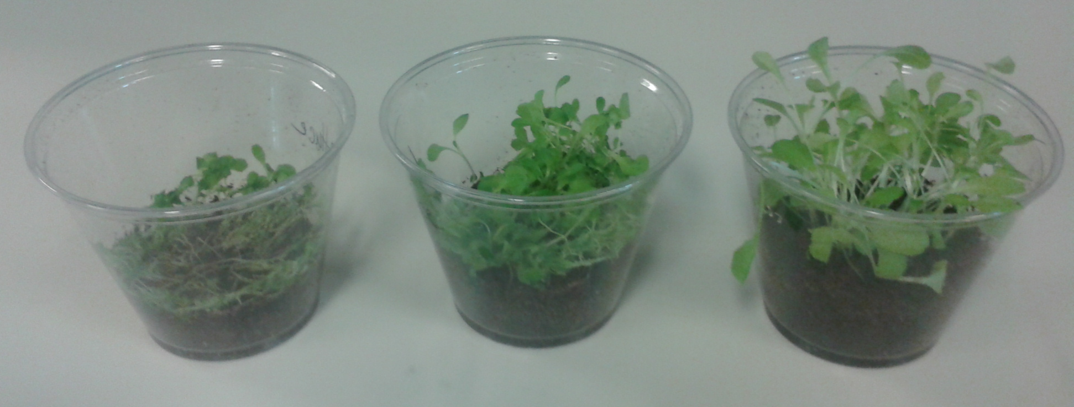
Notes:
Nancy

Slide 12
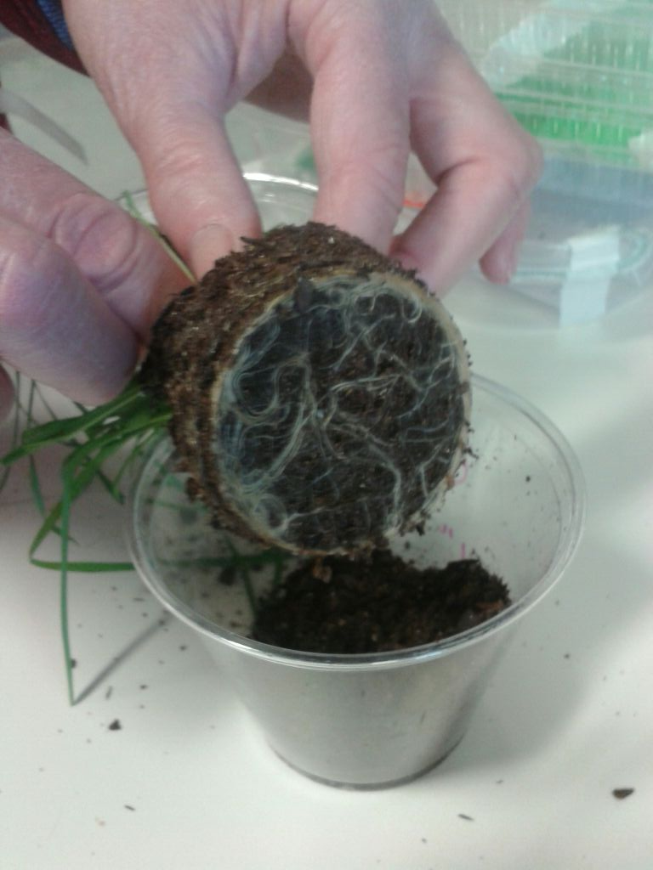

Slide 13
Design Task
Design the roof so as to minimize the amount of the soil that slips off roof.
3 Centimeters maximum depth of soil will be added
Students will need to measure depth of soil in their roofs to ensure that it does not exceed the maximum depth
Set-up the roof in the container
Measure soil that slides off the roof.
Notes:
Tahira and Bryan

Slide 14
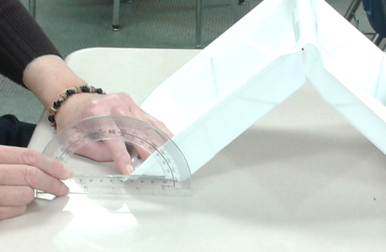
Measuring Angle of Tray

Slide 15
Materials
Show materials table

Slide 16
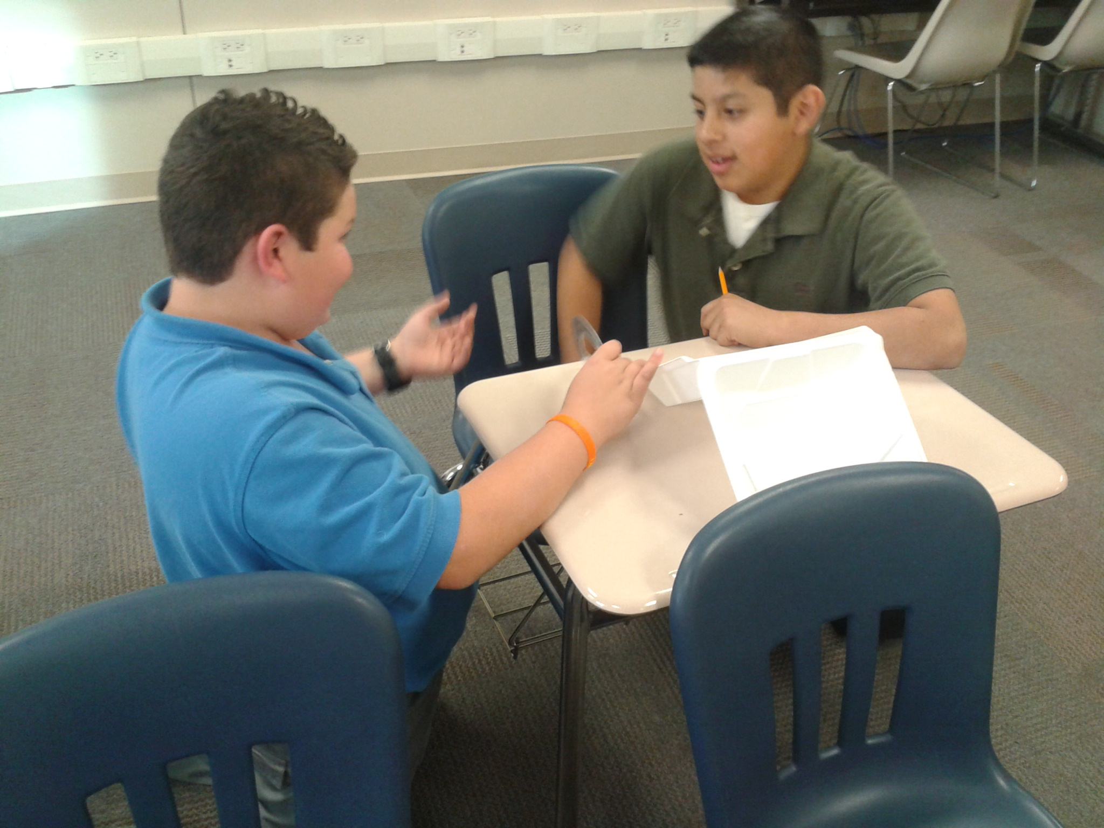

Slide 17
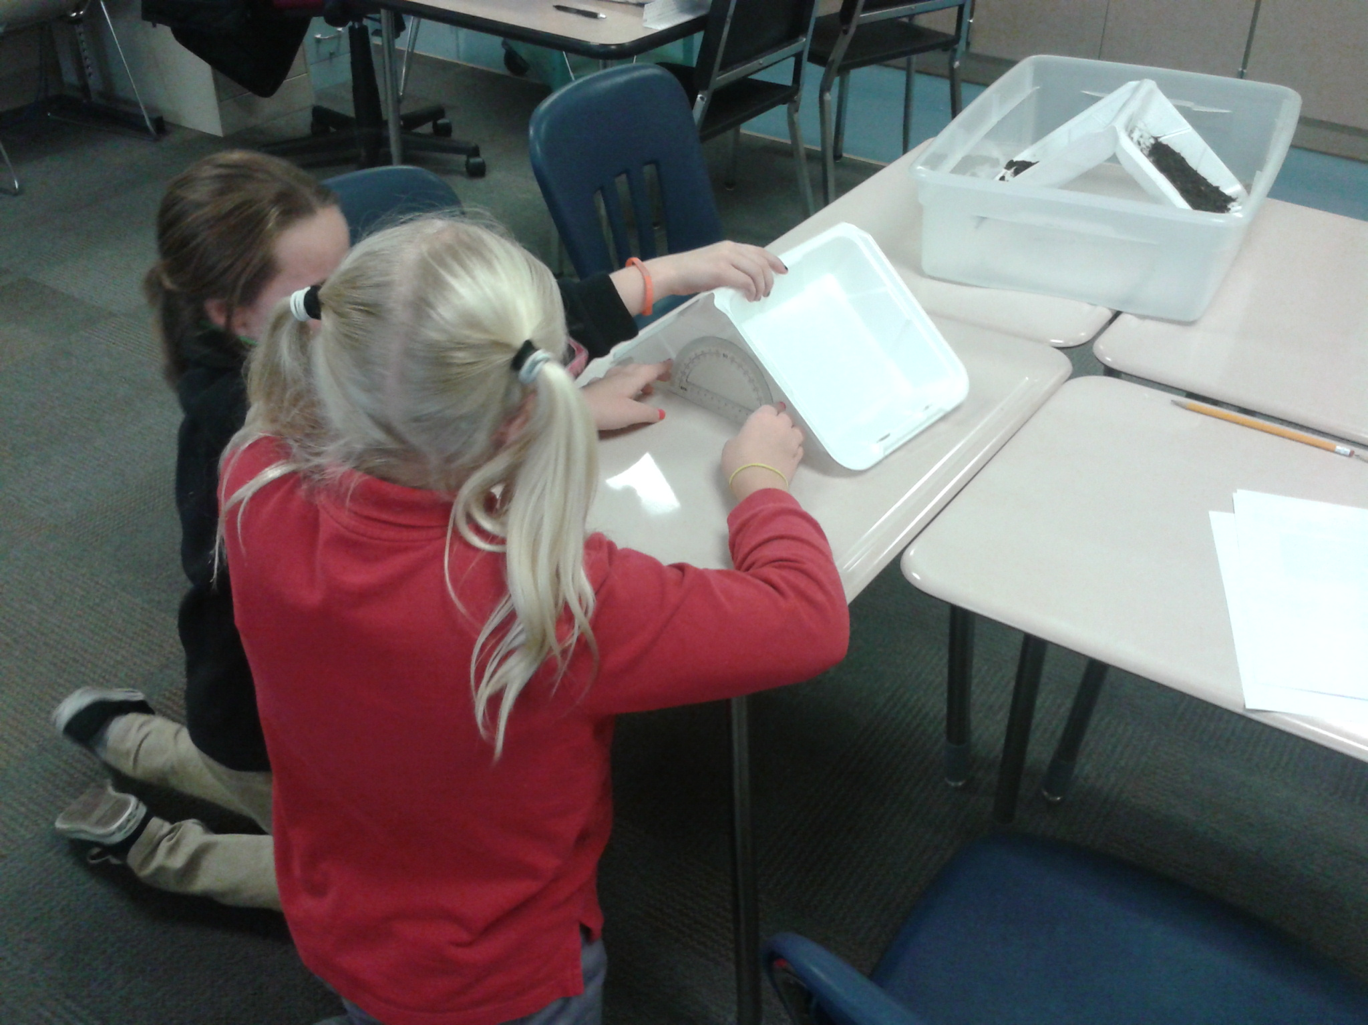

Slide 18
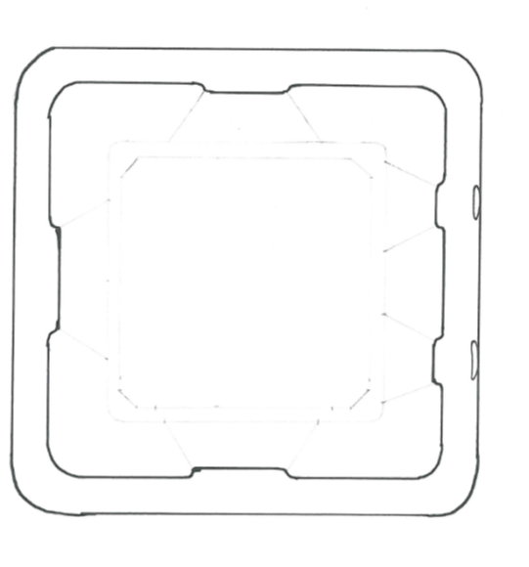

Slide 19
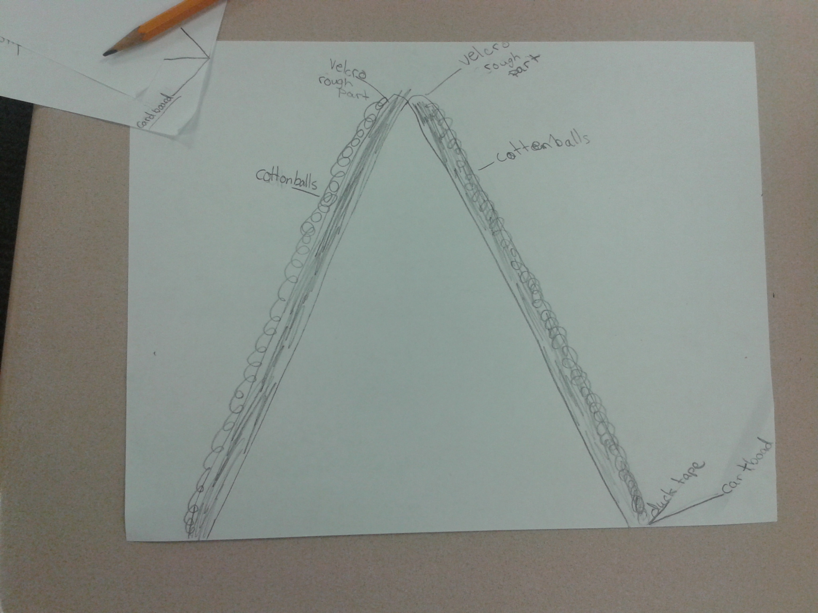

Slide 20
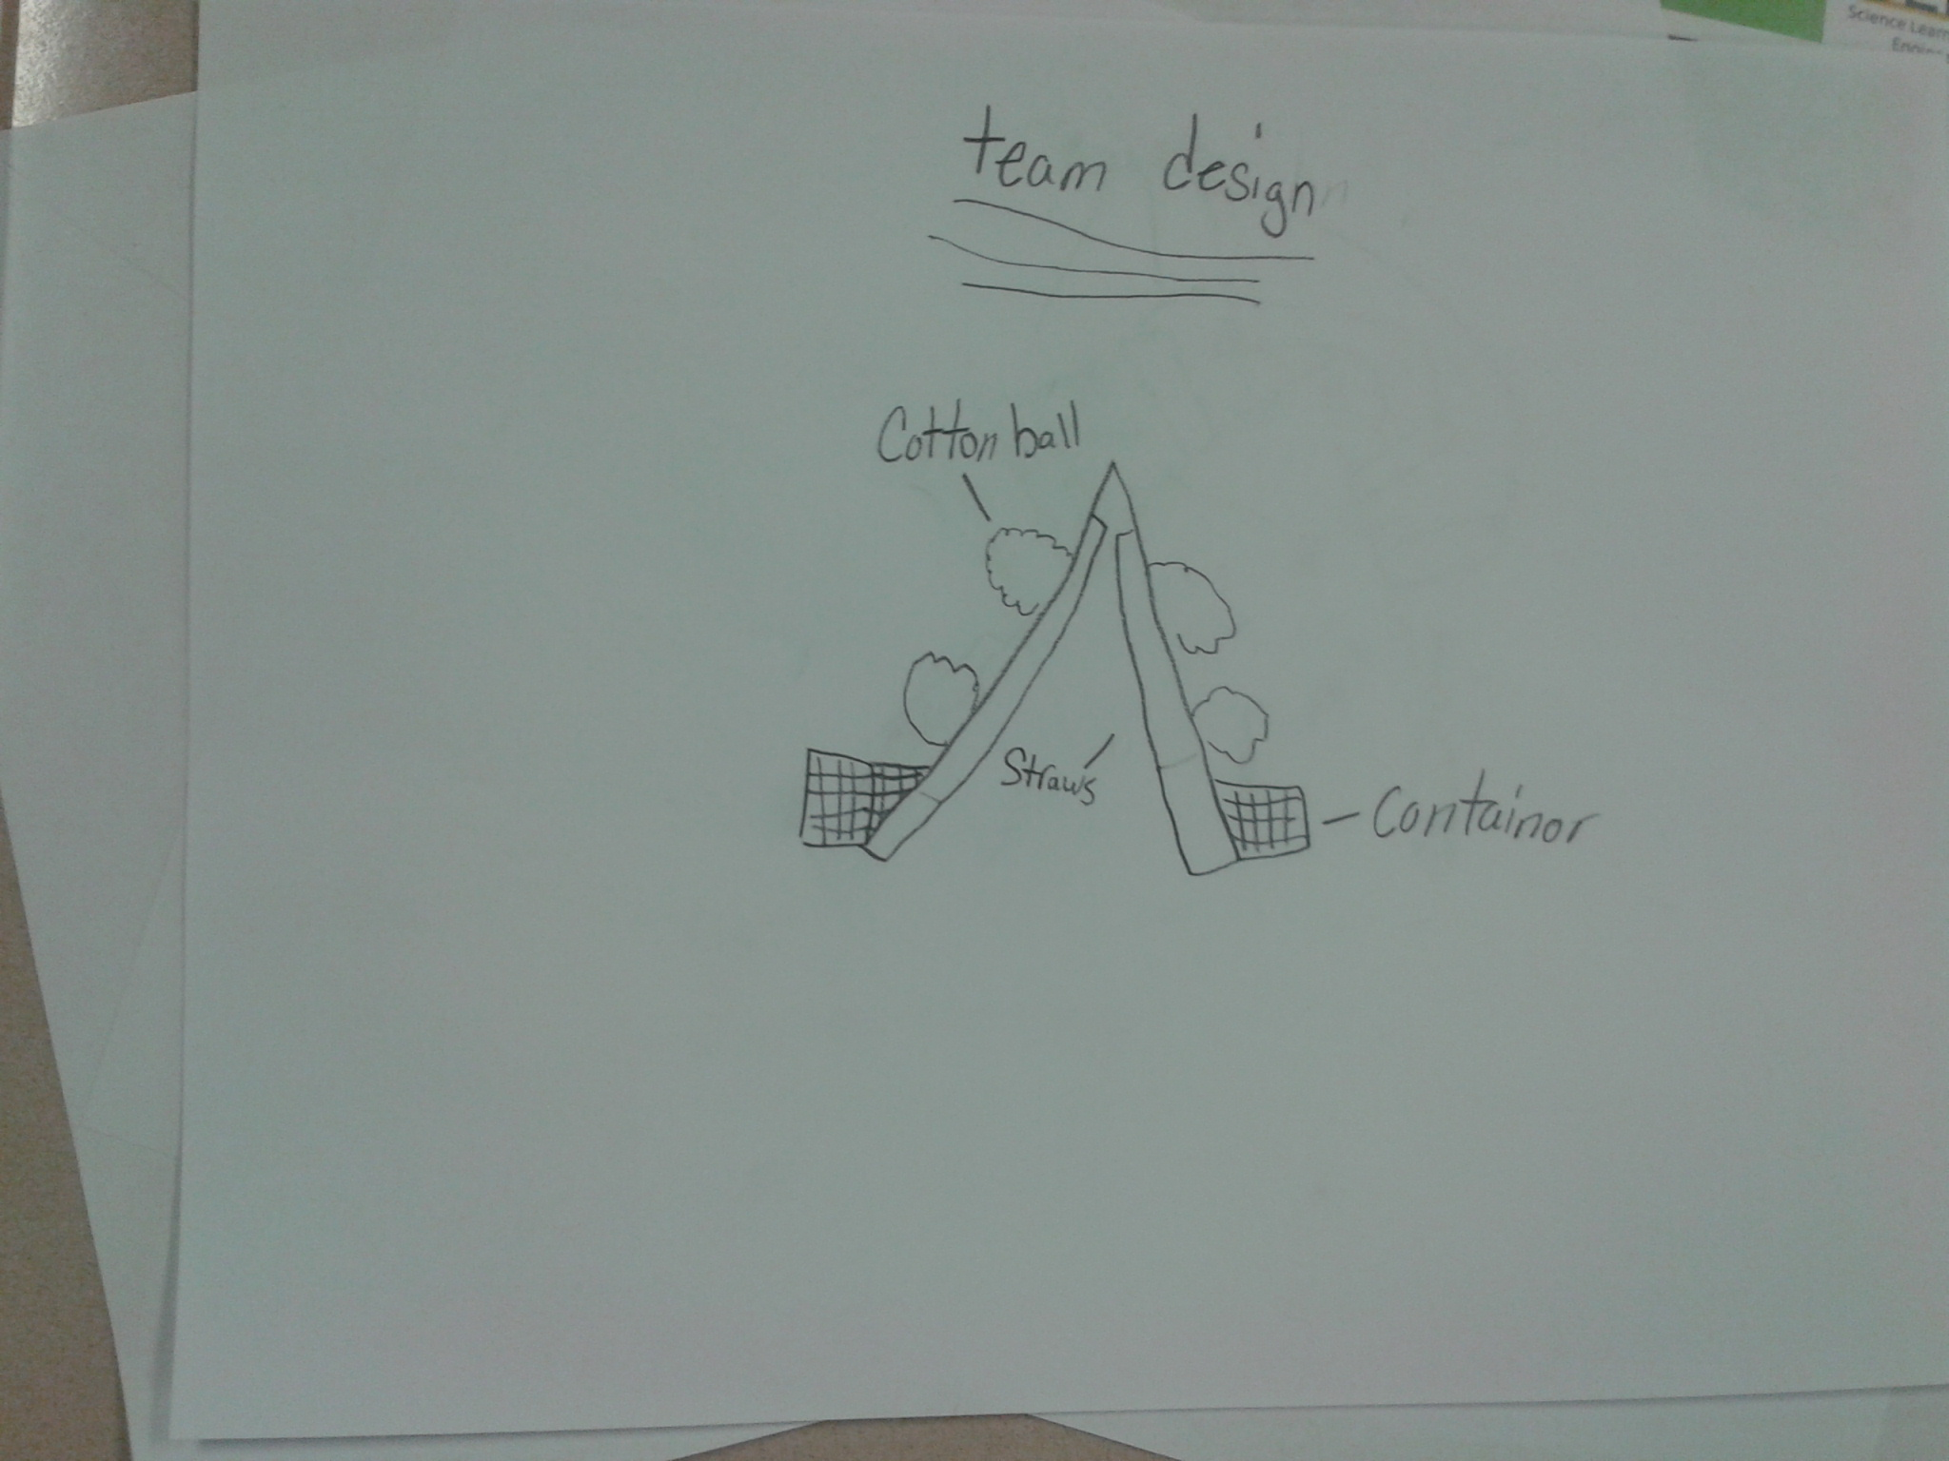

Slide 21
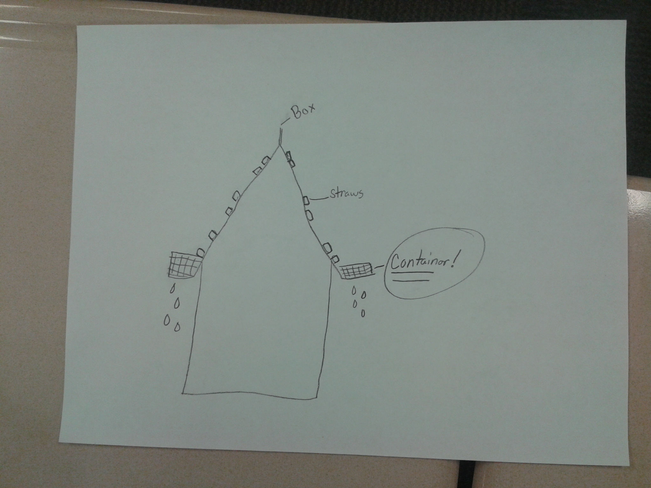

Slide 22
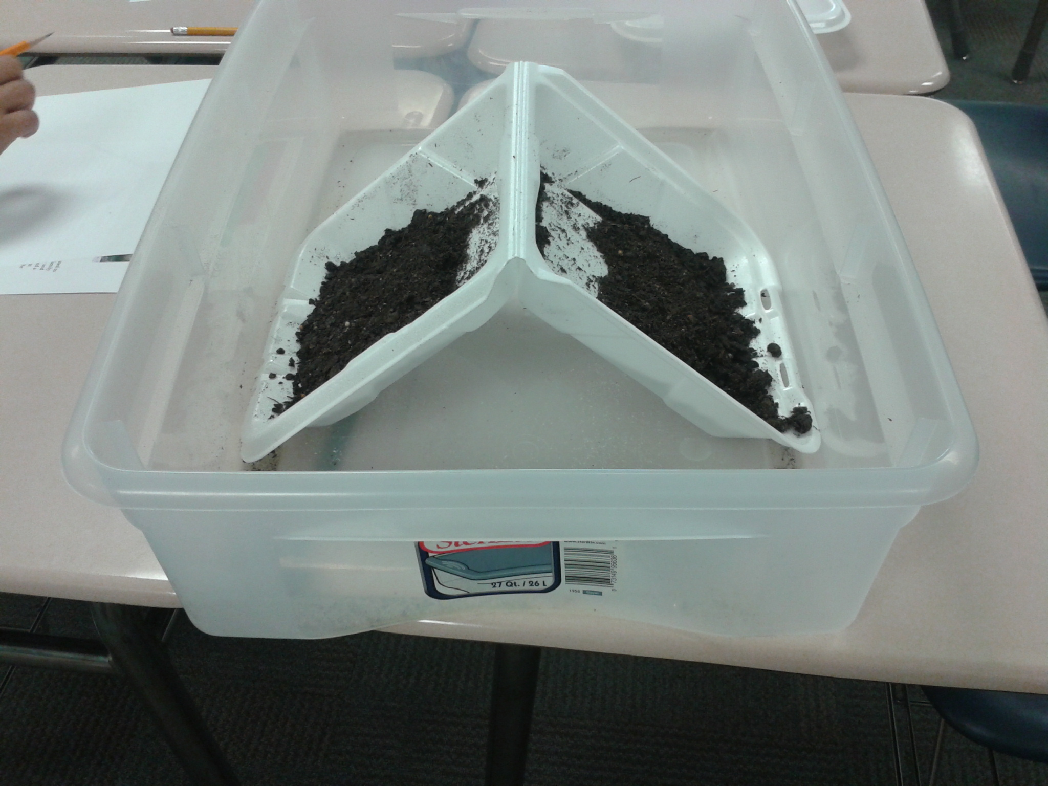

Slide 23
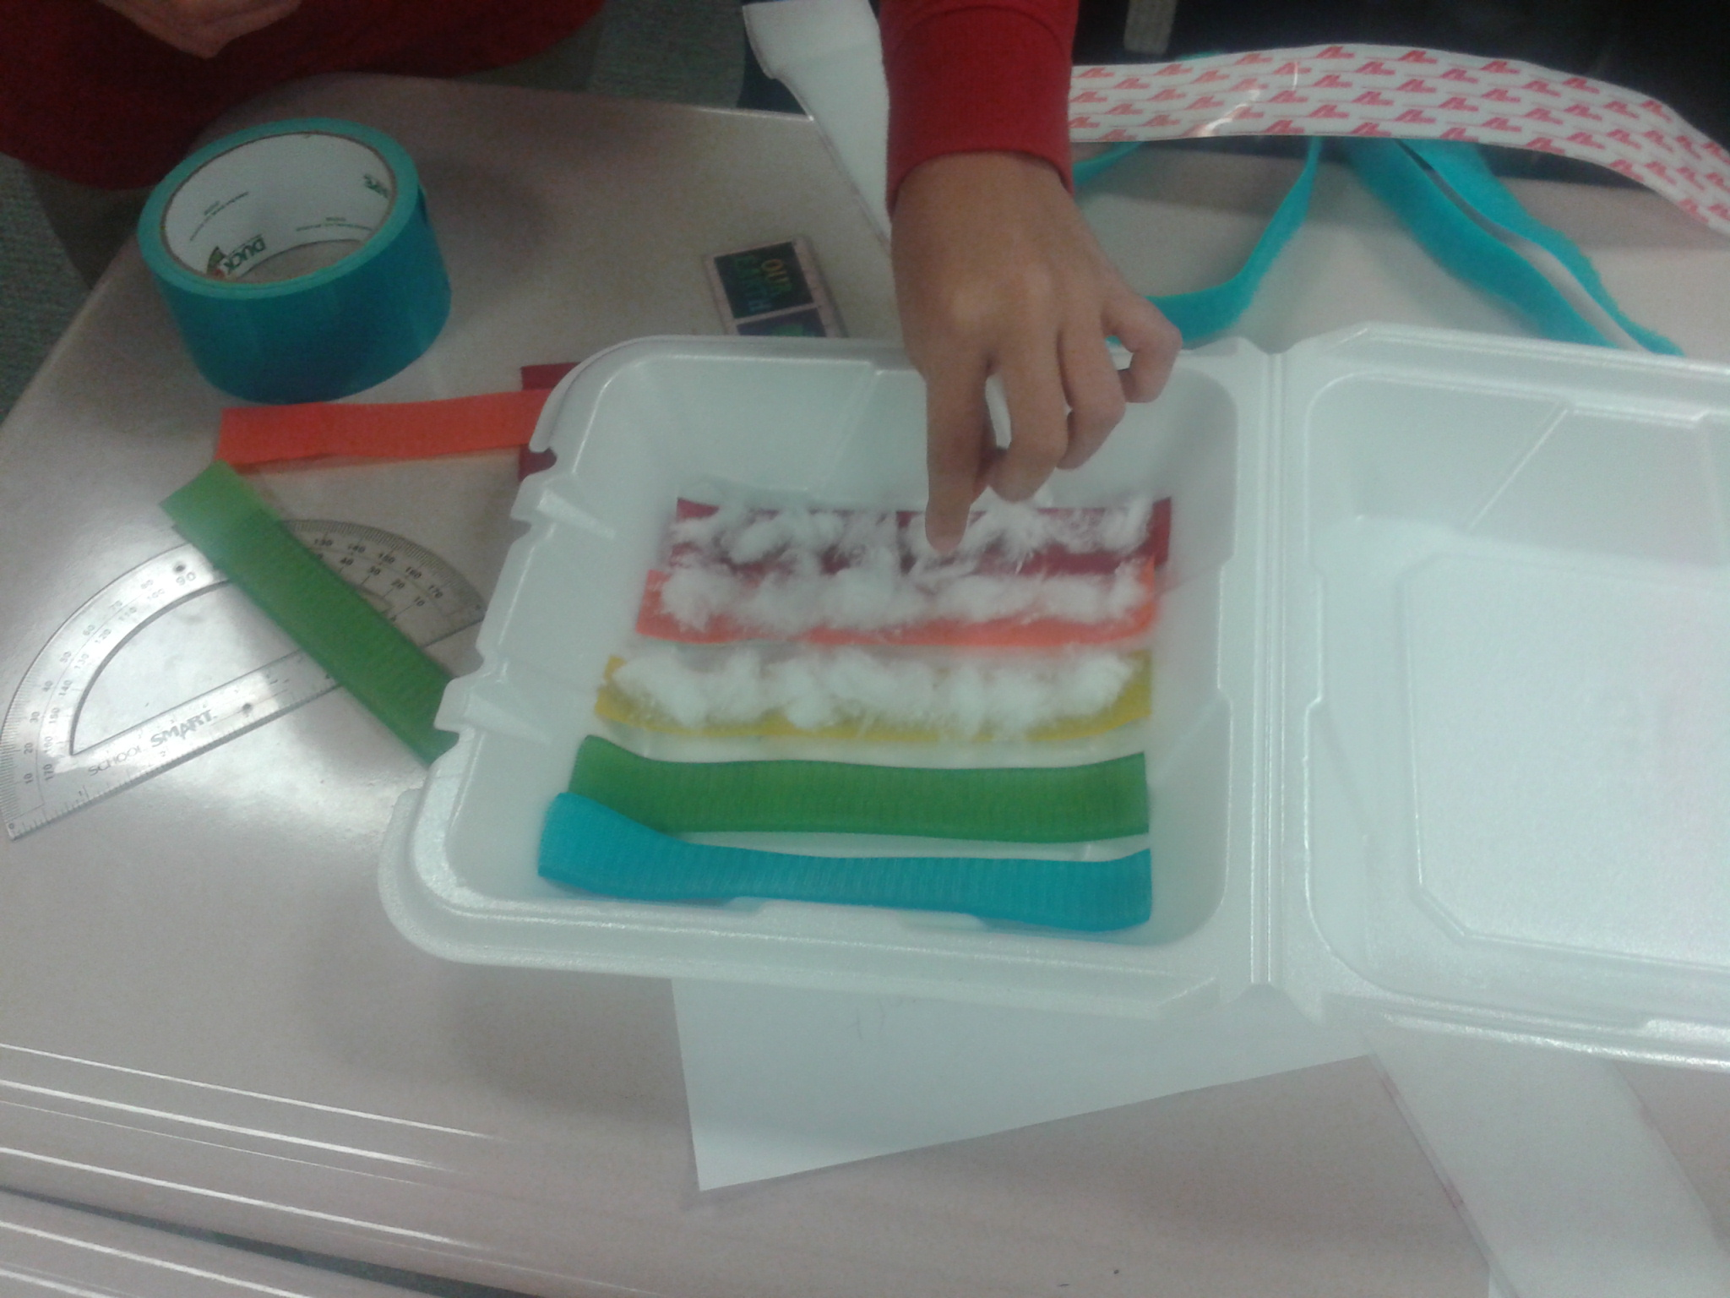

Slide 24
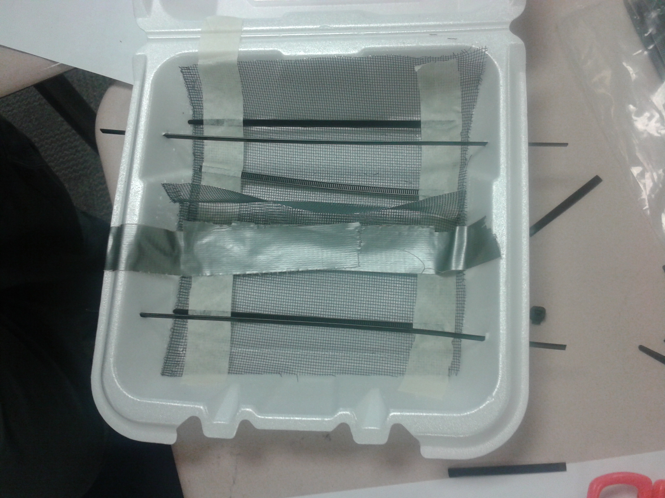

Slide 25
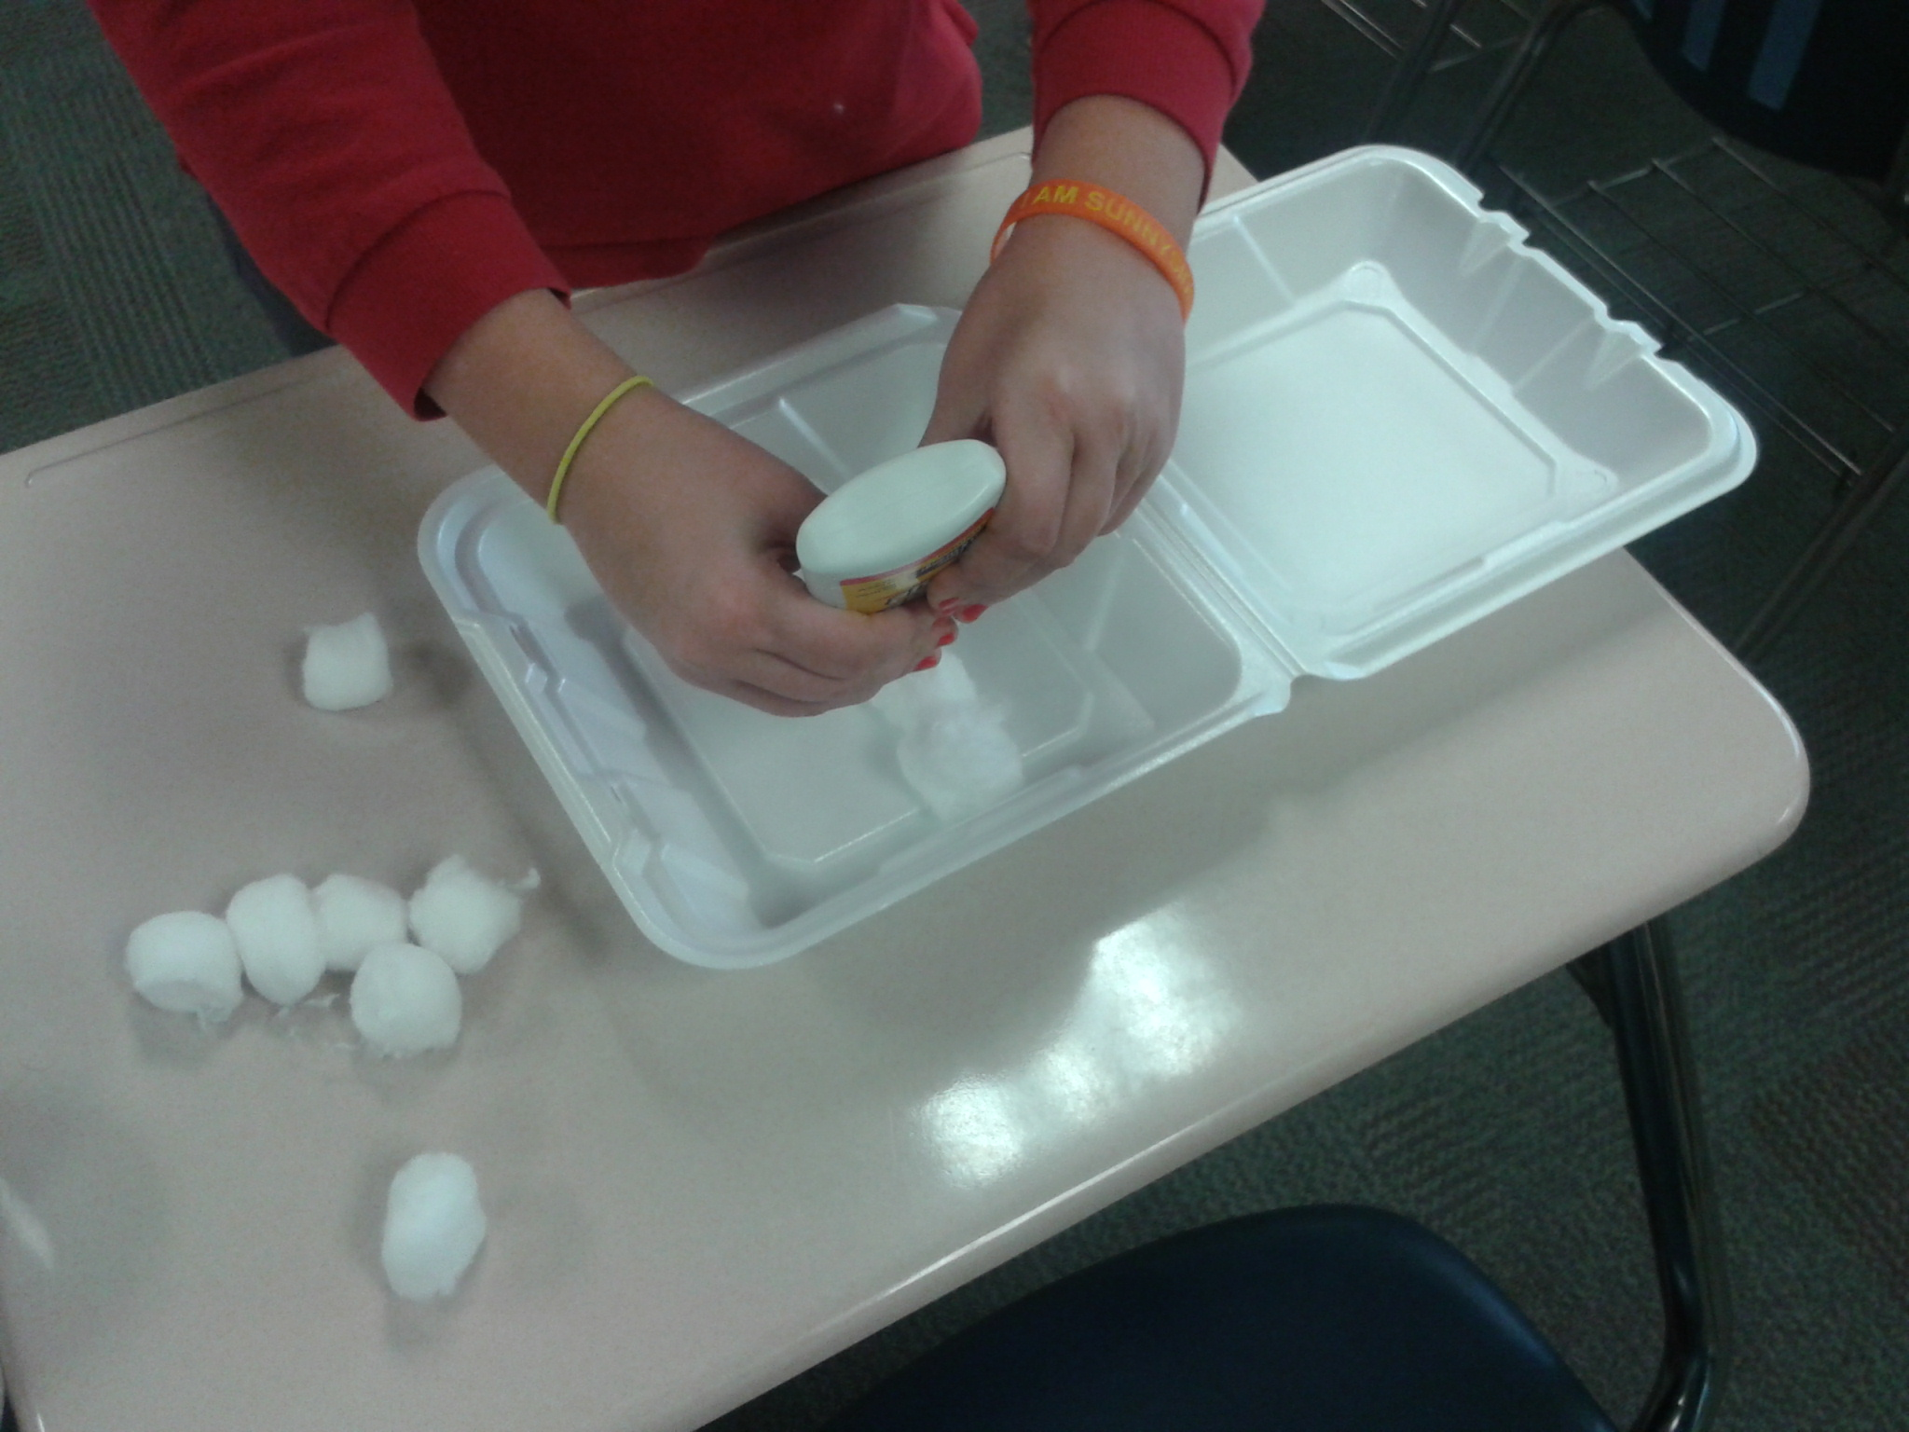

Slide 26
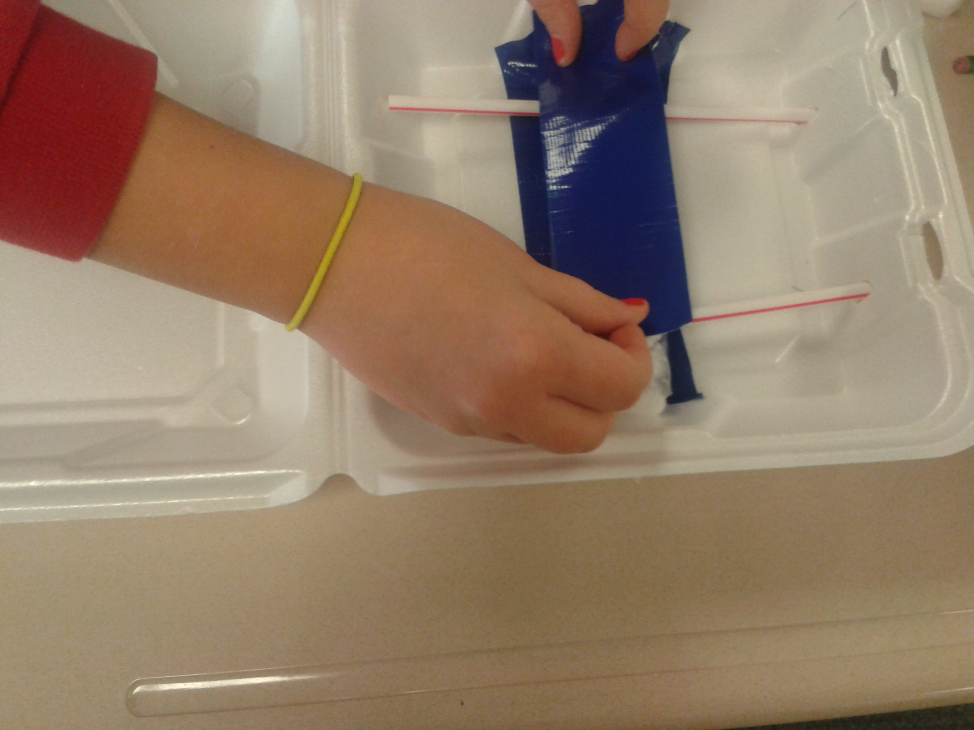

Slide 27
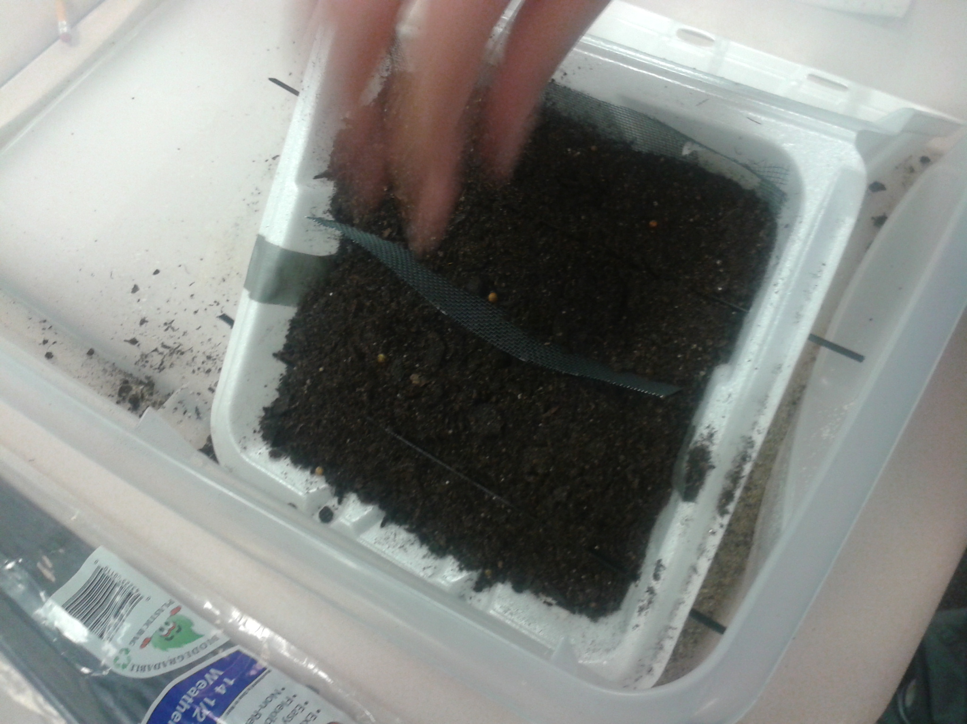

Slide 28
