Slide 1
Student Learning Research Data Collection 2013-2014
This project is supported by the National Science Foundation, Grant #0962840

Slide 2
Question guiding the SLED Partnership
If given the necessary tools and resources, cross-disciplinary support, and instructional time, could elementary/intermediate school teachers (grades 3 – 6) effectively improve students’ science achievement through an integrated curriculum based on the use of the engineering design process?

Slide 3
SLED Research Questions
How do students conceptualize and learn design?
How do students utilize and learn science when engaging in engineering design-based tasks?
What new science content knowledge do students construct when engaging in engineering design-based tasks?
How do students connect individual scientific concepts together in the context of an engineering design-based task and how enduring and accurate are these connections?
Notes:
TK and JS

Slide 4
SLED Research- Student Learning
Measuring students’ transfer of knowledge:
Pre and Post- Student Knowledge Tests
Student Participant Interviews
Think-aloud Protocol Method
Open-response/mental models
Indiana State-wide Test of Educational Progress (ISTEP)

Slide 5
Obtaining Consent/Assent
Purdue IRB compliance

Slide 6
Parent (or legal guardian) Consent
Printed on light blue paper- (for Knowledge tests and Interviews)
Parent Consent Forms distributed (sent home or open house)
Parents carefully read the form
For consent
initial and date the front
print parent’s name, sign and date the back
It is helpful if teachers have students print their name at the top of the form
Notes:
Both parents/guardian do not have to sign, just one
CHANGED BY SARA: Language on last bullet point – teachers can have student print their own names at the top in class

Slide 7
Parent Consent Form (Front)
Parent or Guardian Initials and Date

Slide 8
Parent Consent Form (Back)
Parent or Guardian Signature and Date

Slide 9
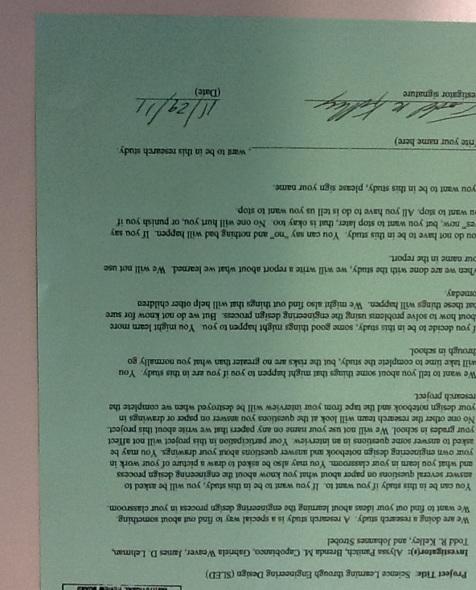
Student Assent
Printed on green paper- (for Knowledge tests and Interviews)
Student Assent Forms distributed in class.
Students carefully read the form
For Assent
print student’s name
It is helpful if the teacher
prints the child’s name at
the top of the form

Slide 10
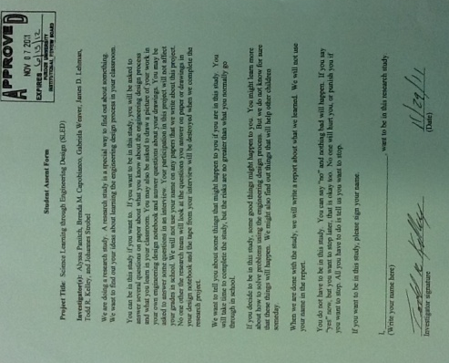
Video Consent/Assent
Three students will be selected to participate in a think-aloud protocol.
These students will need special consent/assent for the protocol study.
Rachel Smith will contact you via e-mail regarding this data collection.
The parent consent forms(Pink) will be sent to you.
The student assent (Yellow) will be collected by Rachel during the protocol session.

Slide 11
Student Data Collection

Slide 12
SLED Student Knowledge Tests
Test Structure:
Multiple choice (~15 questions)
Reflect vocabulary in text books
Science content
Engineering design process
Vary the depth of knowledge (level of difficulty)

Slide 13
Administering Student Knowledge Tests
A knowledge test is created for each design task.
A bank of pre-test (six per grade level) will be administered at the start of the school year.
A post test (same as pre-test) will be given within 5 days after the SLED lesson for each lesson implemented.
Notes:
No delayed post tests given this year

Slide 14
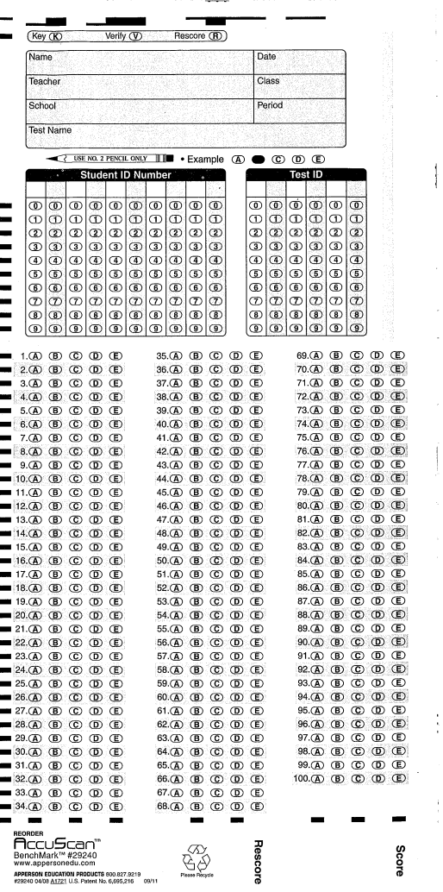
Delivering the Knowledge Test
Knowledge tests (Pre/Post) will be delivered to you electronically via e-mail
Student answer cards delivered the school office in envelopes marked for your classroom
Specific test instructions will be given via-email
Tests will be given to entire class by projecting test, reading aloud, and using answer cards completed in pencil

Slide 15
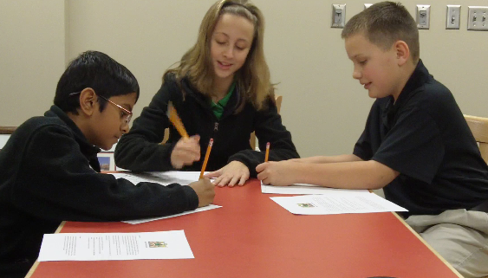
What is a Think Aloud Protocol?
Think-aloud protocol is a research methodology that requires one or more students to speak aloud their thoughts as they perform a task or activity.
SLED research uses a triad (group of three students) selected to collect data on student design thinking
Video taped during
the session
Notes:
Grounded in a theory of cognitive science, transfer of learning “allows students to apply what was learned in new situations and to learn related information more quickly” (Bransford, Brown, & Cocking, 1999, p. 17).

Slide 16
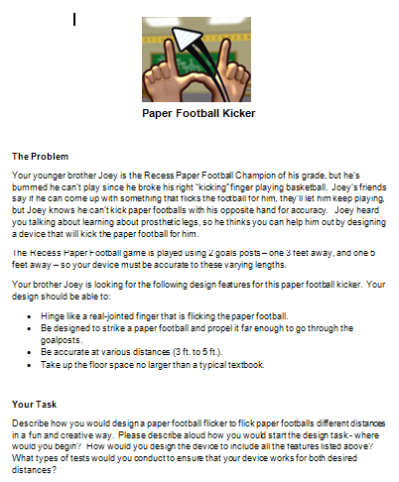
Transfer Problems
Transfer problems are “problems that are structurally, but not conceptually unfamiliar to the solver” (Robertson, 1990, p. 253).
Structured similarly to design briefs
Contains a scenario
Constraints and criteria
Specific instruction for the design team

Slide 17
Think Aloud Protocols: Your Responsibilities
Rachel may e-mail you after implementation of your SLED lesson to set up a protocol session
You will select a group of three students for the think-aloud protocol based on Rachel’s instructions.
You will send home a special video consent form (pink) to obtain parent permissions for the triad.
Notes:
Kevin will provide specific instructions that include:
Locating a place to conduct the think-aloud protocol
Selecting students that will talk and students that have already obtained IRB consent/assent
Obtain video consent from parents

Slide 18
Assessing Students’ Mental Models
Mental models include individual science topics and the relationships between them
Assessment instruments:
Draw-and-explain task
Open response questions
These assessments provide a snapshot of students’ conceptual understanding of a given science concept

Slide 19
Data Collection: Mental Models
Upon the completion of an engineering design task, a graduate assistant may contact you to schedule a time to administer the assessment items.
The instrument will be given to the entire class
Two students will be interviewed individually(about 5-10 minutes each)

