Slide 1


Purdue-Woodland SLED Team
Ann Kirchmaier, PU Biochemistry
John Lumkes, PU Agriculture & Biological Engr
Jaime Peterson, Woodland Elementary (3rd)
Jill Shambach, Woodland Elementary (3rd)
Kendra Erk, PU Materials Engineering
Notes:
Ann, 494-0977, akirchma@purdue.edu
John, 494-1173, lumkes@purdue.edu
Jaime, jppeterson@tsc.k12.in.us
Jill, jrshambach@tsc.k12.in.us
Kendra, 494-4118, erk@purdue.edu

Slide 2
3rd Grade Inquiry & Design Activity
Indiana Standard 3.4.2: Define the uses and types of simple machines and utilize simple machines in the solution to a “real world” problem

Slide 3
Lesson Objectives
Identify and describe simple machines and apply their use to real-world tasks
Define what a compound machine is and give several examples

Slide 4
Lesson Vocabulary
(pg. 2)
Term | Defined by a scientist or engineer | Defined by a 3rd grader
Simple Machine | Simple non-powered devices that change the directions of forces and motions | Tools that make work easier
Force | Interaction between physical bodies that create a pushing or pulling on the bodies | A push or a pull
Work | The product of force and motion | When a force moves an object
Gravity | The force exerted by celestial bodies that acts to pull objects to their centers | The force that keeps us on earth; prevents us from flying into space
Friction | An force opposing relative motion between objects | A force that holds back the movement of an object (i.e. skating on an ice rink vs. skating on carpet)
Incline Plane | A planar surface at an angle from horizontal | Helps us move things higher and lower
Screw | An inclined plane wrapped around a cylinder (round tube) | Holds things together; a long and twisted incline plane
Wedge | Two planar surfaces at small acute angles and coming together at a sharp edge | Splits or cuts objects
Lever | A rigid object that rotates on a pivot point | Moves things up and down
Pulley | A wheel that a cord can wrap around to change direction of force | Changes the direction of something
Wheel and Axle | Two round objects connected by a straight rod | Moves objects by rolling
Gear | A set of wheels with teeth that engage and cause both wheels to rotate and transmit force | Toothed wheel

Slide 5
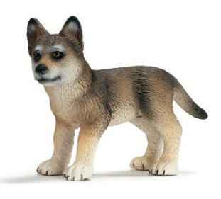
Design Activity Preview
Construct a compound machine to trap a wolf!
Machine will be entirely constructed from classroom materials
Super cute wolf pup

Slide 6
Work
Science Background
(pg. 5)
Using force to move an object

Slide 7
force
Push or pull

Slide 8
forces
gravity
friction
Force that pulls two
objects together
Gravity pulls us
toward the ground
Force that
holds back the
movement
of an object

Slide 9
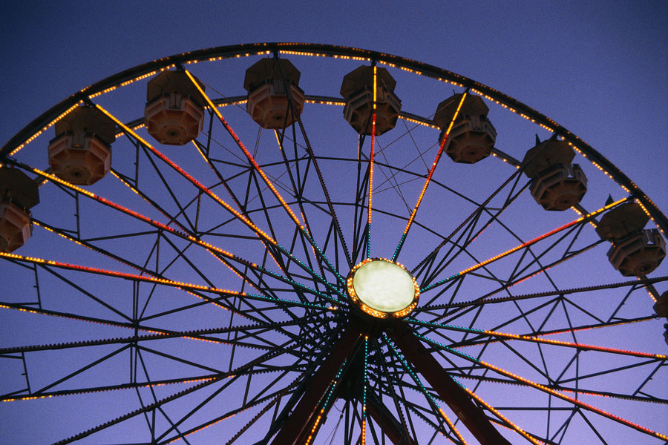
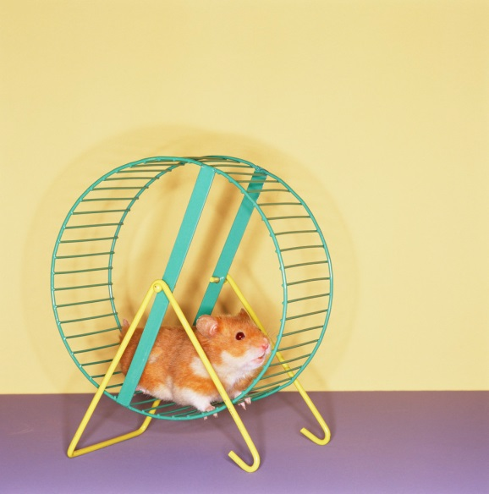
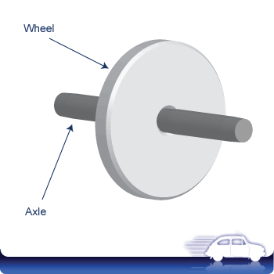
Wheel and Axle
connected so they
turn together

Slide 10

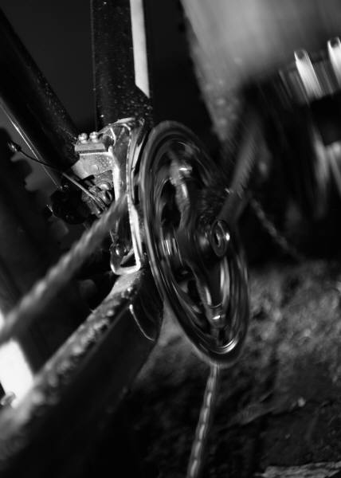
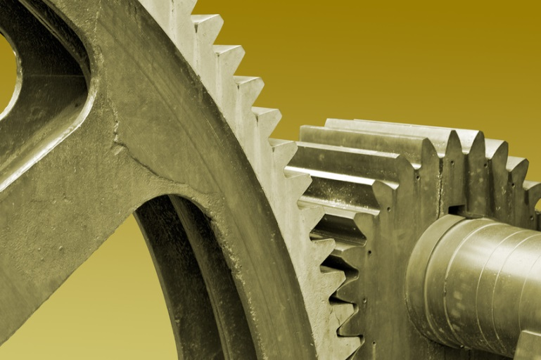
gears
Toothed wheels

Slide 11
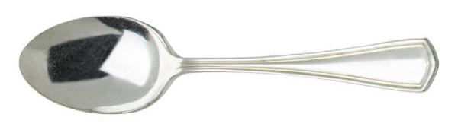
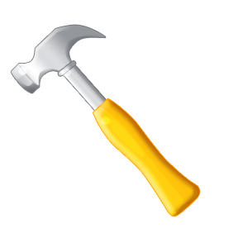
lever
fulcrum
a bar that pivots on a fixed point
the point that a lever pivots on

Slide 12
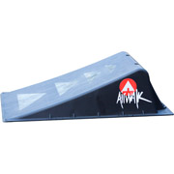
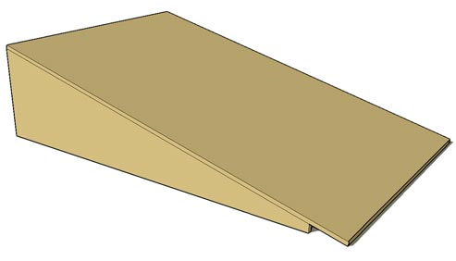
Inclined plane
flat, sloping surface

Slide 13
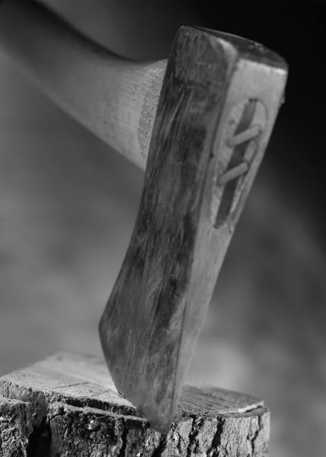
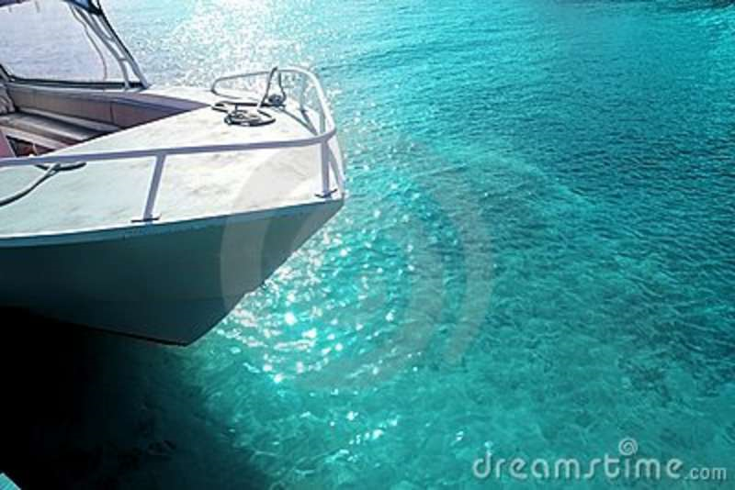
wedge
2 inclined planes placed back to back.
Used to force two things apart or split one thing into two.

Slide 14
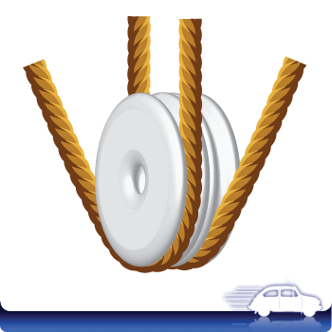
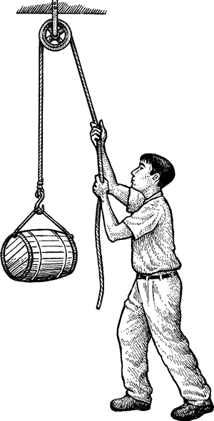
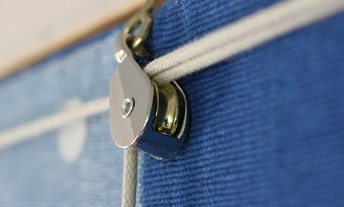
pulley
a wheel with a rope, cord, or chain around it
Makes work easier by changing the direction of force

Slide 15
Simple machines
few or no moving parts
used by applying force
make work easier by changing the amount of force needed to do the work

Slide 16
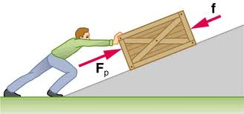
Lesson Plan #1: Introduction
(pg. 7)
Objective: introduce the students to the concepts of work and forces.

Slide 17
Lesson Plan #2: Inquiry Activity
(pg. 7)
Objective: students will explore different simple machines, including:
real-world examples,
examples specific to nature, and
classroom-constructed machines
Notes:
Inclined Plane
Classroom version: make from cardboard/foam and stack of books
Real: wheel chair ramp
Nature: ??
Lever
Classroom version: make from ruler and a fulcrum (small object)
Real: See-Saw on the play ground
Nature: ??
Wedge
Classroom version: make from cardboard/foam
Real: classroom door stop
Nature: plant growing through a crack in the sidewalk
Pulley
Classroom version: string around a pencil
Real: System to raise and lower the USA flag from a flag pole
Nature: ??
Screw
Classroom version: ??
Real: lid of a jar, lightbulb, a real screw
Nature: ??
Wheel
Classroom version: mints on straw, bottom ends of a Styrofoam cup on a pencil
Real: wheels on a car
Nature: (wheel) rolling caterpillars, salamanders, from BBC (Chell N. can work to get future permissions); (“toothed wheel) Leaf hopper, gear legs SEM and videos

Slide 18
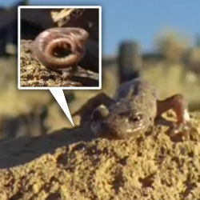
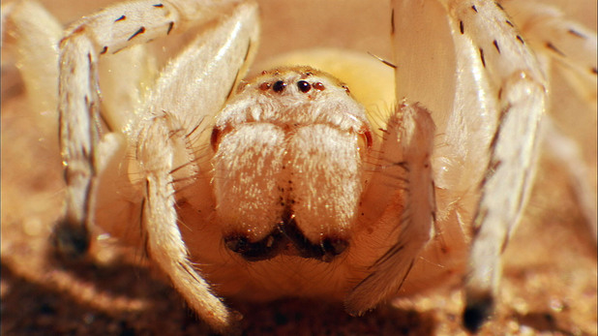
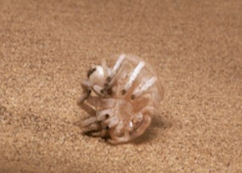
(pg. 13)
The Wheel and Axle
Salamanders and Caterpillars, oh my!
http://www.youtube.com/watch?v=HmLS2WXZQxU
http://videosift.com/video/Nature-invented-the-wheel
And Golden Wheel Spiders, too!
http://www.youtube.com/watch?v=V4odlo0Afjs

Slide 19
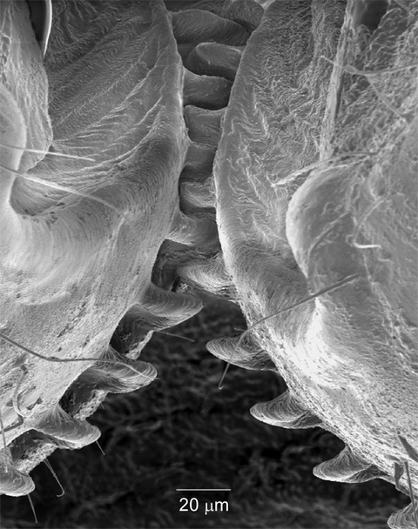
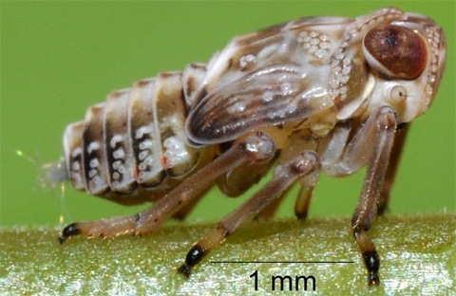
(pg. 13)
The Wheel and Axle
Planthoppers hop with a modified wheel: The Gear.
Planthopper nymph
http://www.youtube.com/watch?v=cq0Mf2pt2XA
http://www.npr.org/2013/09/13/219739500/living-gears-help-this-bug-jump
Gears on hind legs
Planthopper synchronize their hind leg movements in 30 millionths of a second using small gears on the first segment of its hind legs (similar to the top of your thigh bone).
As one leg prepares to leap, the interlocking gear system causes the other leg to move at the same time. This lets the planthopper to propel itself faster and farther and in a straighter path to escape danger. At such speeds, synchronizing leg movements is very important, as one wrong move could send the insect springing to the side instead of forward.

Slide 20
Lesson Plan #2: Inquiry Activity
(pg. 13)
Try to build a wheel & axle system using the materials at your table!
Notes:
Inclined Plane
Classroom version: make from cardboard/foam and stack of books
Real: wheel chair ramp
Nature: ??
Lever
Classroom version: make from ruler and a fulcrum (small object)
Real: See-Saw on the play ground
Nature: ??
Wedge
Classroom version: make from cardboard/foam
Real: classroom door stop
Nature: plant growing through a crack in the sidewalk
Pulley
Classroom version: string around a pencil
Real: System to raise and lower the USA flag from a flag pole
Nature: ??
Screw
Classroom version: ??
Real: lid of a jar, lightbulb, a real screw
Nature: ??
Wheel
Classroom version: mints on straw, bottom ends of a Styrofoam cup on a pencil
Real: wheels on a car
Nature: (wheel) rolling caterpillars, salamanders, from BBC (Chell N. can work to get future permissions); (“toothed wheel) Leaf hopper, gear legs SEM and videos

Slide 21
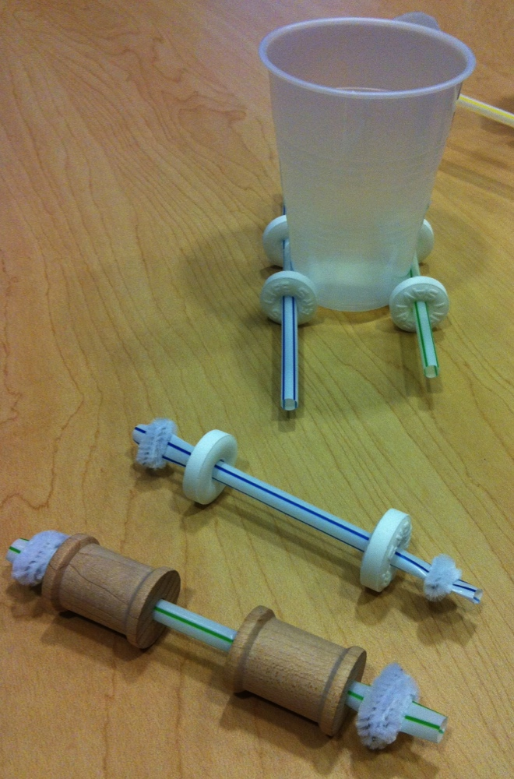
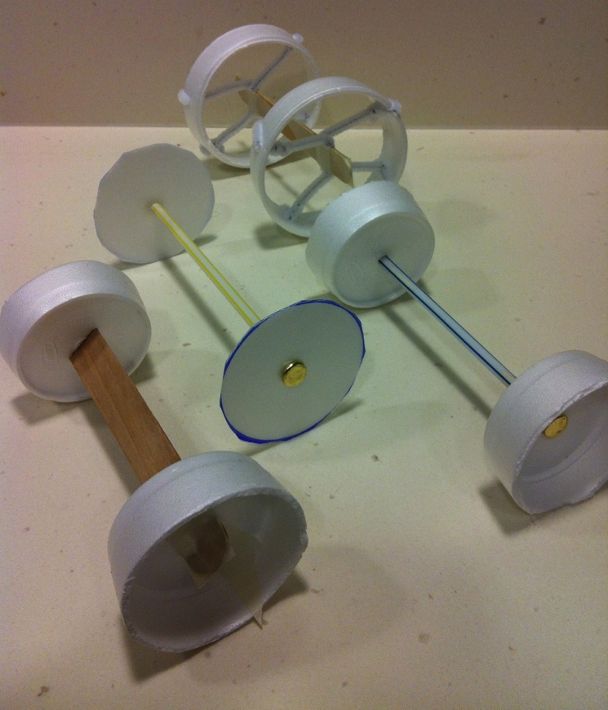

Slide 22
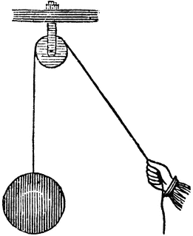
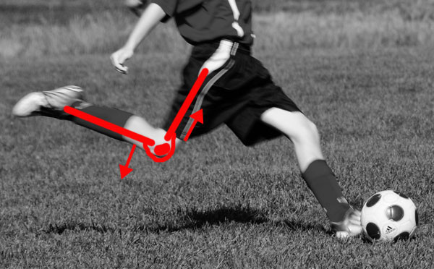
(pg. 14)
The Pulley
“The pulley is a way of getting force to go around corners…”
“The patella, or knee cap, allows your thigh muscles to lift your lower leg without crushing the knee joint. If the quadriceps were connected directly to your shin, every time it contracted, the bones of the lower leg would grind into the base of the femur, and it would take a lot of effort to move. But by routing the connection over the top of the patella, evolution changed the geometry--when the quad pulls on the lower leg, the force comes from in front of the shin, rather than from directly above, so the shin moves easily.”

Slide 23
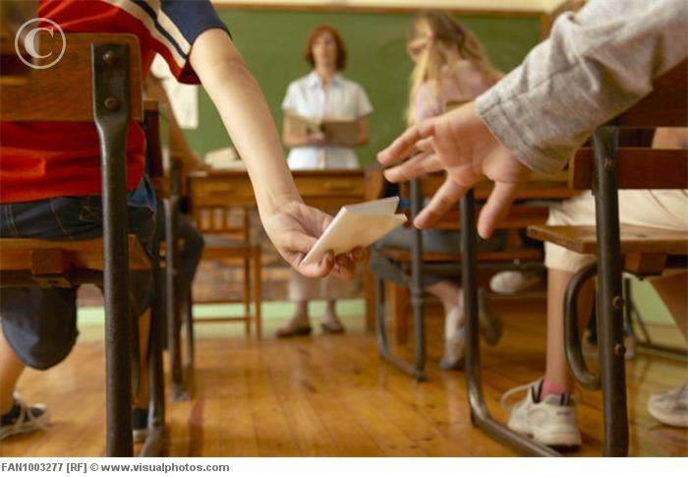
Lesson Plan #2: Inquiry Activity
(pg. 14)
Using the materials at your table, try to build a pulley system to pass messages to a classmate seated across the room.
Notes:
Inclined Plane
Classroom version: make from cardboard/foam and stack of books
Real: wheel chair ramp
Nature: ??
Lever
Classroom version: make from ruler and a fulcrum (small object)
Real: See-Saw on the play ground
Nature: ??
Wedge
Classroom version: make from cardboard/foam
Real: classroom door stop
Nature: plant growing through a crack in the sidewalk
Pulley
Classroom version: string around a pencil
Real: System to raise and lower the USA flag from a flag pole
Nature: ??
Screw
Classroom version: ??
Real: lid of a jar, lightbulb, a real screw
Nature: ??
Wheel
Classroom version: mints on straw, bottom ends of a Styrofoam cup on a pencil
Real: wheels on a car
Nature: (wheel) rolling caterpillars, salamanders, from BBC (Chell N. can work to get future permissions); (“toothed wheel) Leaf hopper, gear legs SEM and videos

Slide 24
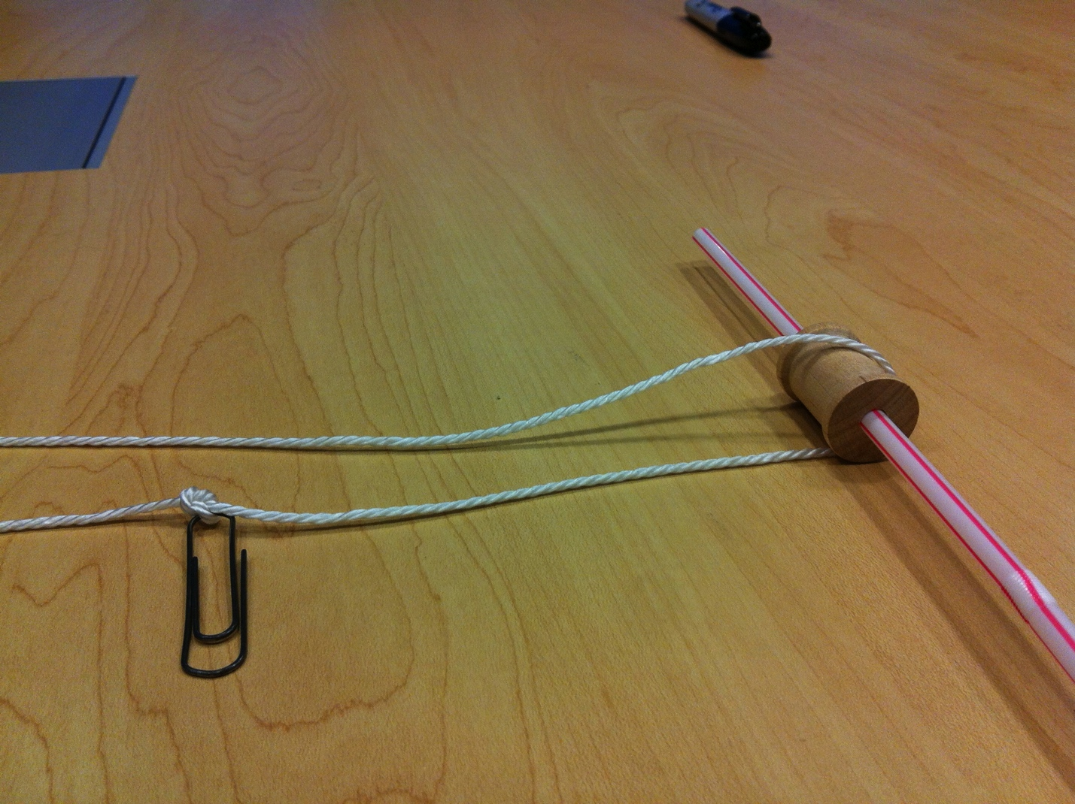

Slide 25
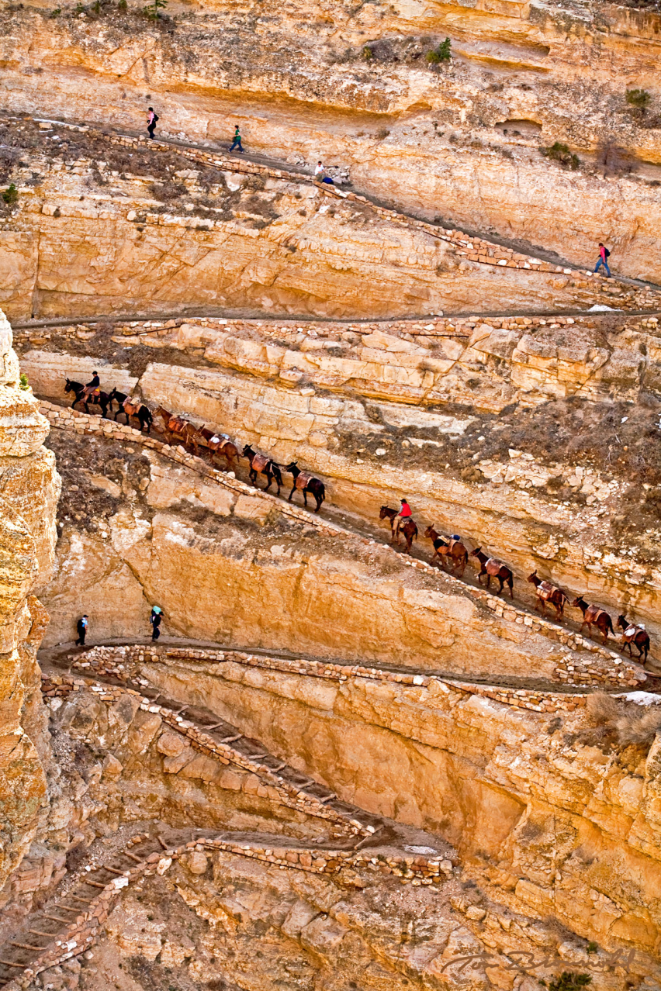
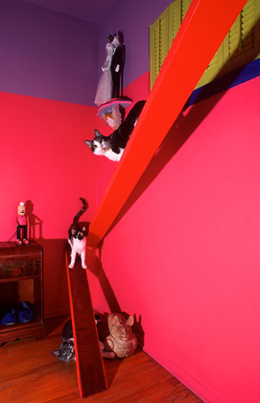
The Inclined Plane
(pg. 8)
Cats like them.
Penguins, too!
http://www.youtube.com/watch?v=CkMzHGA8GgM

Slide 26
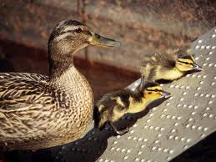
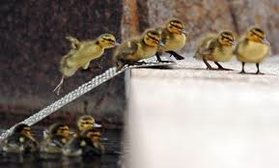
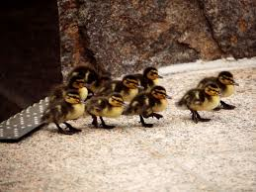
(pg. 8)
The Inclined Plane

Slide 27
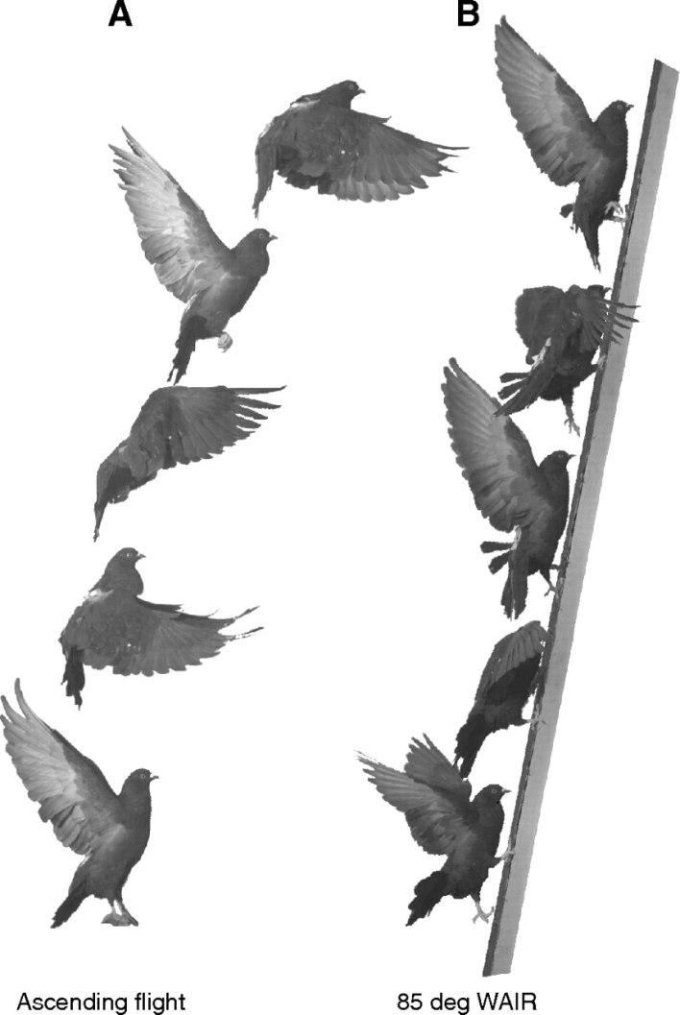
(pg. 8)
The Inclined Plane
http://www.youtube.com/watch?v=e81J915TEXg
J Exp Biol 214:2354-2361, 2011
Wing-assisted incline running (WAIR): when a bird flaps its wings to aid in climbing a slope. Ground birds use this as an escape strategy.

Slide 28
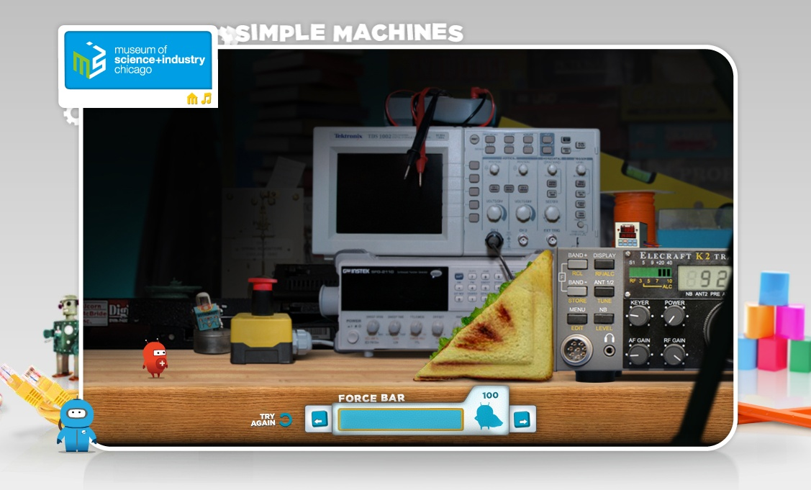
Inclined Plane Online Example
(pg. 8)
Chicago Museum of Science & Industry Simple Machines game
http://www.msichicago.org/fileadmin/Activities/Games/simple_machines/

Slide 29
Lesson Plan #2: Inquiry Activity
What are the different ways you could construct an inclined plane using the materials at your table?
Notes:
Inclined Plane
Classroom version: make from cardboard/foam and stack of books
Real: wheel chair ramp
Nature: ??
Lever
Classroom version: make from ruler and a fulcrum (small object)
Real: See-Saw on the play ground
Nature: ??
Wedge
Classroom version: make from cardboard/foam
Real: classroom door stop
Nature: plant growing through a crack in the sidewalk
Pulley
Classroom version: string around a pencil
Real: System to raise and lower the USA flag from a flag pole
Nature: ??
Screw
Classroom version: ??
Real: lid of a jar, lightbulb, a real screw
Nature: ??
Wheel
Classroom version: mints on straw, bottom ends of a Styrofoam cup on a pencil
Real: wheels on a car
Nature: (wheel) rolling caterpillars, salamanders, from BBC (Chell N. can work to get future permissions); (“toothed wheel) Leaf hopper, gear legs SEM and videos

Slide 30
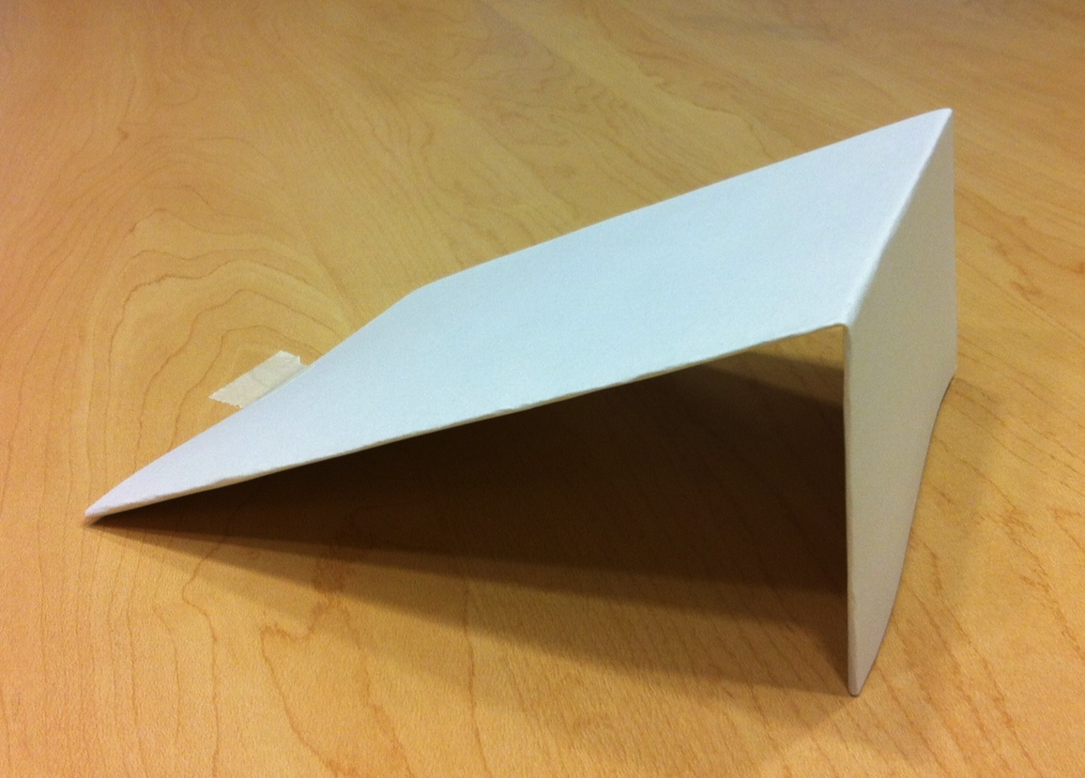

Slide 31
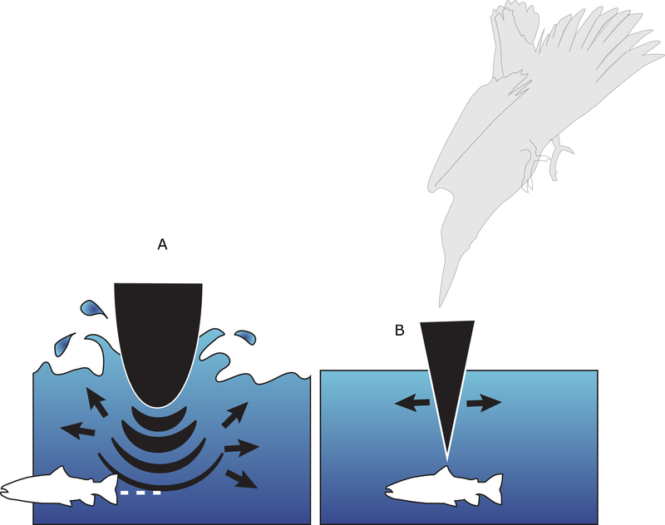
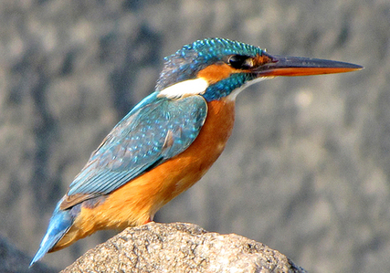
(pg. 9)
The Wedge
The Kingfisher
“If a kingfisher had a rounded beak, such as on the left, it would push water ahead of it, scaring or displacing the prey. Instead, the wedge-shaped beak and head (right) enters the water without a splash, increasing the changes of a successful hunt. Artist: Emily Harrington. Copyright: All rights reserved.”
http://www.asknature.org/strategy/4c3d00f23cae38c1d23517b6378859ee

Slide 32
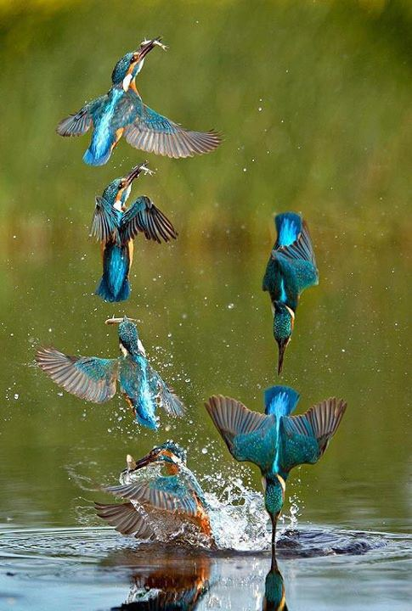
(pg. 9)
The Wedge
The Kingfisher fishing!
http://www.youtube.com/watch?v=1CsyenHROSE
http://www.youtube.com/watch?v=6YRM0sy3xIY
http://besttravelphotos.me/2012/11/14/airborne-fishing-kingfisher-england/

Slide 33
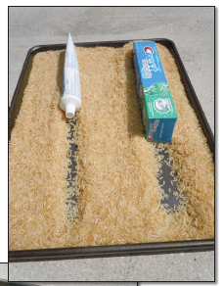
Lesson Plan #2: Inquiry Activity
(pg. 9)
Activity: watching wedges in action!
Notes:
Inclined Plane
Classroom version: make from cardboard/foam and stack of books
Real: wheel chair ramp
Nature: ??
Lever
Classroom version: make from ruler and a fulcrum (small object)
Real: See-Saw on the play ground
Nature: ??
Wedge
Classroom version: make from cardboard/foam
Real: classroom door stop
Nature: plant growing through a crack in the sidewalk
Pulley
Classroom version: string around a pencil
Real: System to raise and lower the USA flag from a flag pole
Nature: ??
Screw
Classroom version: ??
Real: lid of a jar, lightbulb, a real screw
Nature: ??
Wheel
Classroom version: mints on straw, bottom ends of a Styrofoam cup on a pencil
Real: wheels on a car
Nature: (wheel) rolling caterpillars, salamanders, from BBC (Chell N. can work to get future permissions); (“toothed wheel) Leaf hopper, gear legs SEM and videos

Slide 34
Lesson Plan #2: Inquiry Activity
Try to build a wedge using the materials at your table!
Notes:
Inclined Plane
Classroom version: make from cardboard/foam and stack of books
Real: wheel chair ramp
Nature: ??
Lever
Classroom version: make from ruler and a fulcrum (small object)
Real: See-Saw on the play ground
Nature: ??
Wedge
Classroom version: make from cardboard/foam
Real: classroom door stop
Nature: plant growing through a crack in the sidewalk
Pulley
Classroom version: string around a pencil
Real: System to raise and lower the USA flag from a flag pole
Nature: ??
Screw
Classroom version: ??
Real: lid of a jar, lightbulb, a real screw
Nature: ??
Wheel
Classroom version: mints on straw, bottom ends of a Styrofoam cup on a pencil
Real: wheels on a car
Nature: (wheel) rolling caterpillars, salamanders, from BBC (Chell N. can work to get future permissions); (“toothed wheel) Leaf hopper, gear legs SEM and videos

Slide 35
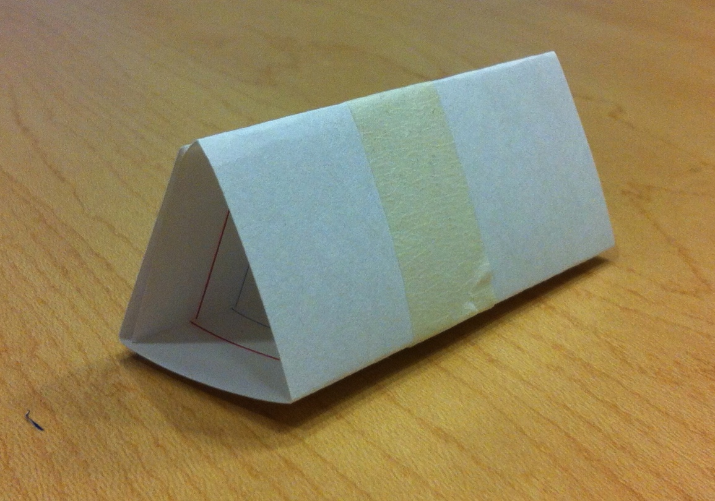

Slide 36
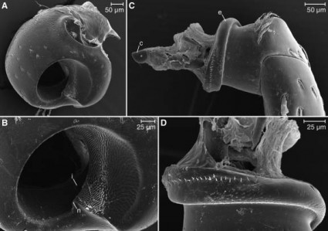
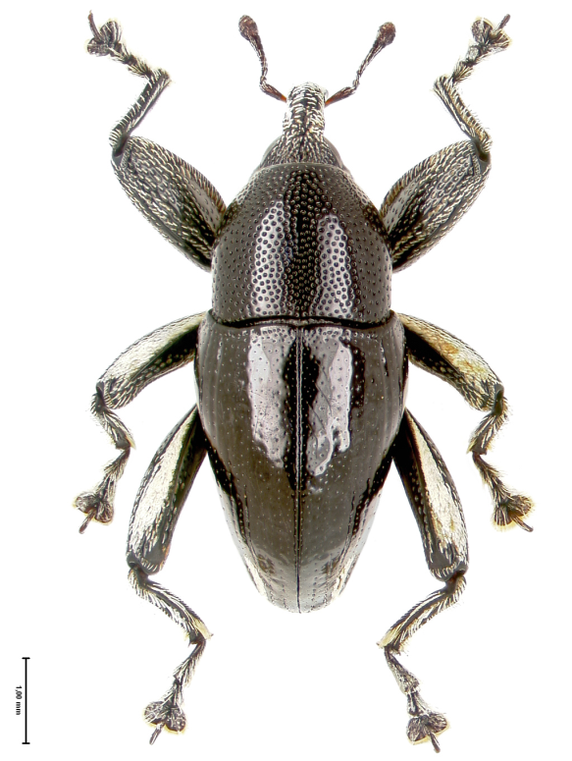
(pg. 10)
The Screw
Papuan Weevils have leg joints that screw together!
The nut: The outer part of the joint (the coxa) has an inner screw thread (A & B).
The screw: The inner part of the joint (the trocanter) has an external screw thread (C & D).
The beetles’ muscles pull on the leg to turn the screw!

Slide 37
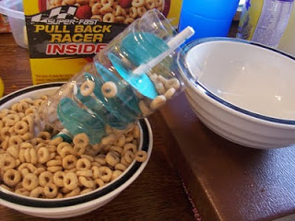
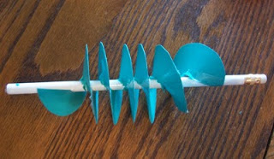
Lesson Plan #2: Inquiry Activity
(pg. 10)
Activity: watching screws in action!

Slide 38
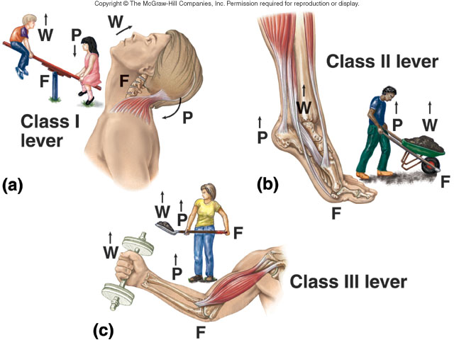
(pg. 12)
The Lever
Your skeletal muscles work as levers to move your body.

Slide 39
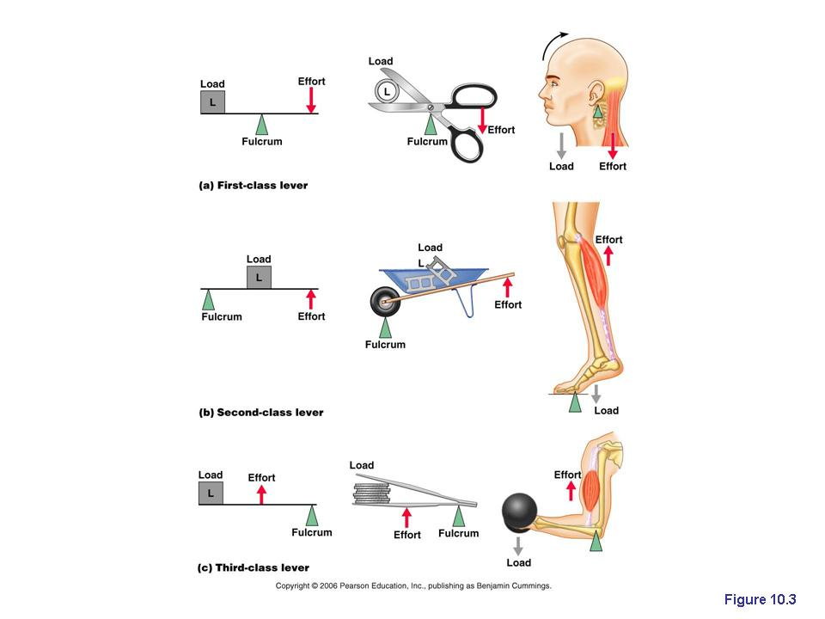
(pg. 12)
The Lever

Slide 40
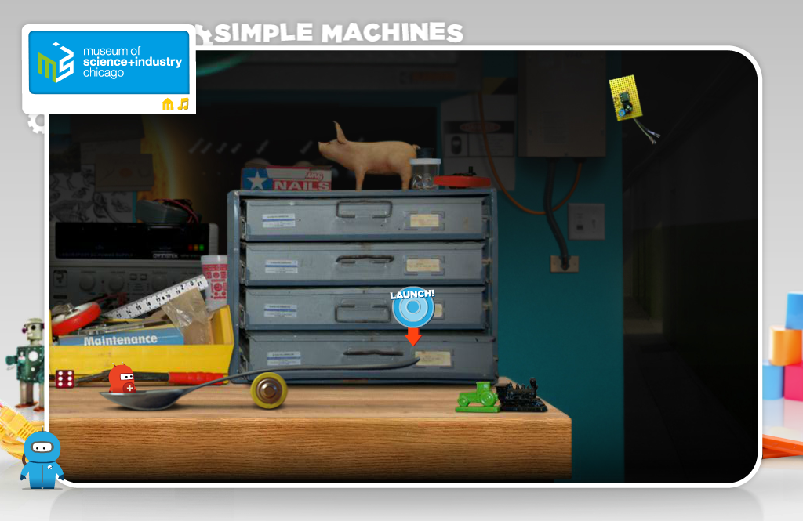
Lever Online Example
(pg. 12)
Chicago Museum of Science & Industry Simple Machines game
http://www.msichicago.org/fileadmin/Activities/Games/simple_machines/

Slide 41
Lesson Plan #2: Inquiry Activity
Try to build a lever using the materials at your table!
Notes:
Inclined Plane
Classroom version: make from cardboard/foam and stack of books
Real: wheel chair ramp
Nature: ??
Lever
Classroom version: make from ruler and a fulcrum (small object)
Real: See-Saw on the play ground
Nature: ??
Wedge
Classroom version: make from cardboard/foam
Real: classroom door stop
Nature: plant growing through a crack in the sidewalk
Pulley
Classroom version: string around a pencil
Real: System to raise and lower the USA flag from a flag pole
Nature: ??
Screw
Classroom version: ??
Real: lid of a jar, lightbulb, a real screw
Nature: ??
Wheel
Classroom version: mints on straw, bottom ends of a Styrofoam cup on a pencil
Real: wheels on a car
Nature: (wheel) rolling caterpillars, salamanders, from BBC (Chell N. can work to get future permissions); (“toothed wheel) Leaf hopper, gear legs SEM and videos

Slide 42
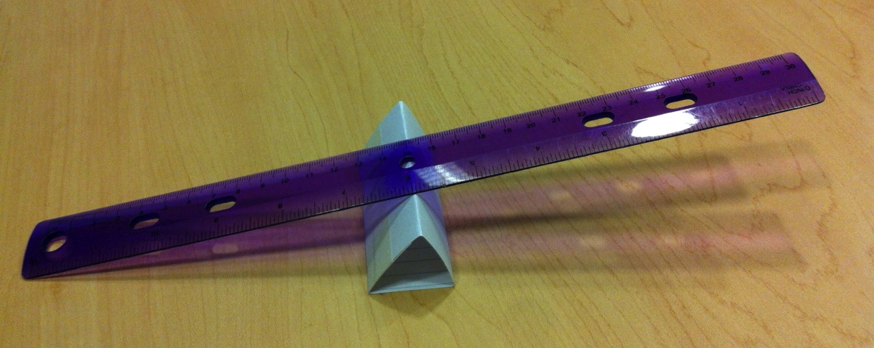
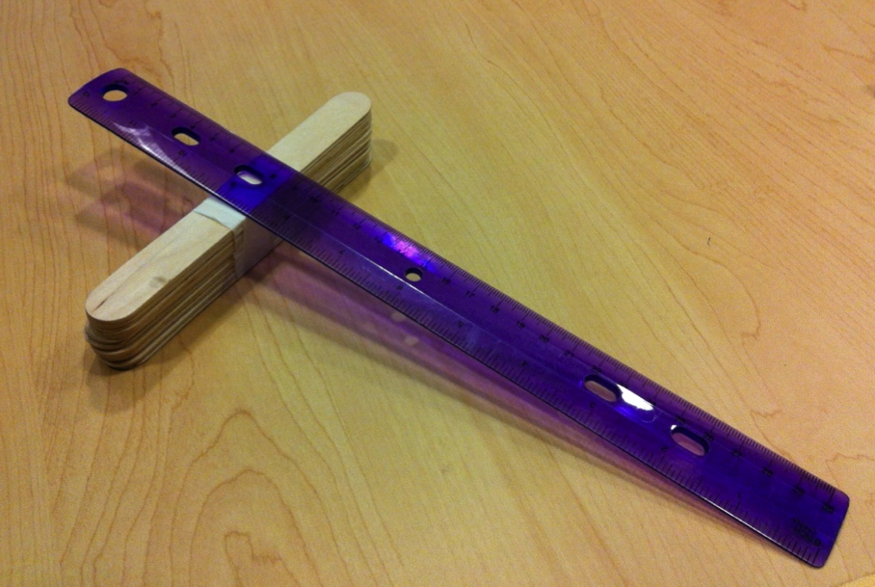

Slide 43
Combining Simple Machines into a Compound Machine:
the hamster trap.
http://www.youtube.com/watch?v=ogCp1W7cRZ4

Slide 44

Design Challenge: Save the Wolf!
(pg. 16)
A gray wolf has wandered into an active construction zone on the campus of Purdue University. The construction zone is not a safe place for the wolf. Purdue decides to hire the staff of Wolf Park to safely capture and move the wolf from the construction zone to their park in Battleground, Indiana.
As a staff member of Wolf Park, you and your team must design a compound machine to safely capture the wolf. The machine must be large enough to comfortably contain the wolf and should prevent the wolf from escaping. The machine should be made from at least two classes of simple machines (lever, pulley, wedge, inclined plane, wheel/axel, screw) and should be constructed from the materials provided.

Slide 45
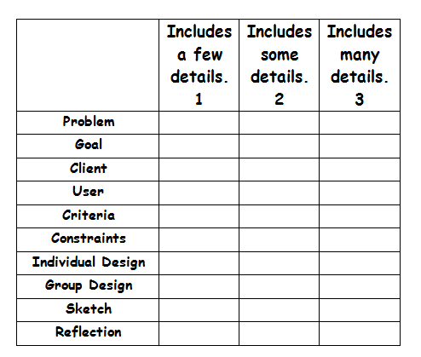

Assessment
(pg. 19)

Slide 46

Lesson Extensions and Resources
(pg. 22)
Activities
  Wolf Park in Battle Ground, Indiana
  The Children’s Museum of Indianapolis has a “Construction Site” exhibit that allows students to explore different types of simple machines. (http://www.childrensmuseum.org/scienceworks)
  Purdue University hosts a regional Rube Goldberg Machine Contest…
Interactive Websites
iPad apps
Books
Force & work examples
related to simple machines

