Slide 1
Designing least erodible canal
David Eichinger, Ryan Habben, Brad Harriger and Venkatesh Merwade

Slide 2
Objectives
In this lesson, students will:
Learn what erosion is
Explore the erodibility of different earth materials
Study the effect of slope on erosion
Design a least erodible canal with an erosion control structure

Slide 3
Science 4.2.2 (Earth Science)
Describe how wind, water and glacial ice shape and reshape earth’s land surface by eroding rock and soil in some areas and depositing them in other areas in a process that occurs over a long period of time.

Slide 4
What is erosion?
http://www.youtube.com/watch?v=G5Rp9MJJGCU
http://www.youtube.com/watch?v=ZNJe6hrdL3M

Slide 5
What causes erosion to happen?
What are different kinds of erosion?
Where do you see examples of erosion around you?
Does the size and shape of the material being eroded have an affect on how much erosion will happen? If so, how and why?
Does the slope (how much it is tilted) of the material being eroded have an affect on how much erosion will happen? If so, how and why?

Slide 6
Erosion in rivers
Moving water has energy, which carries away the bed material. Carrying away the bed material (sand or clay) is erosion.
Will fast water or slow water cause more erosion?
How does the slope of the river affect erosion?

Slide 7

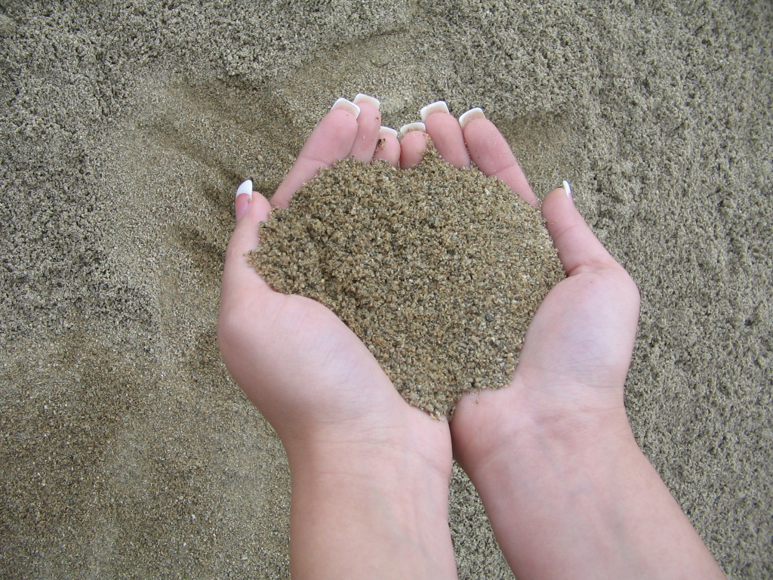
Which material will erode faster?
Clay
Sand

Slide 8
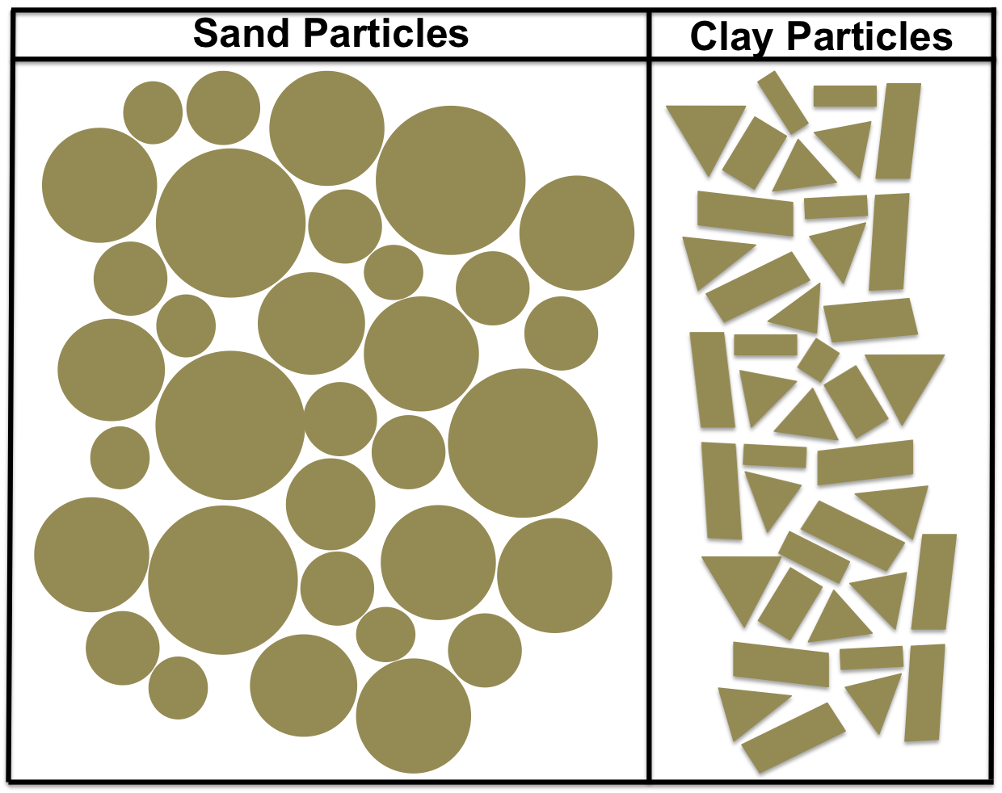
Microscopic View
Which material will erode faster?

Slide 9
Fill out the table in your handout
Material | Less Likely to erode | More Likely to Erode | Why?
Sand
clay

Slide 10
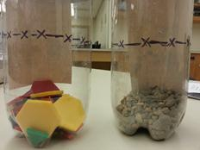
Activity 1
You have two bottles, each containing material that resembles sand or clay. You will verify which material will erode faster.

Slide 11
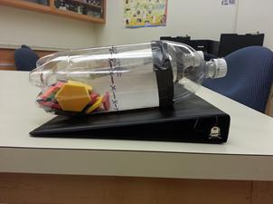
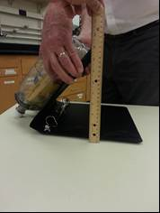
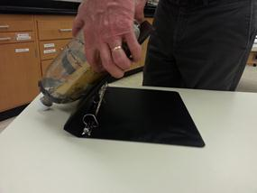
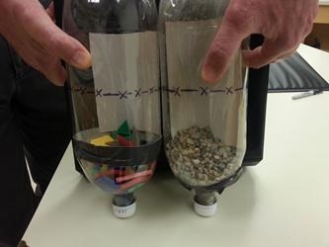
Activity 1 - Steps
1) Place both bottles on a 1-inch binder
2) Slowly open the binder until the material in one of the bottles crosses the line
3) Measure and record the height
Repeat 2-3 times to see if you get consistent results
4) Continue opening the binder until the material in the second bottle crosses the line. Record the height at which the binder is open.

Slide 12
Fill out the next table
Material | Smaller or Bigger Slope (height) | Less Likely or More Likely to Erode | Explanations based on particle shapes
Sand
Clay

Slide 13
Activity 2 (Demonstration)
Effect of slope on erosion of Sand
Water flow
River bed slope
Water flow
Slope 1
River bed slope
Slope 2
Which slope will cause more erosion?

Slide 14
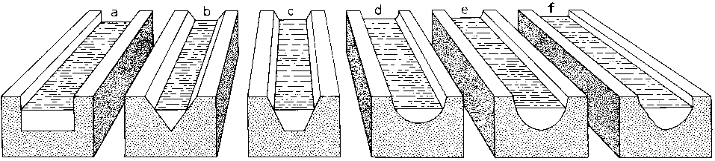
Canals
What is a canal?
  It is an open waterway whose purpose is to carry water from one place to another

Slide 15
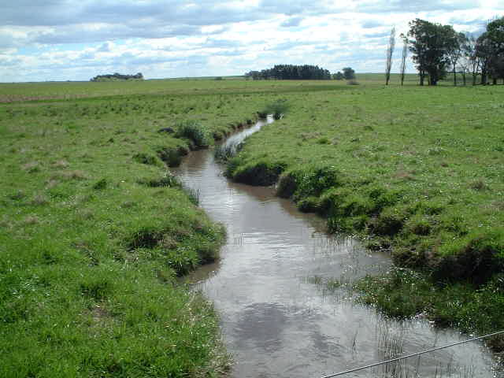
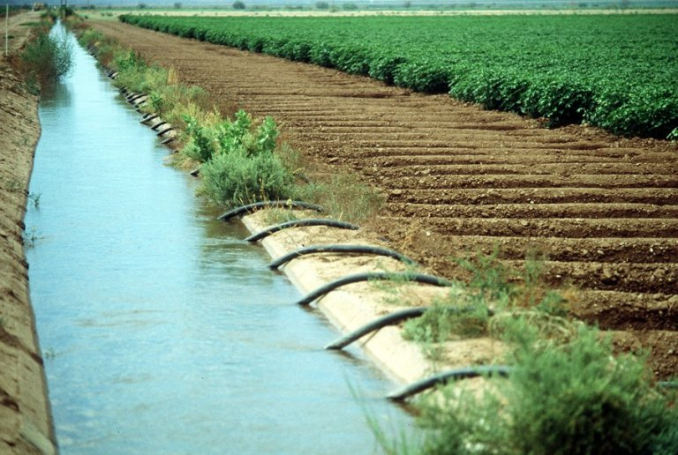
Irrigation

Slide 16
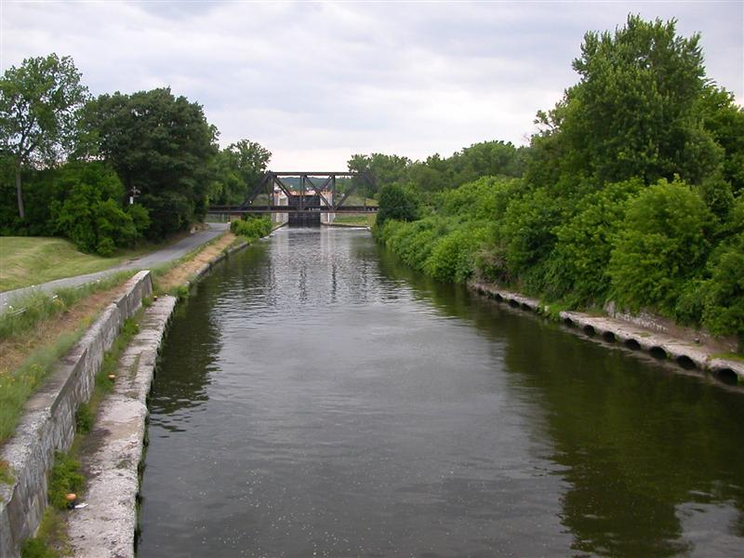
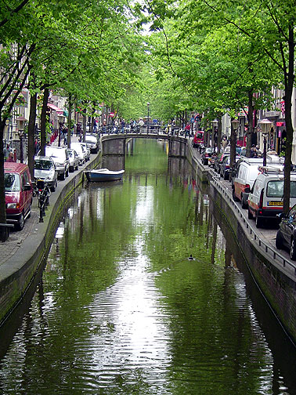
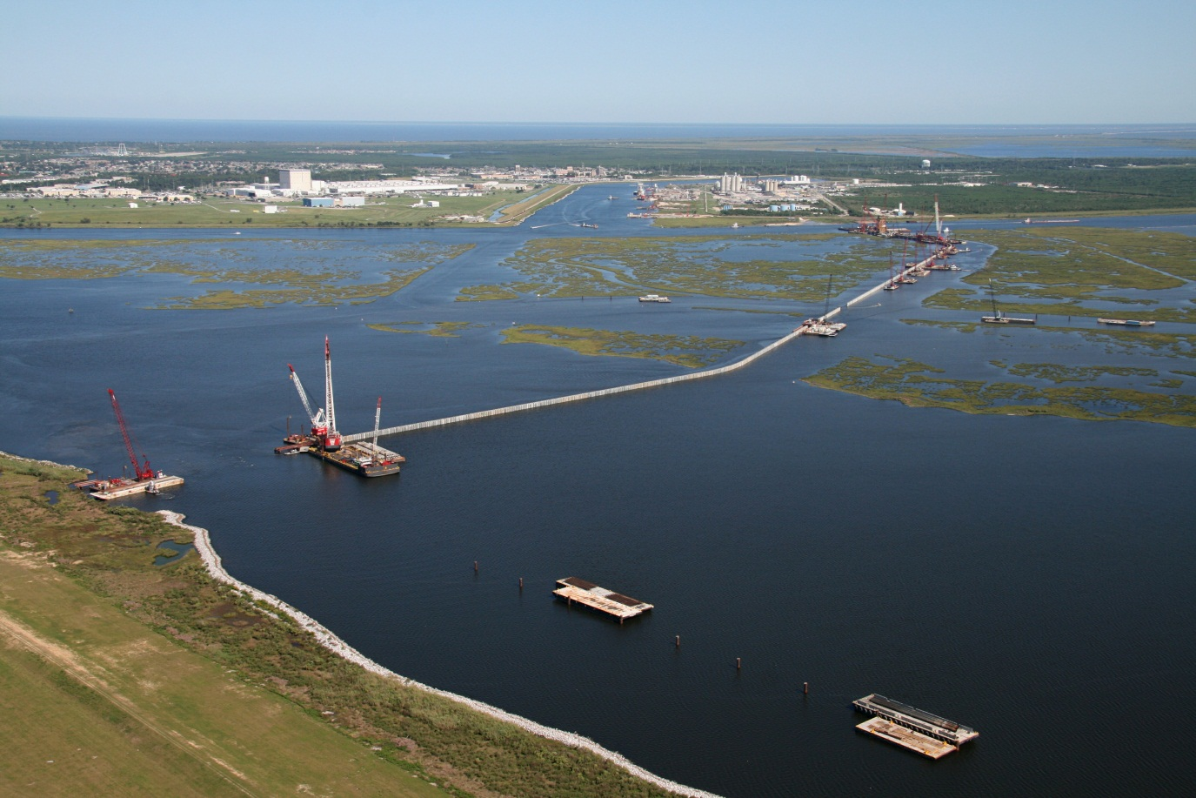
Navigation

Slide 17
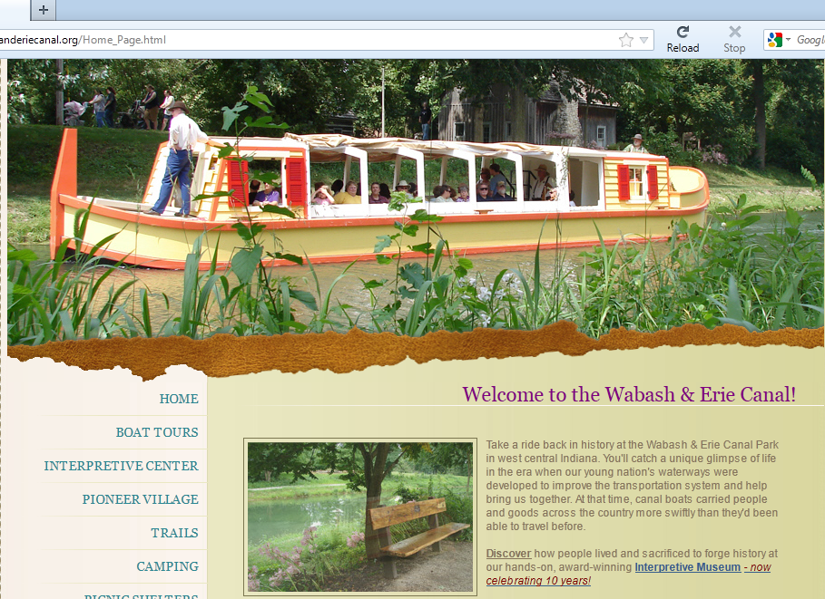
Canals in Indiana
http://www.wabashanderiecanal.org/Home_Page.html

Slide 18
New water park in Lafayette
The city of Lafayette has decided to build a new water park in Lafayette for the children in the Greater Lafayette area. However, a large amount of water needs to be carried from the water treatment plant to the water park through a trapezoidal canal. To keep the construction cost low, the city has decided to use available earth materials (sand ) to build the canal.

Slide 19
Engineering Design
The city officials want to make sure that there is the least amount of erosion of the materials used in its construction.
The city needs the help of the area engineers (you) in designing the canal and an erosion control structure.

Slide 20
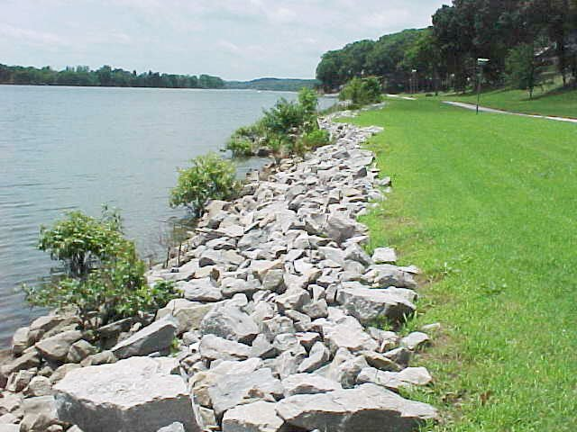
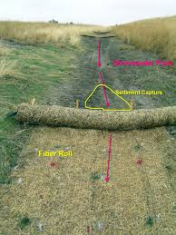
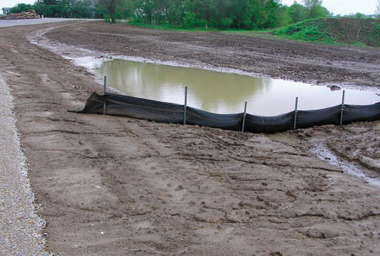
erosion control structure?
Erosion control is the practice of preventing or controlling wind or water erosion in agriculture, land development, coastal areas, riverbanks and construction.
Riprap, also known as rip rap, rip-rap, shot rock, rock armour or rubble, is rock or other material used to armor shorelines, streambeds, bridge abutments, pilings and other shoreline structures against scour, water or ice erosion.
A fiber roll is a erosion control and sediment control device used on construction sites to protect water quality in nearby streams, rivers, lakes and seas from sediment erosion. It is made of straw, coconut fiber or similar material formed into a tubular roll.
A silt fence, sometimes (misleadingly) called a "filter fence," is a temporary sediment control device used on construction sites to protect water quality in nearby streams, rivers, lakes and seas from sediment (loose soil) in stormwater runoff.

Slide 21
Design
Your objective is to design a trapezoidal canal by choosing an appropriate slope and putting in an erosion control structure.

Slide 22
Criteria
The canal should be able to carry water from one place to other;
Carry the water with least erosion;
The canal should be leak proof;
Must have erosion control mechanism to handle 50 ml of sand;

Slide 23
Design and build
Step 1: Discuss with your team which one of the following bed slopes you will choose for your canal:
Step 2: Sketch a trapezoidal Canal that is least 3 inch wide and has 0.5 inch bank.
Step 3: Sketch a plan (top view) for your canal by showing the location and details of your erosion control measure.
Step 4: Get your plan approved from the teacher, and build the canal and the control structure.
Step 5: Take your canal to the teacher for testing.
S1
S2

