Slide 1
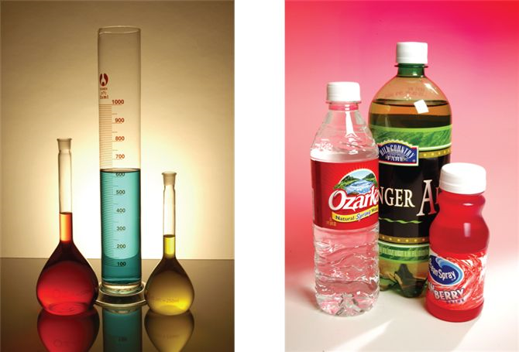
Volume
250 mL
500 mL
1L containers
©mcgraw-hill.
Volume is the amount of space occupied by an object
Metric Unit: meter³, cm³, etc
1.0 Liter = 1000 mL = 0.001 m³ = 1 dm³ = 1000 cm³
1.0 ft³ =? in³
1.0 ft³ = 1728 in³

Slide 2
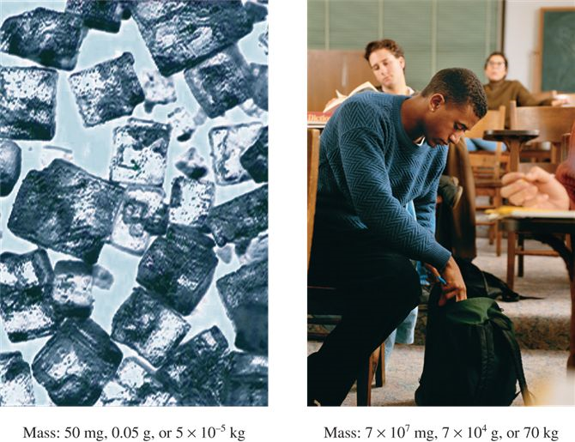
Mass
Mass is the quantity of matter in an object (traditional)
©mcgraw-hill.
Salt crystals
~ 50 mg
= 0.05g = 5x10⁻⁵kg
Adult
~70kg
= 70,000g = 7x10⁷mg
Inertial Mass – Resistance to acceleration (Physics)

Slide 3
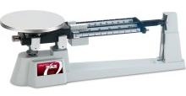
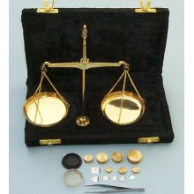
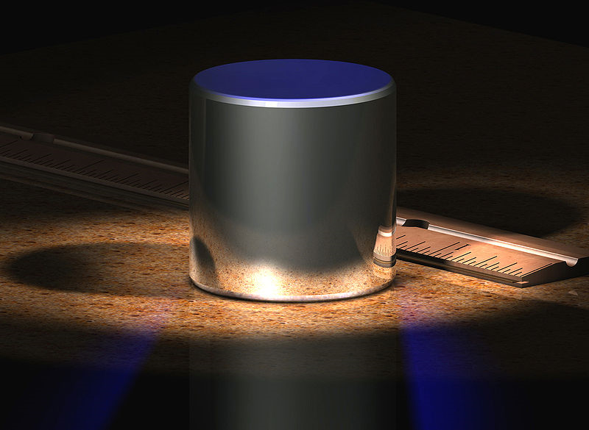
Mass Measurement
Balances
Independent of location
Standard Kilogram
http://en.wikipedia.org/wiki/Kilogram

Slide 4
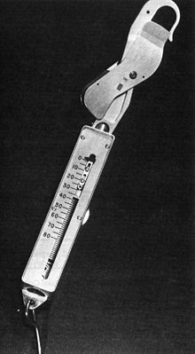
Weight
F = ma
W = mg
Weight = m x g where g is the gravitational acceleration
Spring Balance
Depends on location
as g varies
from place to place
http://en.wikipedia.org/wiki/MGal

Slide 5
Mass vs Weight
Mass
Weight
Quantity of matter
Measure on beam balance
Independent of location
Mass 1.000000 kg
Force
Measure on force balance
e.g. spring or magnetic
Depends on location
Moon weight 0.1667 kg http://www.exploratorium.edu/ronh/weight/
Kokomo weight 0.999960 kg
Greenwood weight 1.000025 kg
http://mrdata.usgs.gov/geophysics/gravity.html

Slide 6
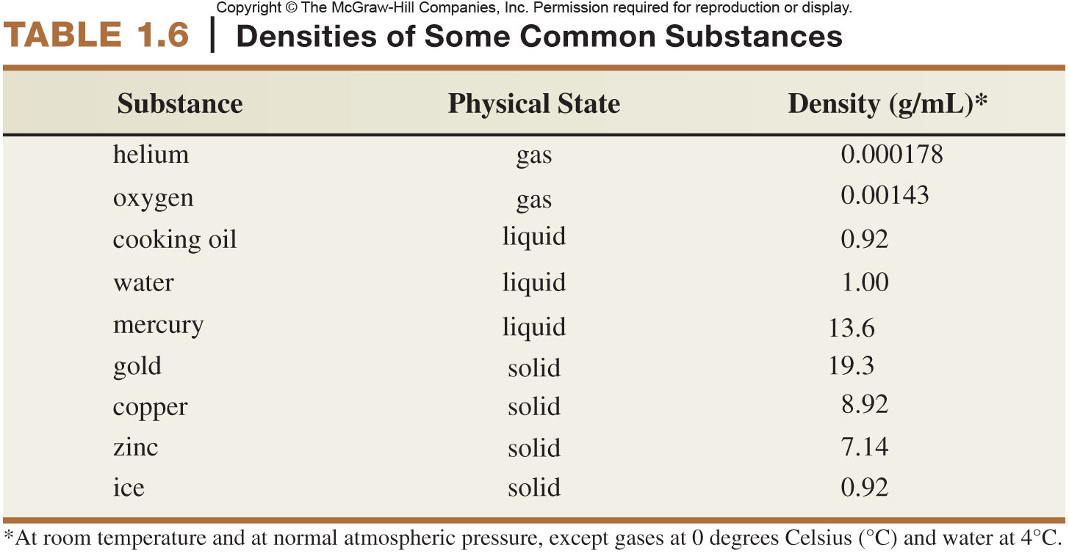
Density
Density = Mass
Volume
Intrinsic property
Independent of amount

Slide 7
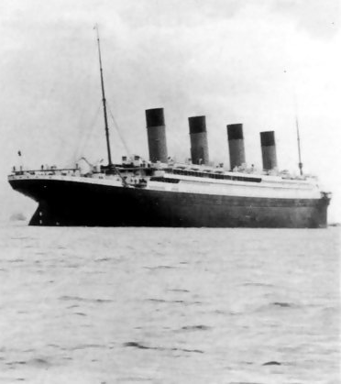
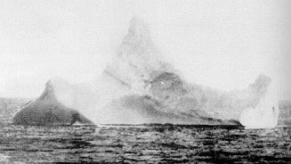
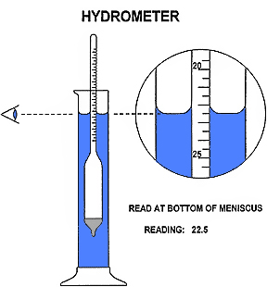
Density Applications
Any floating object displaces its own weight of fluid.
– Archimedes of Syracuse^{[3}
+
= ?
Determine Density of liquid
Determine mass of floating solid
Determine Volume of irregular dense solid

Slide 8
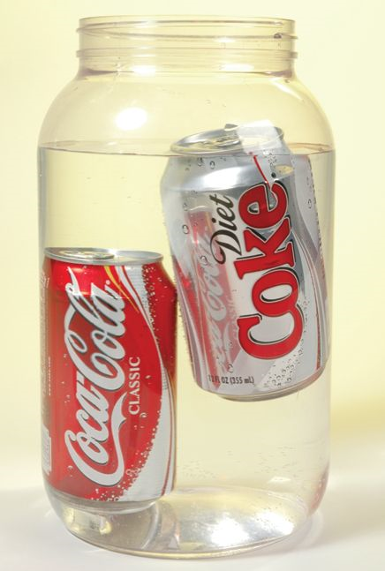
Specific Gravity
Specific Gravity is the ratio of the density of the material
to the density of a reference (usually water).
©mcgraw-hill
 | Submerged Object | Floating Object
Density | Greater than liquid | Less than liquid
Volume | = Vol of liquid displaced | Vol submerged = Vol displaced
Mass |  | = Mass of liquid displaced

Slide 9
Mass: Pepsi vs Diet Pepsi

